Slide 1
Cholesterol transport and uptake
Dr. Carolyn K. Suzuki

Slide 2
OBJECTIVES
To compare and contrast the properties of apolipoprotein particles (e.g. chylomicrons, LDL, HDL), with respect to their composition, metabolism and transport.
To distinguish the different biochemical pathways that can be potentially targeted pharmacologically to control plasma apolipoprotein levels and manage cardiovascular disease.
To predict the effect of LDL receptor mutations on the levels of intracellular cholesterol and the regulation of cholesterol synthesis within the cell.

Slide 3
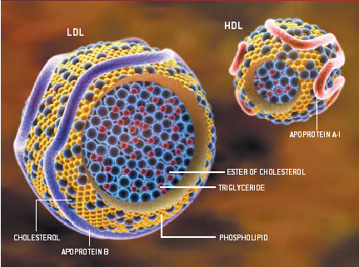
Anatomy of lipoprotein particles

Slide 4
Lipoprotein particles
Lipoprotein particles- general characteristics and functions
  spherical particles with varying amounts of lipid and protein
  maintain solubility of constituent lipids
  transport of lipids in plasma
Major classes of lipoprotein particles
  chylomicrons
  VLDLs- very low density lipoproteins
  LDLs- low density lipoproteins
  HDLs- high density lipoproteins
Principal lipid components of lipoproteins
  triacylglycerols
  cholesterol esters
  phospholipids
Principal protein components of lipoprotein particles
  apolipoproteins- five classes A-E
  important in release of lipoprotein particles from cell
  activate lipid-processing enzymes in blood
  mediate uptake of lipoprotein particles into cells

Slide 5
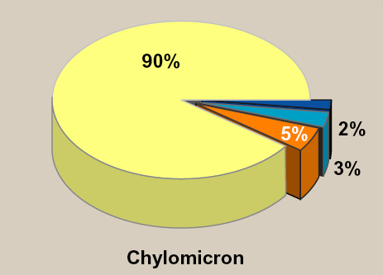

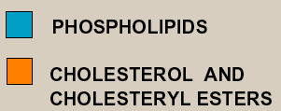
Chylomicrons
Notes:
5
5

Slide 6
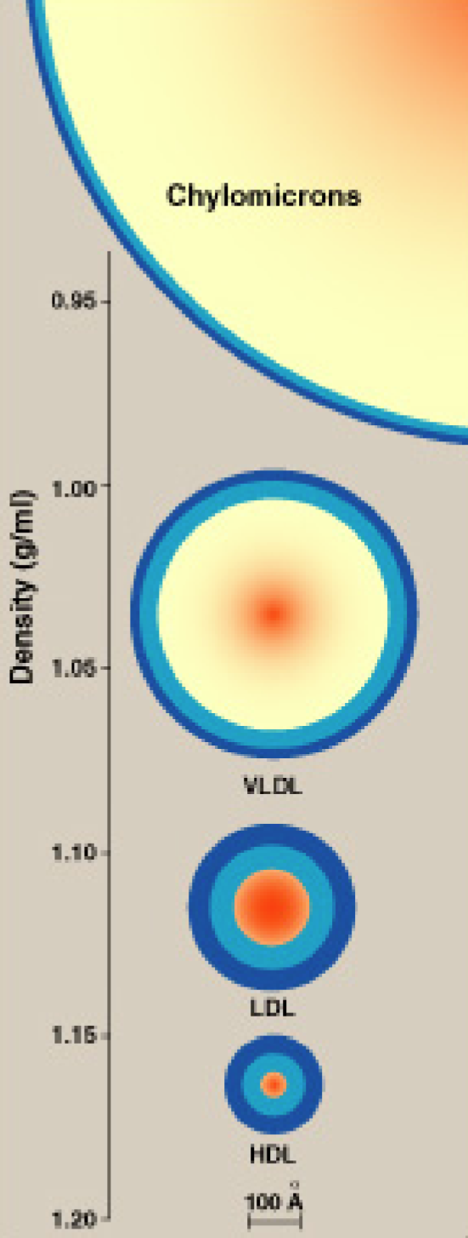
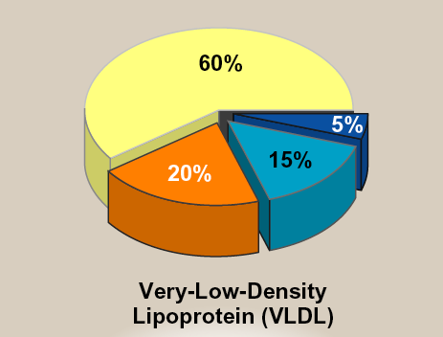
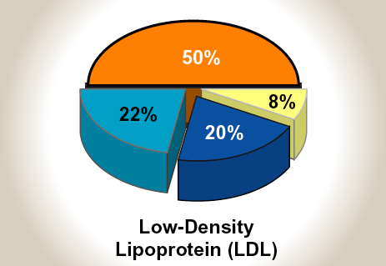
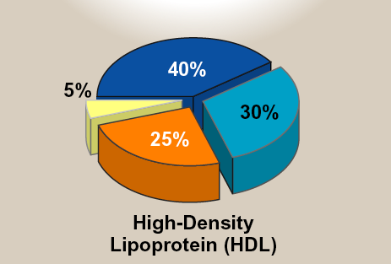
Major classes of lipoprotein particles
Lippincott Fig. 18.19

Slide 7
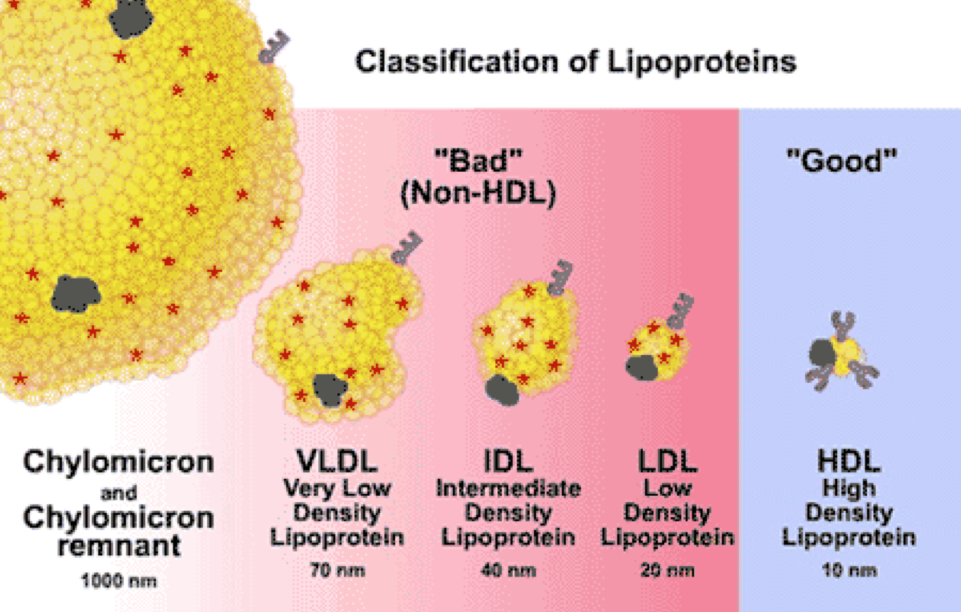
Relative size and densities of lipoproteins

Slide 8
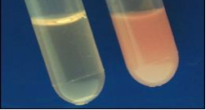
Cholesterol is absorbed in the small intestine
and assembled into chylomicrons
plasma before a
cholesterol-rich meal
plasma after a
cholesterol-rich meal

Slide 9
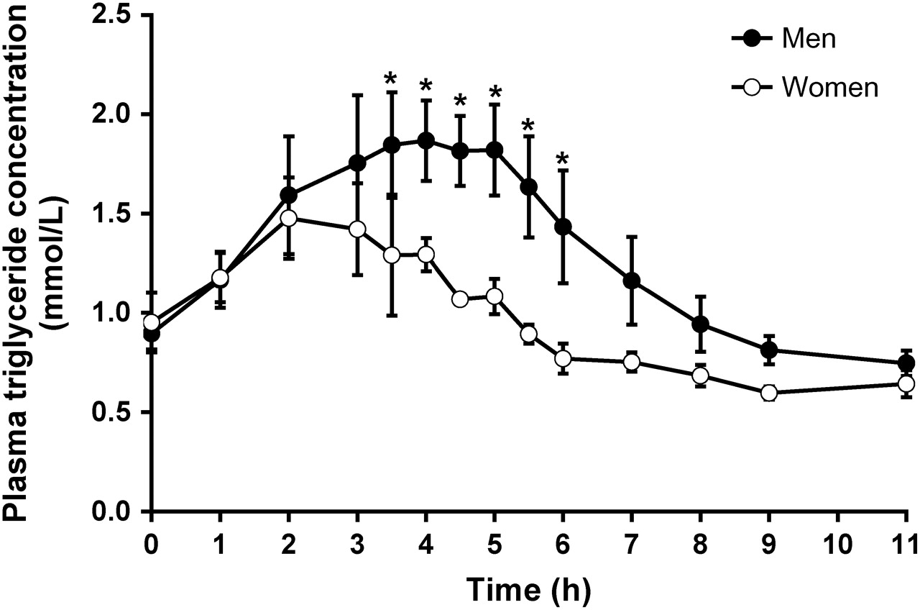
Clearance of chylomicrons from plasma
represents tissue uptake and chylomicron breakdown
Knuth N D , Horowitz J F J. Nutr. 2006;136:1498-1503

Slide 10
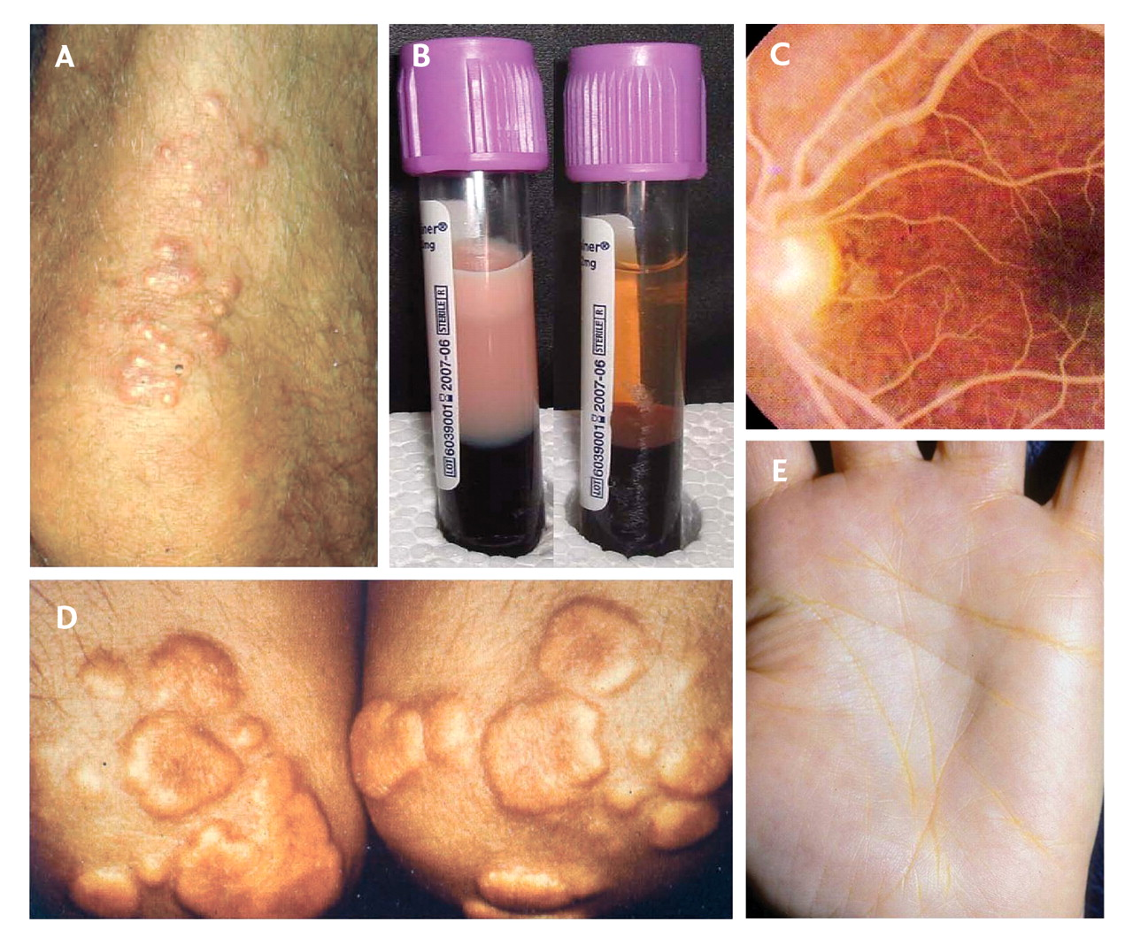
Some clinical manifestations of hyperlipidemia
A. Cutaneous xanthomas linked to elevated plasma chylomicrons and/or LDL.
B. Lipemic plasma (left), normal plasma (right).
C. Lipemia retinalis, elevated plasma triglyceride.
D. Tuberous xanthomas, usually on extensor surfaces.
E. Palmar crease xanthomas.
Notes:
Fig. 1: Clinical manifestations of primary hypertriglyceridemia. A: Eruptive cutaneous xanthomas (here on a patient's knee) are filled with foam cells that appear as yellow morbiliform eruptions 2–5 mm in diameter, often with erythematous areolae. Most often associated with markedly elevated plasma chylomicrons in cases of familial chylomicronemia (hyperlipoproteinemia type 1) or primary mixed dyslipidemia (hyperlipoproteinemia type 5), they usually occur in clusters on the skin of the trunk, buttocks or extremities. B: Lipemic plasma. Whole blood has been allowed to stand at 4°C overnight. The sample on the left comes from a patient whose fasting total cholesterol result was 14.2 mmol/L and triglyceride concentration was 41.8 mmol/L. The sample on the right comes from a normolipidemic subject. C: Lipemia retinalis. A milky appearance of the retinal vessels and pink retina can be seen when plasma triglyceride concentration exceeds 35 mmol/L. D: Tuberous xanthomas, filled with foam cells, appear as reddish or orange, often shiny nodules, up to 3 cm in diameter. They are usually moveable and nontender. In patients with familial dysbetalipoproteinemia (hyperlipoproteinemia type 3), they usually appear on extensor surfaces; these are on a patient's elbows. E: Palmar crease xanthomas are filled with foam cells and appear as yellowish deposits within palmar creases. These skin lesions are pathognomonic for familial dysbetalipoproteinemia (hyperlipoproteinemia type 3). Photo by: Panels A, B and D are courtesy of Robert A. Hegele; panel C is courtesy of Ted M. Montgomery; and panel E is courtesy of Jean Davignon.

Slide 11
Chylomicron metabolism starts in the intestine-
(1) Chylomicrons are assembled in the intestine and contain apo B48
INTEST
INE
(3) Chylomicrons acquire apo C-II and apo E from HDL in plasma
non-hepatic tissues
C E
C E
C E
LIVER
(2) Chylomicrons are released into lymph
chylomicron
FFA
LPL
HDL
LDL
LDL receptor
cholesterol
Notes:
11

Slide 12
Chylomicron metabolism starts in the intestine-
(4) Lipoprotein lipase
on the surface of
non-hepatic tissues,
hydrolyzes triglycerides
(see next slide)
(1) Chylomicrons are assembled in the intestine and contain apo B48
INTEST
INE
(3) Chylomicrons acquire apo C-II and apo E from HDL in plasma
non-hepatic tissues
C E
C E
CE
C E
C E
C E
C E
C E
C E
LIVER
(2) Chylomicrons are released into lymph
chylomicron
FFA
LPL
HDL
LDL
LDL receptor
cholesterol
Notes:
12

Slide 13
Lipoprotein lipase metabolizes chylomicrons
on the cell surface of non-hepatic tissues
Liver
Glycolysis
Gluconeogenesis
Lipid synthesis
apo CII on chylomicrons
(or VLDLs) binds to
LIPOPROTEIN LIPASE
on the surface of
non-hepatic tissues,
hydrolyzes TG
glycerol
+
free fatty acids (FFA)
TG
FFA are taken up by
non-hepatic cells
endothelial surface
of non-hepatic cell
triacylglycerol (TG)
muscle & adipose tissue
apo CII
apo B48
free fatty acids
Notes:
13

Slide 14
Chylomicron metabolism (cont’d)-
formation of chylomicron remants, cholesterol delivery to liver
4
INTEST
INE
1
2
non-hepatic tissues
3
C E
C E
C E
C E
C E
C E
C E
E
C E
C E
C
E
C
E
E
C
5) Chylomicron remnants depleted of glycerol and FFA transfer apo C-II to HDL
E
E
E
nascent chylomicron
chylomicron remnants
6) Remnants w/ apoE and apoB48, bind to the apo E receptor on liver cells, resulting in the uptake of remnants
HDL
LIVER
cholesterol
Notes:
14

Slide 15
Summary- chylomicron interactions with HDL
1a. nascent chylomicrons
assembled in intestine
released into plasma
w/ apoB-48, which is unique to nascent form
1b. HDL
assembled in liver and intestine
transfers apo CII/E to nascent chylomicrons
B48
E
CII
A1
E/CII
from HDL
2. mature chylomicrons
apo E and C-II added from HDL
apoC-II activates lipoprotein lipase
B48
3. lipoprotein lipase
capillary walls, hydrolyzes TG
delivers FFA into adipose & muscle
E
CII
adipose &
muscle
5. mature HDLs
re-acquire apo C-II, also
acquires cholesterol from membranes, accumulates apoCII/ and E, transferring them to VLDL & LDL, functions in reverse transport of cholesterol to liver
FFA
apo CII
E
4. chylomicron remnants
lack apoC-II,
which is transferred to HDL
A1
CII
E
B48
CII
triacylglycerol
cholesterol ester
phospholipid

Slide 16
VLDL and LDL metabolism starts in the liver
(1) assembly and export of nascent VLDL containing apoB100
(2) nascent VLDL acquires apoC-II and apoE from HDL
(3) Lipoprotein lipase hydrolyzes TGs, FFA are taken up, LDL circulates
non-hepatic tissue
LIVER
B
C E
C E
C
E
C
E
C
E
e.g. fat and
muscle
B
C E
B
B
B
(8) cholesterol is excreted as bile
C E
B
C E
C E
(4) apo C-II and apo-E
are transferred from VLDL to HDL
resulting in LDL
B
B
B
B
(7)
LDL and HDL
bind specific receptors and mediate uptake
in the liver
(5) LDL
binds receptor on cells
B
B
B
e.g. fat,
muscle
non-hepatic
tissue
(6) LDL is taken up by cells, increasing intracellular cholesterol
FFA
VLDL
cholesterol
LPL
HDL
LDL
LDL receptor
Notes:
16

Slide 17
Summary- VLDL and LDL interactions with HDL
(1a) HDLs
assembled in liver transfer apoCII/E to VLDLs
(1b) nascent VLDLs
assembled in liver
mediated by apoB100
E
B100
A1
CII
(2) mature VLDLs
apoE and CII are acquired from HDL
apoCII activates lipoprotein lipase
E
B100
(3) lipoprotein lipase
hydrolyzes TG
FFA are delivered to
adipose tissue & muscle
CII
adipose &
muscle
FFA
CII + E
(4) mature HDLs
re-acquire
apoCII/E from VLDLs
A1
E
(5) LDLs
are derived from
from VLDLs that
No longer contain
apoCII and E
B100
CII
Notes:
17

Slide 18
Summary- lipoprotein particle receptors in liver
chylomicronremnants
mature
HDL
LDL
B48
E
CII
AI
E
AII
PCSK9
E
E
B100
apo E
receptor
apo E
receptor
LDL receptor
lipoprotein uptake
LIVER
cholesterol ester metabolism
storage
bile
Notes:
18

Slide 19
General characteristics of HDLs
synthesized in the liver and intestine
secreted directly into the blood from liver and intestine
protein rich
express apo-AI and AII, apo-CII and apo-E
nearly devoid of cholesterol and cholesterol esters
attempts to increase HDL
by increasing AI synthesis
HDL-apolipoprotein exchange
HDL transfers apo-CII and apo-E to chylomicrons
Chylomicrons return apo-CII to mature HDLs
HDL transfers apo-CII and apo-E to VLDLs
VLDL returns apo-CII and apo-E to HDLs
R & D
new cholesterol
lowering drugs
HDL and cholesterol/cholesterol ester exchange
HDL can acquire cholesterol from chylomicrons, VLDLs or membrane and convert them to cholesterol esters
Cholesterol esters in HDL can be transferred to VLDLs and LDLs by cholesterol ester transfer protein (CETP)
development of CETP inhibitors
data show that people
with CETP deficiency have
increased HDL, lower risk
of heart disease
HDL and reverse cholesterol transport-
HDLs that are rich in cholesterol esters
are returned to liver

Slide 20
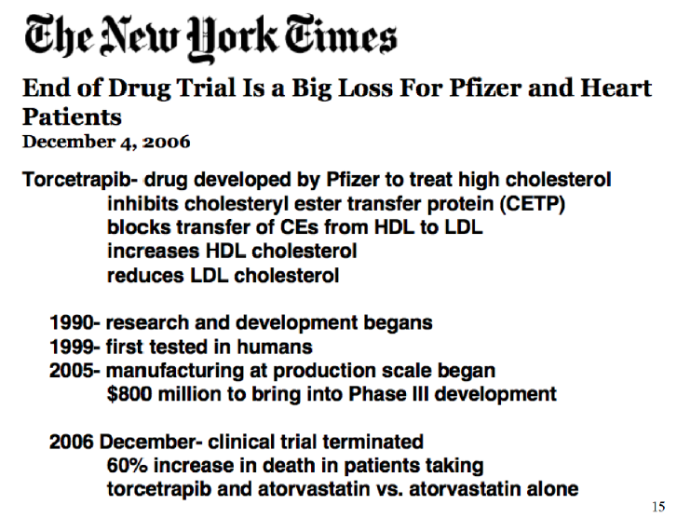

Slide 21
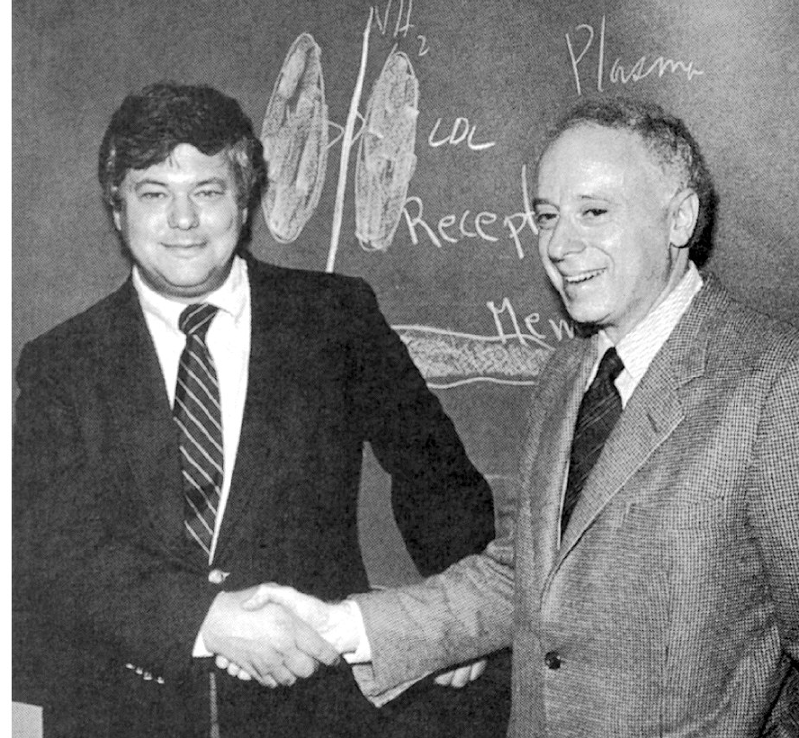
Cholesterol paradigm of atherosclerosis
Brown and Goldstein
Nobel Prize in Physiology and Medicine 1985
Familial Hypercholesterolemia (FH)
Elevated total cholesterol
>300 mg/dL in adults
>250 mg/dL in children
Dominant inheritance
Heterozygotes (1 in 500)
heart attacks at 30-40 yrs
Homozygotes (1 in million)
heart attacks in childhood
Their hypothesis:
FH is caused by defects in the regulation of cholesterol synthesis

Slide 22
Familial Hypercholesterolemia (FH)
Caused by mutations in the gene encoding the LDL receptor
(also known as the apoB-100/apoE receptor)
LDL receptor mediates cellular uptake of cholesterol by
"receptor-mediated endocytosis"
When the LDL receptor functions normally-
increased blood cholesterol leads to
increased LDL uptake into cells, resulting in
increased cholesterol in cells and inhibition of cholesterol synthesis
Remember from our last lecture-
when intracellular cholesterol is high
expression of cholesterol synthesis genes is blocked
HMG CoA reductase is degraded
17

Slide 23
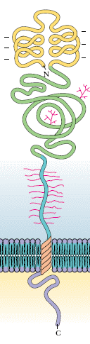
LDL receptor
LDL binding domain
binds apolipoprotein
N-linked oligosaccharide domain
required for LDL binding
O-linked oligosaccharide domain
Transmembrane domain
Cytosolic domain
highly conserved requires for endocytosis

Slide 24
LDL receptor
Class I- No receptors synthesized.
Mutations in LDLR promoter, frameshift or splicing mutations.
Class 2- Receptors are synthesized but retained intracellularly in the endoplasmic reticulum or Golgi complex
Class 3- Receptors reach the cell surface but
lack normal LDL binding
Class 4- Receptors reach the cell surface and bind LDL but are not clustered in coated pits and endocytosed.
All above mutations lead to high blood cholesterol levels

Slide 25
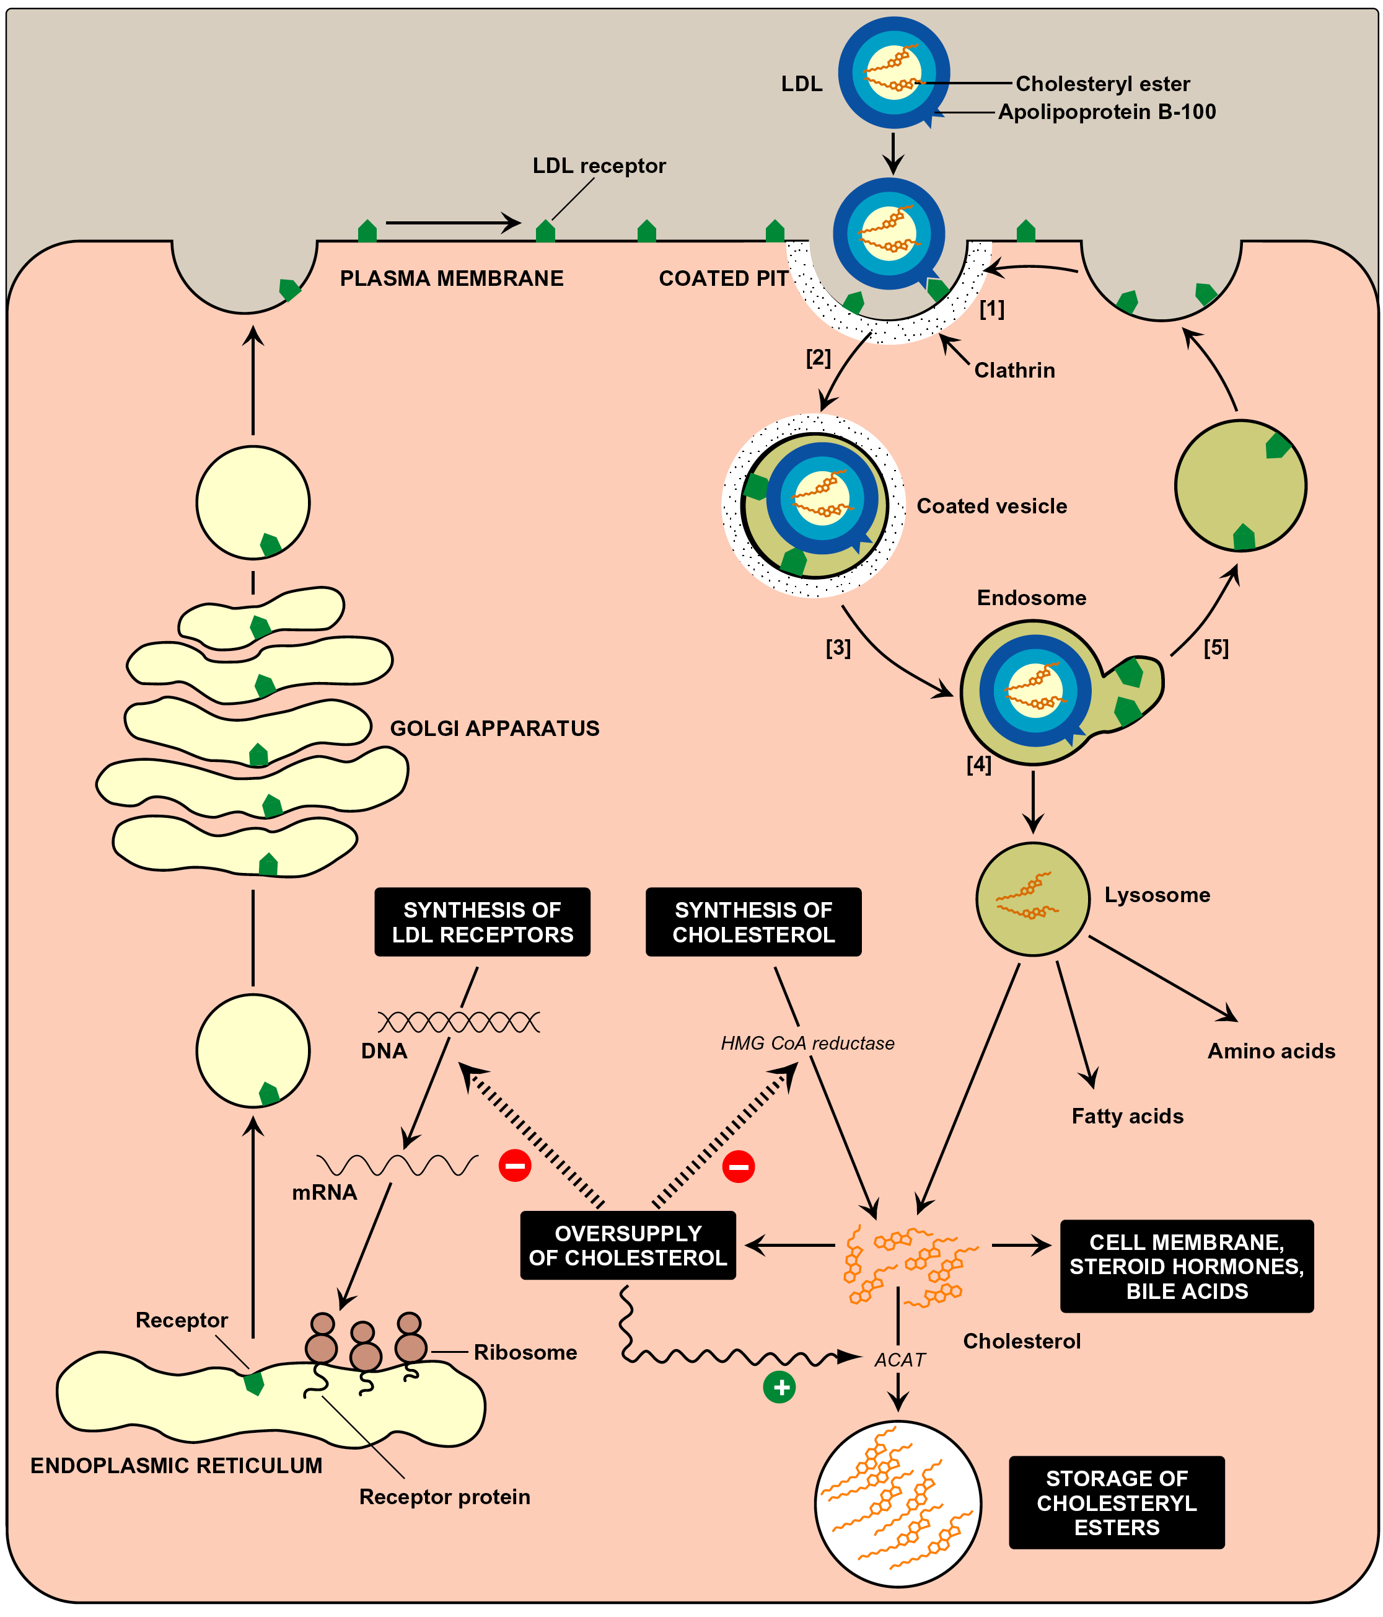
Receptor-mediated endocytosis of LDL
Lippincott Fig. 18-20

Slide 26
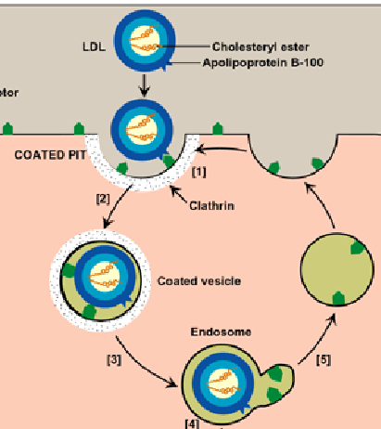
Receptor-mediated endocytosis of LDL
LDL particle
endocytosis of
LDL bound receptor
into cell
LDL receptors
recycle to
plasma membrane
clathrin
coated
vesicle
endosome
LDL dissociates
from receptor
in endosome

Slide 27
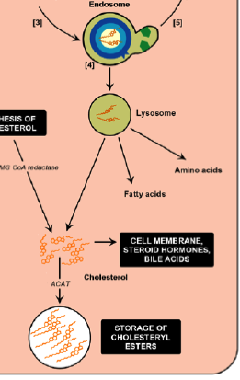

endosome
fuses w/
lysosome
ACAT
acyl CoA cholesterol
acetyltransferase
cholesterol
cholesterol
ester

Slide 28
down-regulation of
cholesterol synthesis genes

Slide 29
Regulation of cholesterol
synthesis and uptake

Slide 30
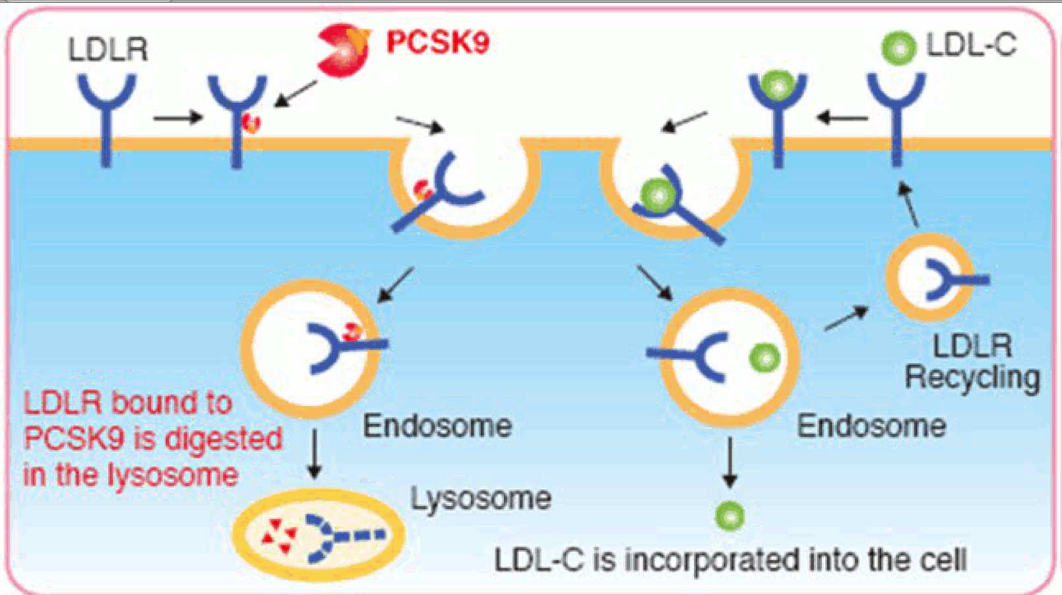
PCKS9- another drug target for reducing LDL levels
PCKS9 is a normal human protein that leads to
LDL receptor degradation in lysosomes
Search for inhibitors of PCKS9
PCKS9
LDL
LDL
receptor
receptor
recycling
LDL receptors
bound to PCKS9
are degraded in lysosomes
lysosomes
endosomes
reduced plasma LDL

Slide 31
Review- you tell me !!!!
Where are chylomicrons synthesized?
Where are VLDL particles synthesized?
Which lipoprotein particle is the largest?
Which is the smallest?
Non-functional LDL receptors result in:
    Lower or higher plasma levels of cholesterol?
    Lower of higher intracellular levels of cholesterol

