Slide 1
Metabolism of Amino Acids. Part I
Dental Biochemistry Lecture 23
Richard D. Howells, PhD

Slide 2
Learning Objectives
To describe biological functions of amino acids.
To discuss protein malnutrition.
To describe names and functions of the two hormones released from the upper part of small intestine upon stimulation by dietary peptides.
To explain how dietary proteins are digested and how dietary amino acids are taken into the portal systems.
To describe pathological conditions associated with protein malnutrition or defective transport of dietary amino acids.
To distinguish between transamination and oxidative deamination reactions, describing key enzymes, coenzymes, and allosteric regulators.
To describe two amino acids that carry ammonia to the liver from the peripheral organs.
To explain the physiological significance of kidney function to excrete ammonia.

Slide 3
Outline
Functions of amino acids
Sources of amino acids:
Nitrogen balance and amino acid pool
Digestion of proteins and transport of amino acids
Removal of nitrogen from amino acids:
Transamination reaction
Oxidative deamination
Glucose-alanine cycle
Formation and secretion of ammonia
General review

Slide 4
Sources and fates of amino acids

Slide 5
Essential amino acids
An essential amino acid is an amino acid that cannot be
synthesized de novo by humans, and therefore
must be supplied in the diet.
The Ten Acid Pornstars Liked Very Hot Ladies In Miniskirts
Threonine
Tryptophan
*Arginine*
Phenylalanine
Leucine
Valine
Histidine
Lysine
Isoleucine
Methionine
PVT TIM HALL:
phenylalanine
valine
threonine
tryptophan
isoleucine
methionine
histidine
*arginine*
leucine
lysine
* conditional, essential in some circumstances

Slide 6
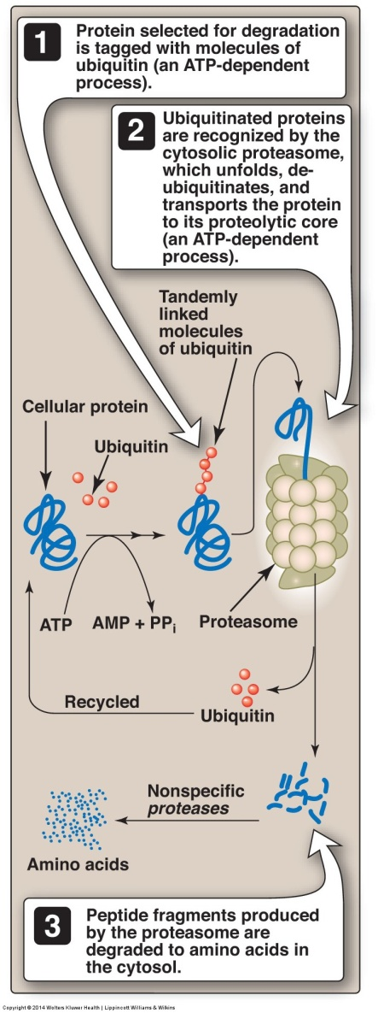
The ubiquitin-proteasome
degradation pathway
of proteins
Note that lysosomes degrade
proteins in an
ATP-independent manner
using acid hydrolases
to nonselectively degrade
intracellular proteins
and extracellular proteins,
such as plasma proteins,
that are taken into the
cell by endocytosis
ATP = 5’-adenosine triphosphate
AMP = 5’-adenosine monophosphate
PP_{i} = pyrophosphate

Slide 7
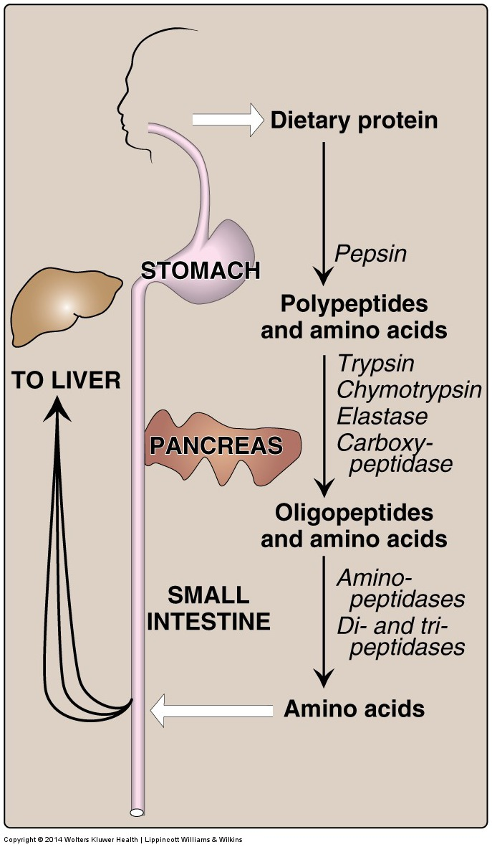
Digestion of dietary
proteins by the
proteolytic enzymes of
the gastrointestinal
tract

Slide 8
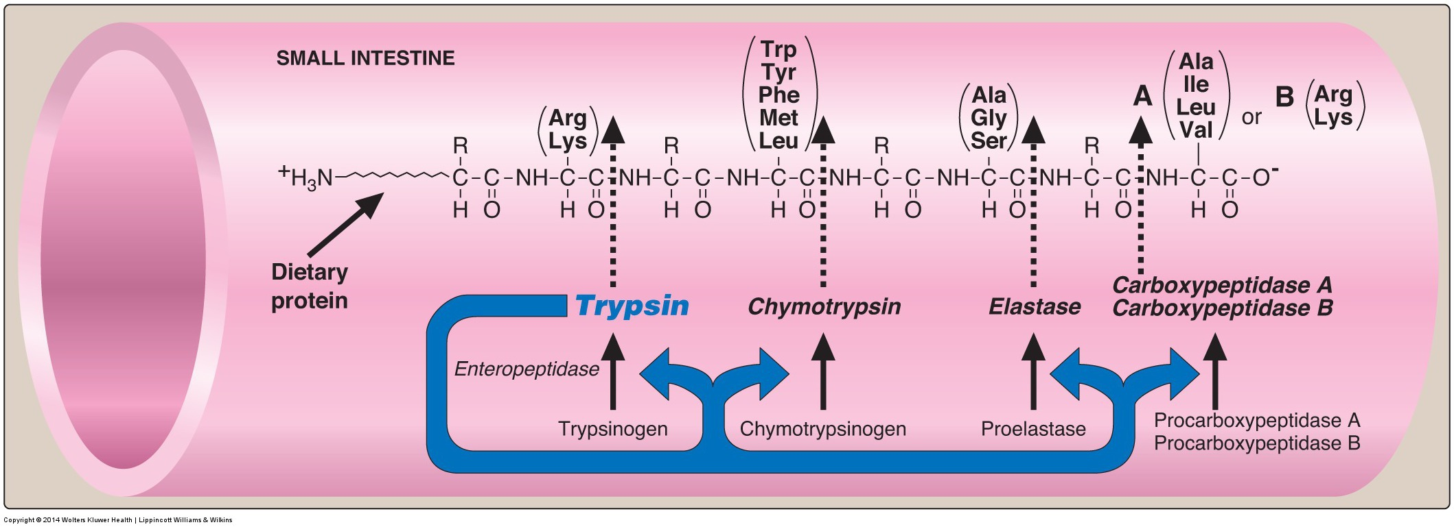
Cleavage of dietary protein in the small intestine
by pancreatic proteases

Slide 9
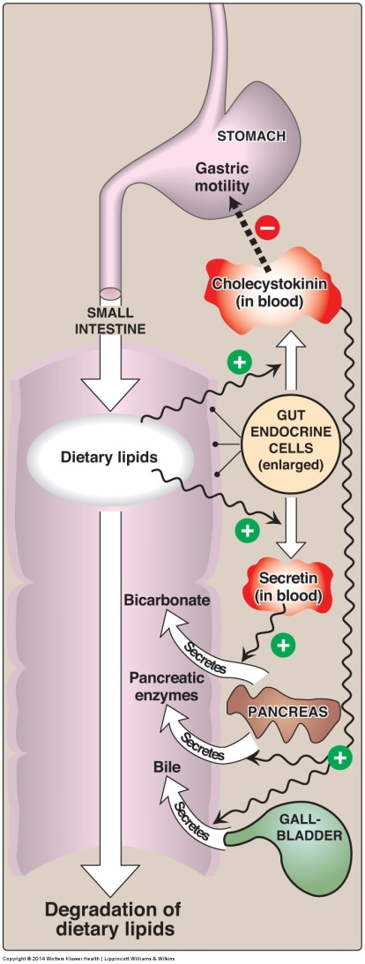
Hormonal control
of nutrient digestion
in the small intestine:
the role of
cholecystokinin
and secretin
and proteins
and proteins

Slide 10
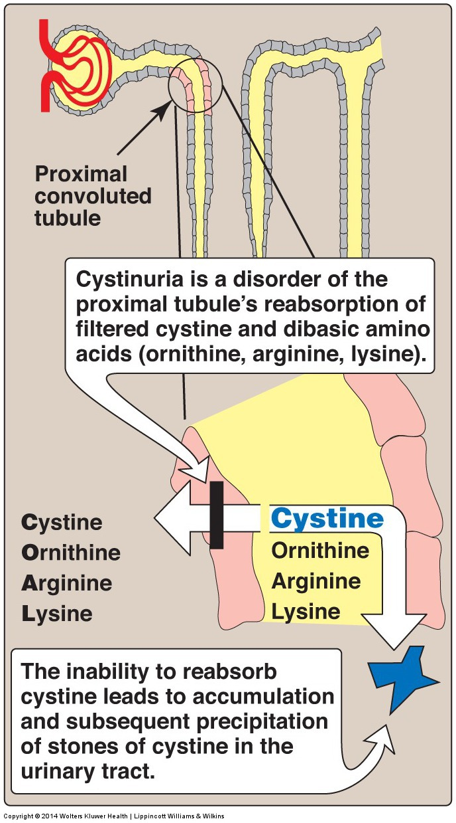
Genetic defect
seen in cystinuria
7 AA transporters exist
Used in AA uptake
from the gut and re-uptake
into the kidney tubules
In cystinuria, the
transporter for cystine,
ornithine, arginine and
lysine is defective and all
4 AA appear in the urine
Cystine precipitates
in the acidic urine
forming stones (calculi)
Recessive, incidence
of 1:7000
AA = amino acid

Slide 11
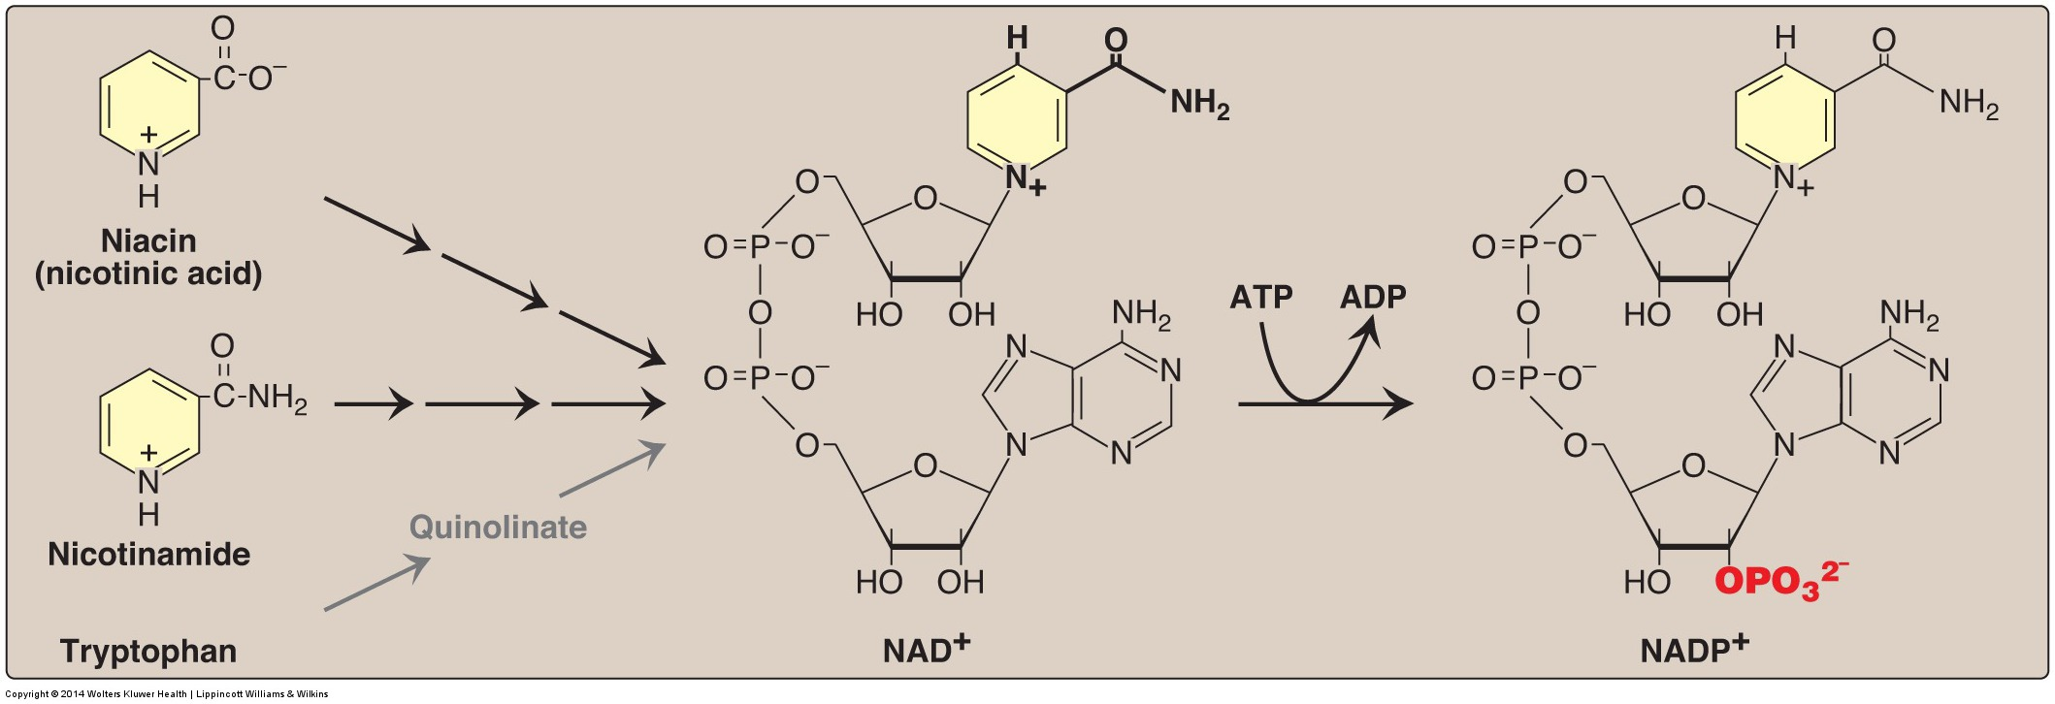
Hartnup disorder: defective absorption of tryptophan
Deficiency of niacin causes pellagra involving the skin,
GI tract and CNS
Pellagra symptoms progress through the 4 D’s:
dermatitis, diarrhea, dementia and if untreated, death
Hartnup disorder characterized by defective Trp absorption
can result in pellagra-like symptoms
Corn is low in niacin and Trp and corn-based diets can
cause pellagra

Slide 12
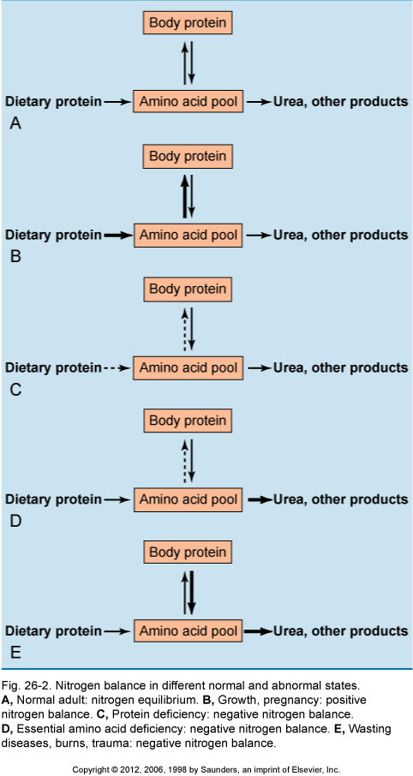
Normal adult:
nitrogen equilibrium
Nitrogen balance in
different normal and
abnormal states
Growth, pregnancy:
positive nitrogen balance
Protein deficiency:
negative nitrogen balance
Essential AA deficiency:
negative nitrogen balance
Wasting diseases, burns, trauma:
negative nitrogen balance

Slide 13
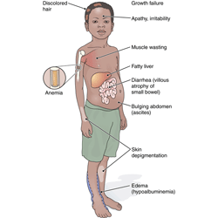
Protein malnutrition (negative nitrogen balance): Kwashiorkor*
Physical symptoms: failure to
gain weight, stunted linear growth, generalized edema, swollen abdomen, diarrhea, skin depigmentation, reddish pigmentation of hair, and decreased muscle mass.
Mental changes; lethargy, apathy, and
irritability.
Physiologic changes; a fatty liver, and
anemia.
During the final stages of kwashiorkor
patients can experience shock, coma, and, finally, death.
Can treat with gradual re-introduction of
protein and amino acids but irreversible damage may have occurred
* The name is derived from the Ga language of coastal Ghana, translated as
"the sickness the baby gets when the new baby comes”.
Jamaican pediatrician, Cicely Williams (1935) The Lancet

Slide 14
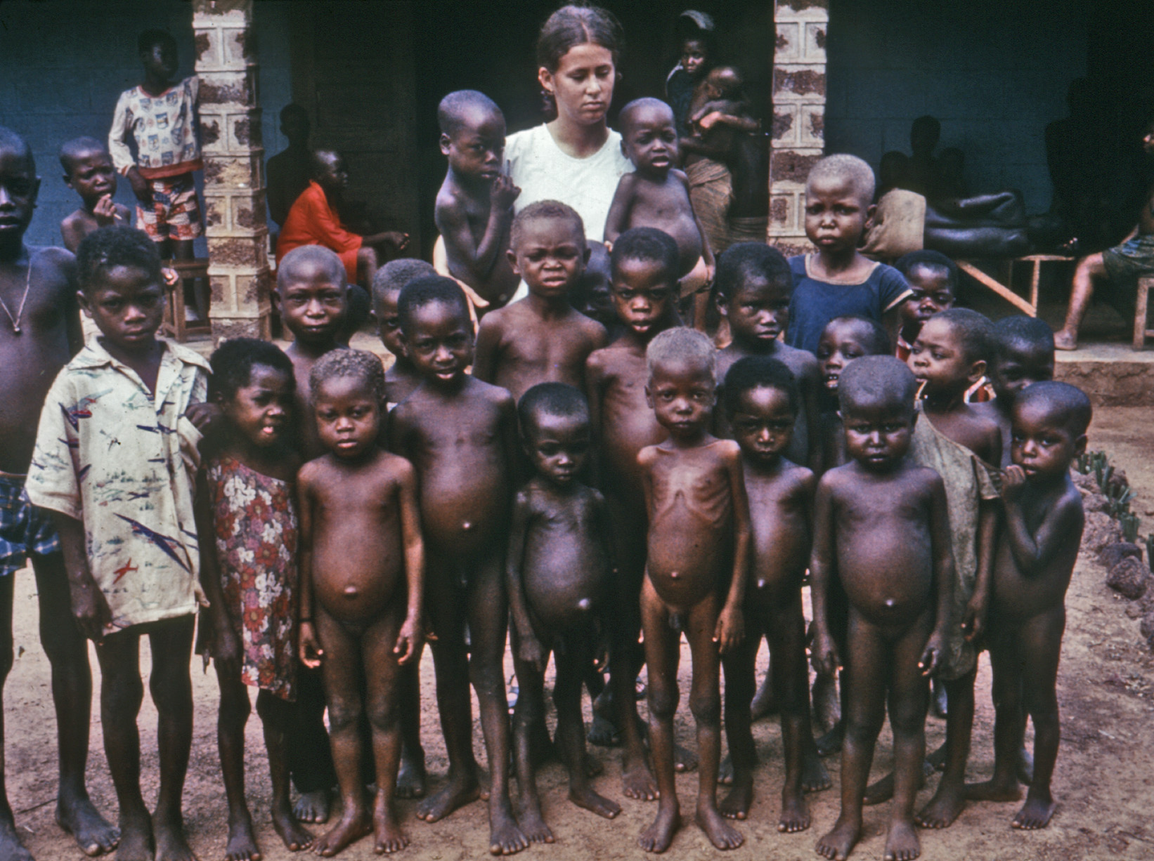
Protein malnutrition: Kwashiorkor

Slide 15
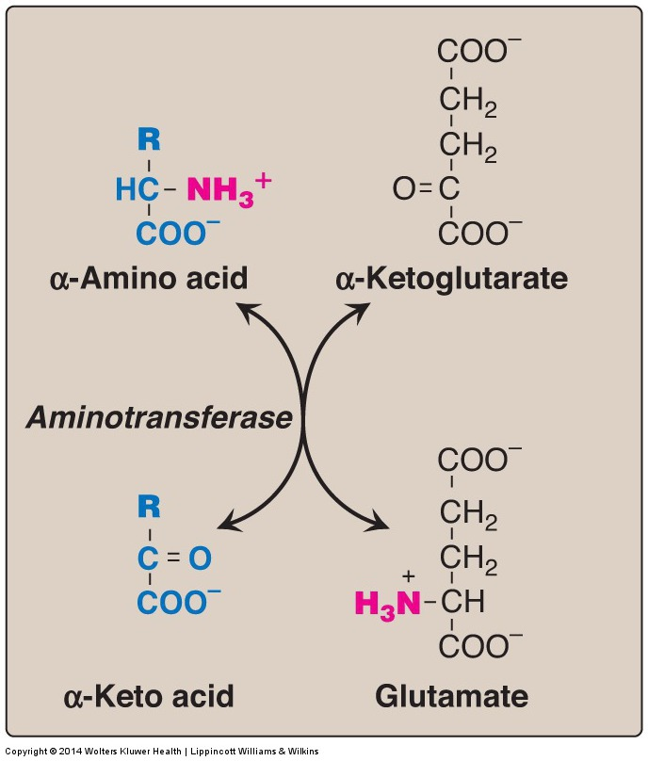
Removal of nitrogen from amino acids
Aminotransferase reaction using α-ketoglutarate
as the amino group acceptor
Transaminase or

Slide 16
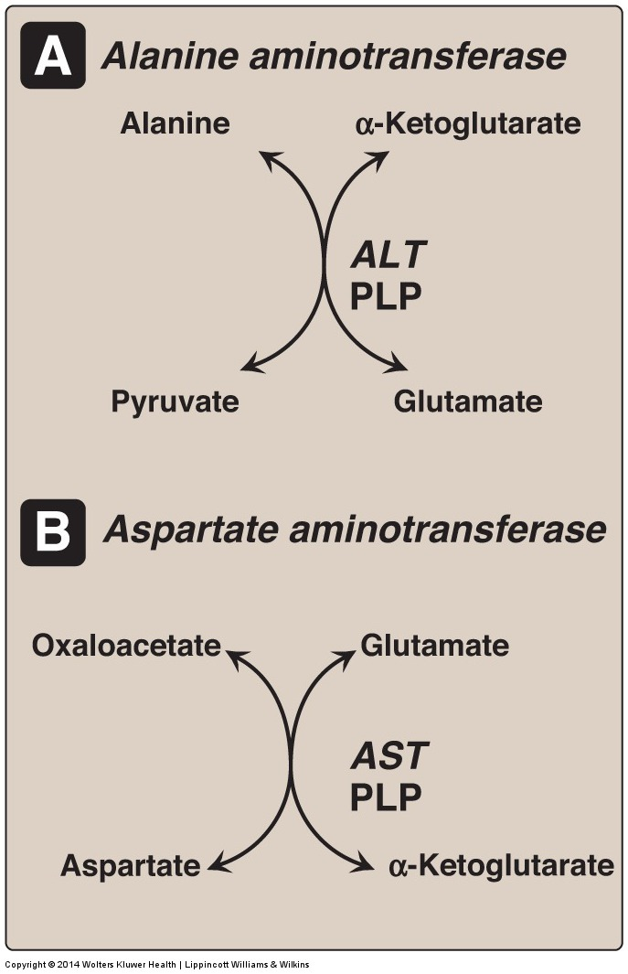
Fate of the amino group
during amino acid
catabolism
Liver function test:
Serum ALT- 10-40 IU/L
Liver function test:
Serum AST- 6-40 IU/L
ALT = alanine transaminase
AST = aspartate transaminase
PLP = pyridoxal phosphate

Slide 17
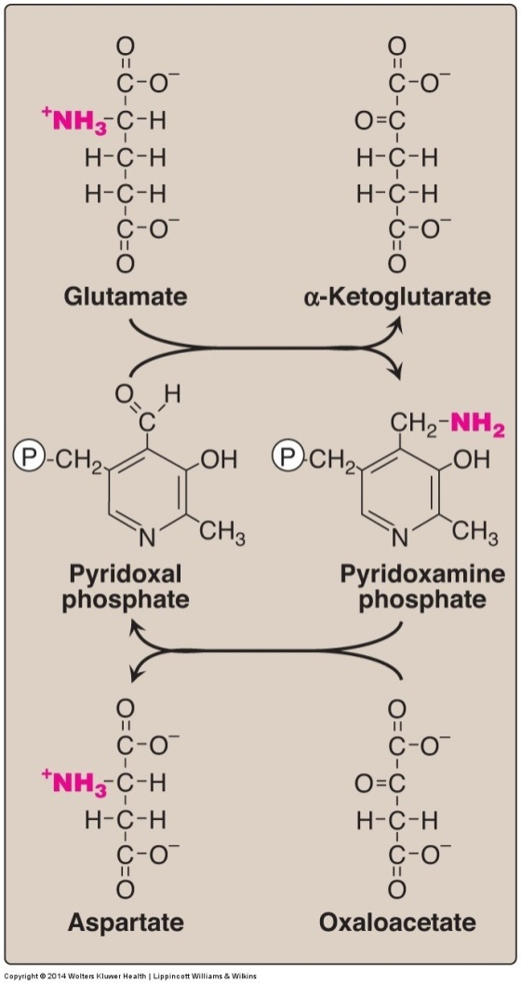
Mechanism of transamination reactions- pyridoxal phosphate
Cyclic interconversion of
pyridoxal phosphate (PLP)
and pyridoxamine phosphate
during the aspartate
aminotransferase reaction
(AST)
P
= phosphate group

Slide 18
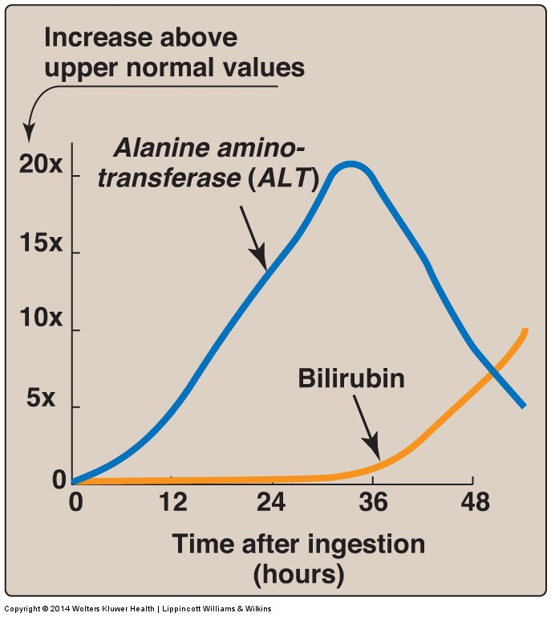
Pattern of serum ALT and bilirubin in the plasma,
following poisoning with the toxic mushroom
Amanita phalloides

Slide 19
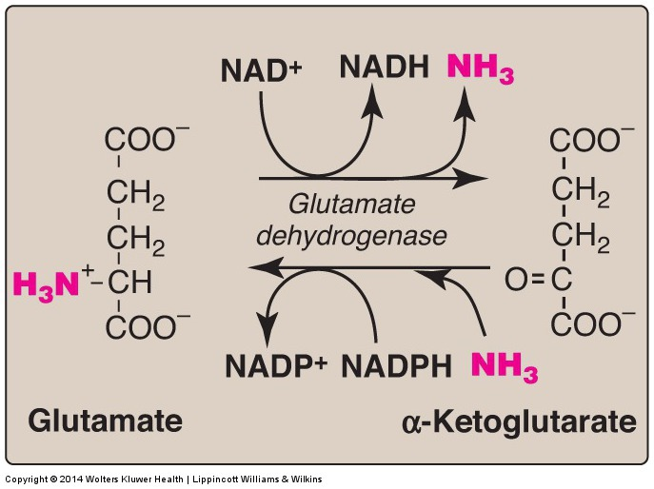
Oxidative deamination of glutamate
by glutamate dehydrogenase
Allosteric modulators:
Guanosine triphosphate (GTP) is an allosteric inhibitor of glutamate dehydrogenase
whereas adenosine
diphosphate (ADP) is an
allosteric activator.
When energy levels are low in the cell, glutamate dehydrogenase activity is high, facilitating energy production from the carbon skeletons derived from amino acids

Slide 20
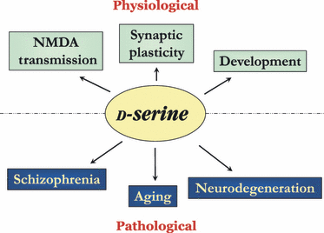
Role of D-serine in the brain
D-serine is present in the diet and is also made in brain by serine racemase from L-serine. D-serine modulates N-methyl-D-aspartate (NMDA)-type glutamate receptors. D-amino acid oxidase (DAO) is a FAD-dependent peroxisomal enzyme that catalyzes the oxidative deamination of D-AA’s
producing α-keto acids, ammonia, and hydrogen peroxide. Increased DAO
activity has been linked to increased susceptibility to schizophrenia.
FEBS Journal 275 (2008) 3514–3526

Slide 21
Transport of ammonia (NH₃)
from peripheral tissues
to the liver:
two mechanisms
Both are important in, but not
exclusive to, skeletal muscle
The first uses glutamine synthetase to combine ammonia with glutamate to form glutamine, a nontoxic form of ammonia. The glutamine is transported in the blood to the liver where it is cleaved by glutaminase to produce glutamate
and free ammonia.
The second involves the formation of alanine by transamination of pyruvate produced from aerobic glycolysis and metabolism of the branched-chain amino acids isoleucine and valine. Alanine is transported to the liver, converted to pyruvate by transamination, which is used to synthesize glucose.

Slide 22
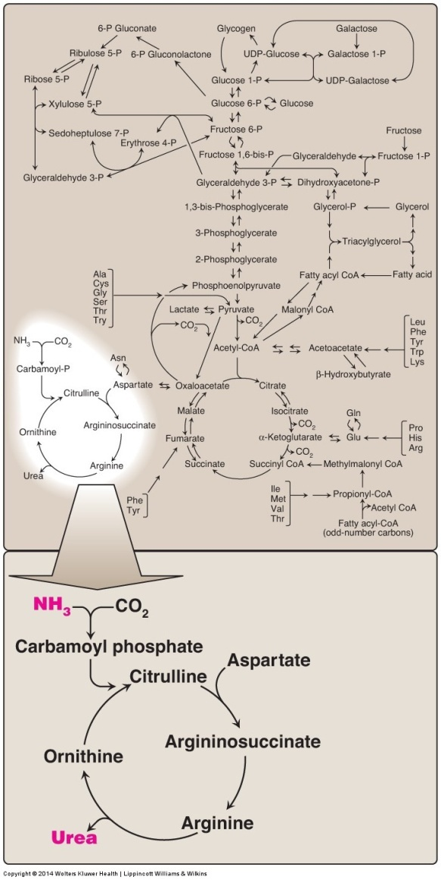
The urea cycle
shown as part of the essential pathways of energy metabolism

