Slide 1
Metabolism of Amino Acids. Part II
Dental Biochemistry Lecture 24
Richard D. Howells, PhD

Slide 2
Learning Objectives
To describe the urea cycle and its fundamental role in the excretion of nitrogen.
To distinguish between glucogenic and ketogenic amino acids.
To delineate important physiological agents that are derived from amino acids.

Slide 3
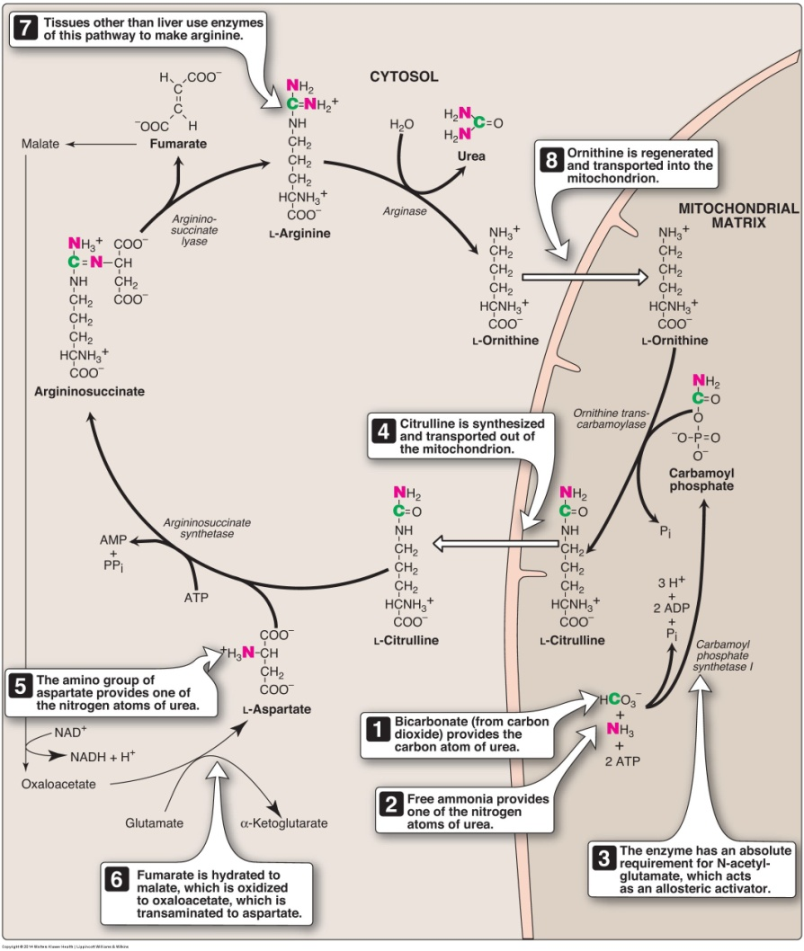
Reactions of
the urea cycle

Slide 4
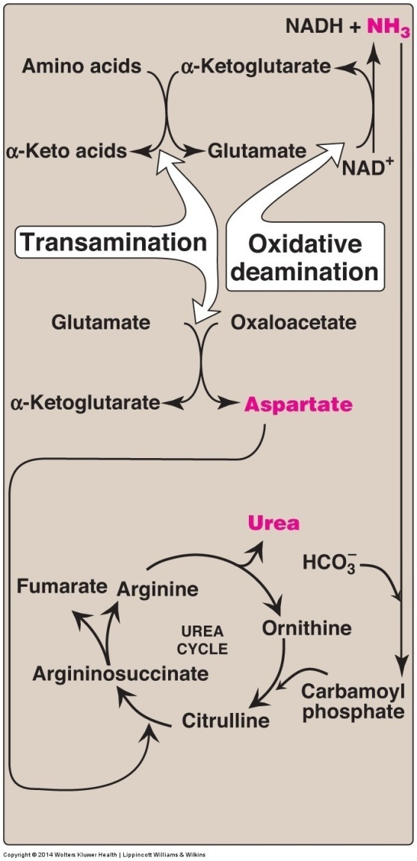
Flow of nitrogen from
amino acids to urea
Amino groups for urea synthesis
are collected in the form of
ammonia and aspartate.
Overall stoichiometry of the
urea cycle
aspartate + NH₃ + HCO₃⁻ + 3 ATP + H₂O
urea + fumarate + 2 ADP + AMP + 2 P_{i} + PP_{i}

Slide 5
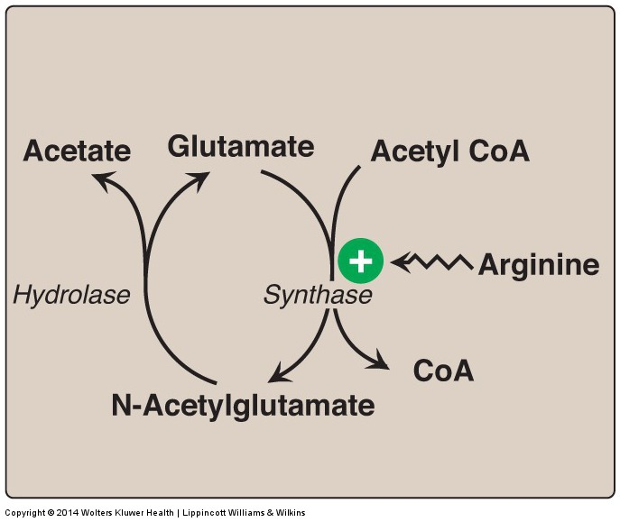
Regulation of the urea cycle
Formation and degradation of N-acetylglutamate (NAG),
an allosteric activator of carbamoyl phosphate synthetase I
NAG
NAG

Slide 6
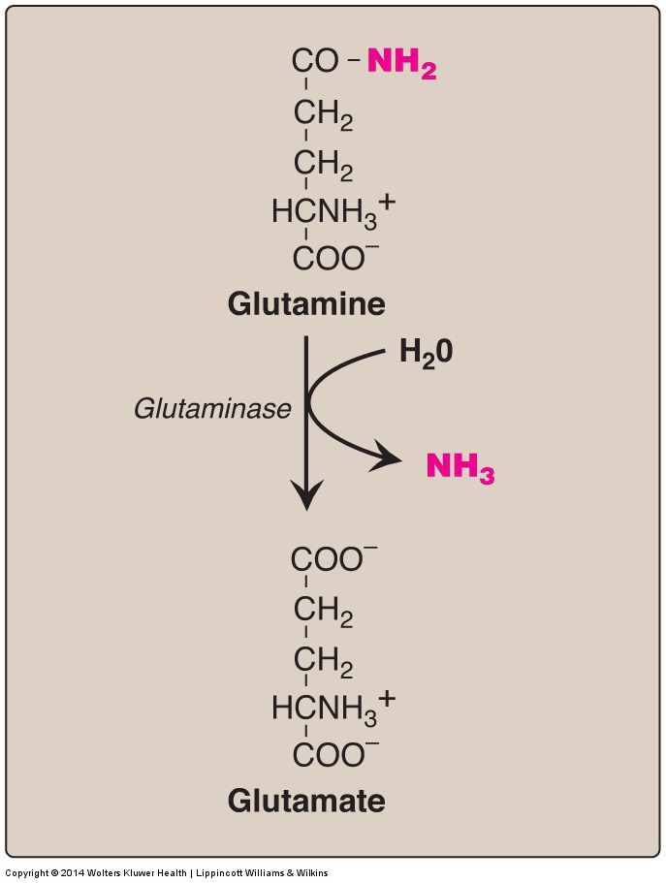
Sources of
Ammonia
Hydrolysis of glutamine
In the kidneys,
most of the ammonia is excreted into the urine as NH₄⁺. In the liver, the ammonia is detoxified to urea and excreted.

Slide 7
Other sources of ammonia
Ammonia is formed from urea by the action of bacterial urease in the lumen of the intestine. (NH₂)₂CO + H₂O CO₂ + 2NH₃
The ammonia is absorbed from the intestine and removed by the liver via conversion to urea.
Amines obtained from the diet and monoamine neurotransmitters give rise to ammonia by the action of monoamine oxidase
in the catabolism of purines and pyrimidines, amino groups attached to the ring atoms are released as ammonia

Slide 8
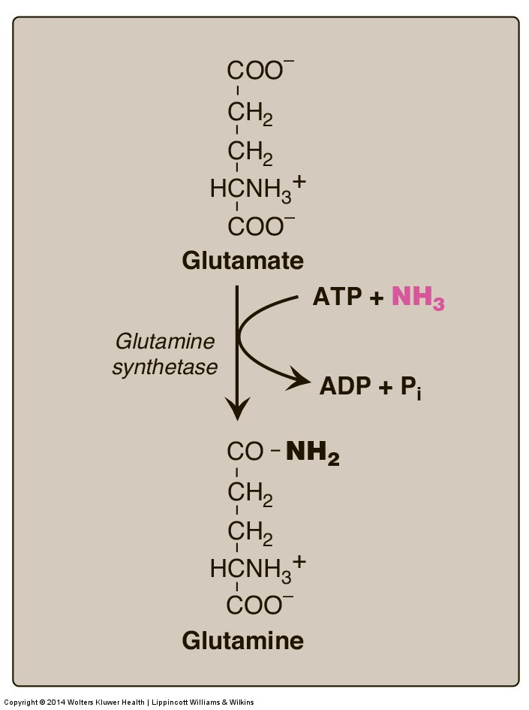
Transport of ammonia in the circulation
Glutamine provides a nontoxic storage and transport form
of ammonia
Formation of urea in the liver is the most important disposal
route for ammonia. Urea travels in the blood from the liver to the
kidneys, where it passes into the glomerular filtrate.

Slide 9
Summary of
ammonia metabolism

Slide 10
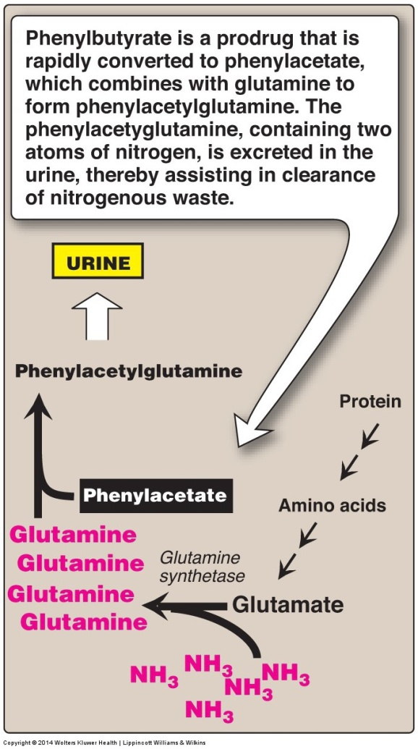
Hyperammonemia
Serum ammonia levels are normally low (5-35 μM). In patients with liver disease or genetic defects in the urea cycle, blood levels can exceed 1000 μM. Elevated ammonia levels cause tremors, slurring of speech, somnolence, vomiting, cerebral edema, blurred vision, and can cause coma and death.
Patients with urea cycle defects can be treated by administration of phenylbutyrate to aid in excretion of ammonia.

Slide 11
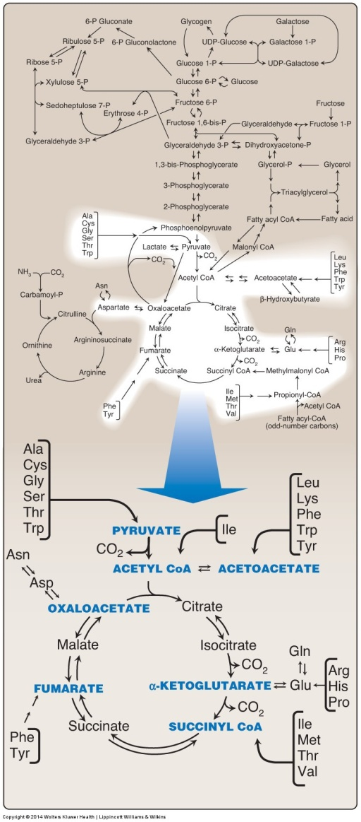
Catabolism of the carbon skeletons of glucogenic or ketogenic amino acids
7 intermediate products
are formed, shown in
blue

Slide 12
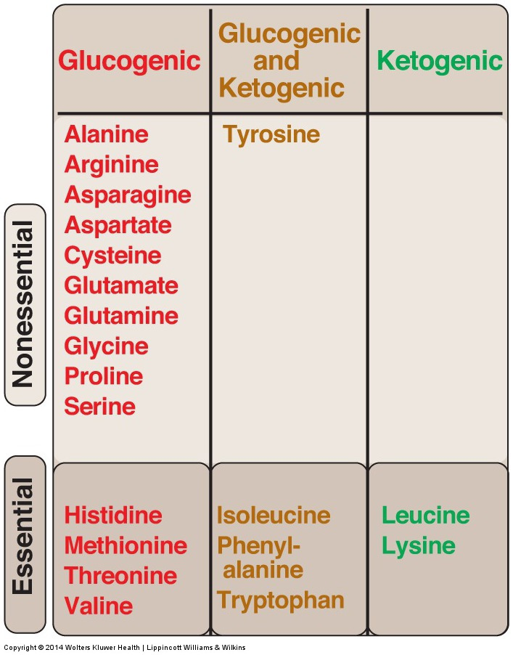
Amino acids can be
classified as glucogenic,
ketogenic, or both,
based on which of
the 7 intermediates
are produced during
their catabolism
Note: Some amino acids can
become conditionally essential.
For example, supplementation
with glutamine and arginine
has been shown to improve
outcomes in patients with
trauma, postoperative
infections, and immunosuppression.

Slide 13
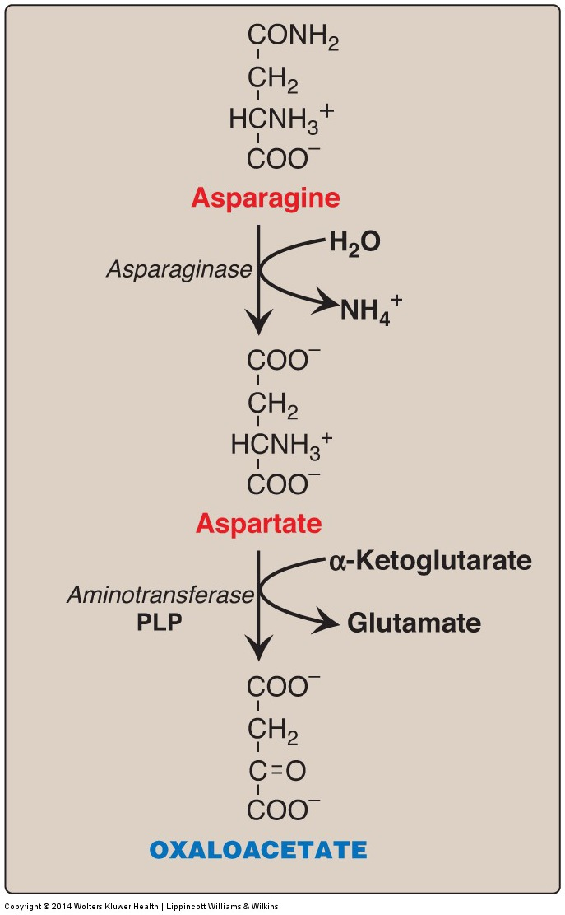
Metabolism of
asparagine and
aspartate forms
oxaloacetate
Some leukemia cells
are unable to synthesize
sufficient asparagine to
support their growth.
Asparaginase can be
administered systemically
to treat leukemic patients.
Aspartate

Slide 14
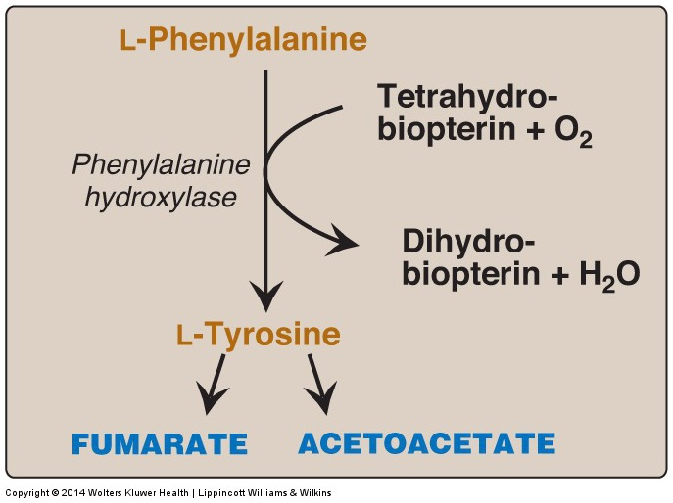
Degradation of phenylalanine yields tyrosine, and then fumarate and acetoacetate

Slide 15
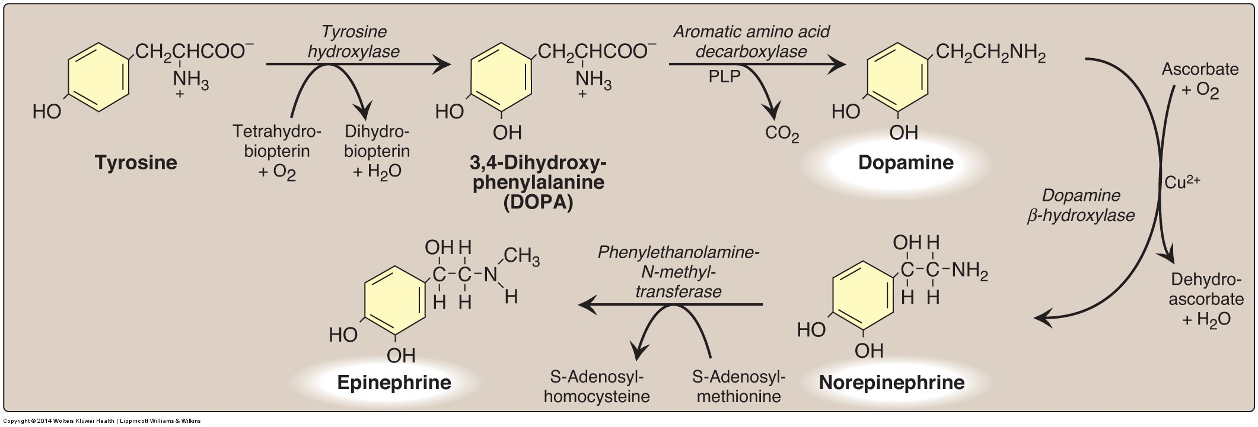
Synthesis of the neurotransmitter catecholamines from tyrosine
Cocaine inhibits dopamine and norepinephrine reuptake in the brain

Slide 16
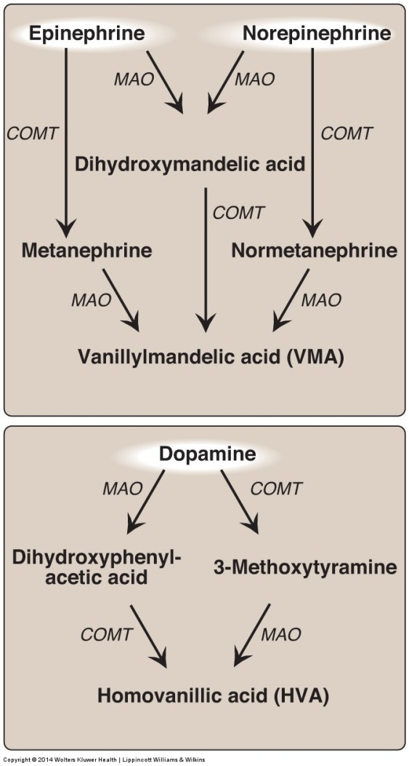
Metabolism of the
catecholamines by
catechol-O-methyl transferase
(COMT) and monoamine
oxidase (MAO)
MAO inhibitors were
the first antidepressants

Slide 17
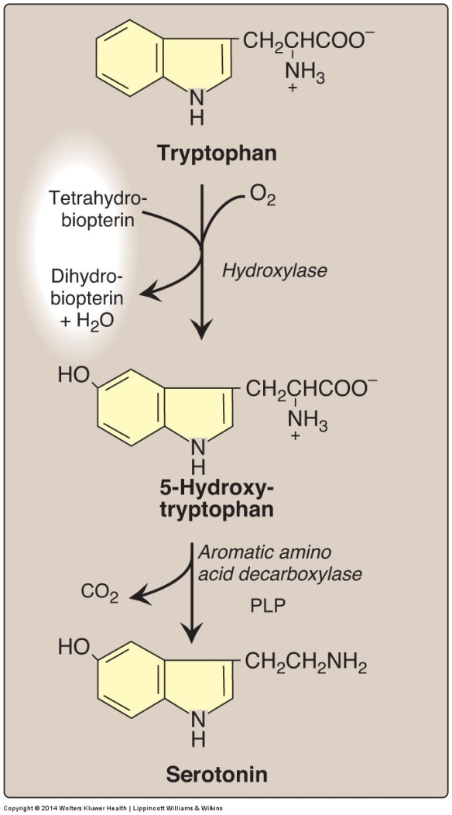
Synthesis of
serotonin
Serotonin is degraded by MAO to 5-hydroxyindole
acetic acid
Fluoxetine (Prozac) is
an antidepressant that
inhibits serotonin reuptake

Slide 18
Synthesis of melatonin from serotonin in the pineal gland
Synthesis of Melatonin from Serotonin and the Protein Fold of Serotonin N-Acetyltransferase
Biochemical pathway for the synthesis of melatonin from serotonin. Serotonin (5-hydroxy-tryptamine) is converted to melatonin through the sequential action of two enzymes, serotonin N-acetyltransferase (arylalkylamine N-acetyltransferase, or AANAT) and hydroxyindole-O-methyltransferase (HIOMT). While levels of HIOMT activity remain fairly constant, the daily rhythm in melatonin synthesis is generated by a concurrent rhythm in AANAT activity.

Slide 19
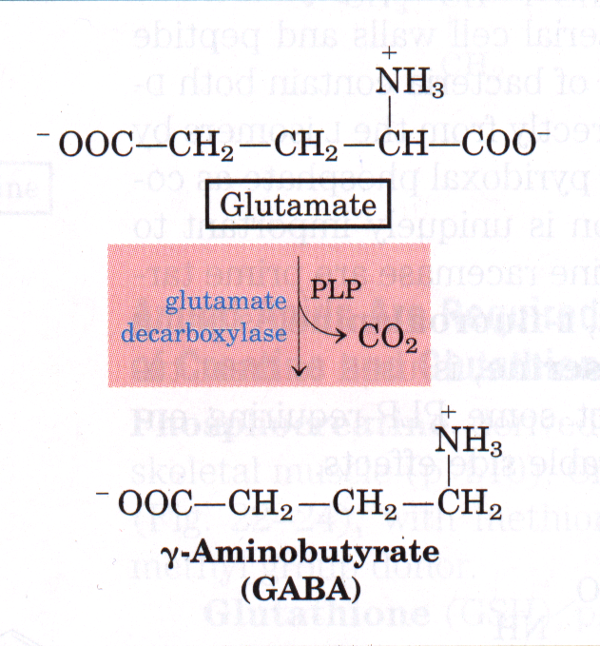
Synthesis of GABA from glutamate
Glutamate acts via ionotropic (Na⁺, Ca²⁺) and metabotropic (GPCR) receptors, and is the major excitatory neurotransmitter in human brain- chronic release can lead to excitotoxicity
GABA acts via ionotropic (Cl⁻) and metabotropic (GPCR) receptors, and is the major inhibitory neurotransmitter in human brain

Slide 20
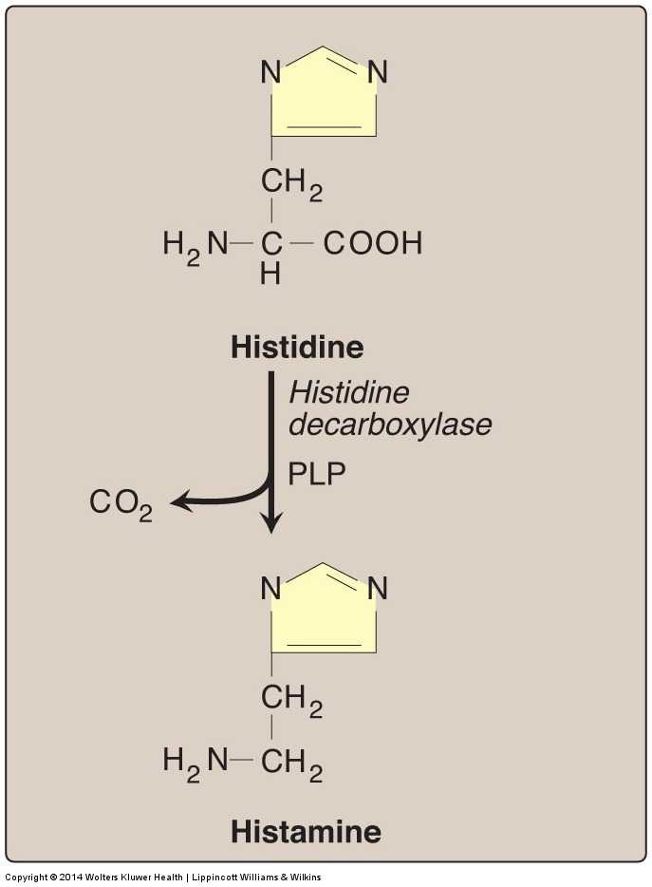
Biosynthesis of
histamine
Histamine is a chemical messenger that mediates allergic and inflammatory reactions and gastric acid secretion

Slide 21
Synthesis of
creatine and creatine phosphate

