Slide 1
Amino acidopathies: defects in amino acid metabolism
Dental Biochemistry Lecture 25
Richard D. Howells, PhD

Slide 2
Learning Objectives
To distinguish between phenylketonuria (PKU) caused by phenylalanine hydroxylase (PAH) defect and PKU caused by defect in dihydropterin synthesis or regeneration.
To describe clinical symptoms and metabolic intermediates indicative of PKU.
To explain the cause and symptoms of albinism and alkaptonuria.
To describe metabolic intermediates indicative of albinism and alkaptonuria.
To explain the cause and symptoms of maple syrup urine disease (MSUD).
To explain the cause and symptoms of homocystinuria.

Slide 3
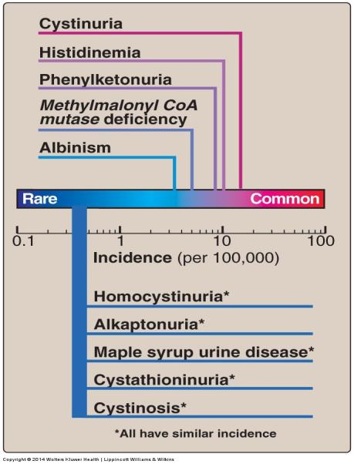
Metabolic defects in amino acid metabolism
Inborn errors of metabolism are commonly caused by mutant genes that generally result in abnormal proteins, most often enzymes. The inherited defects may be expressed as a total loss of enzyme activity or as a partial deficiency in activity.
Newborn screening and timely initiation of treatment are essential. By law, all states must screen for over 20 disorders. All states screen for PKU.
Treatment: diets low in the amino acids whose catabolism is impaired.

Slide 4
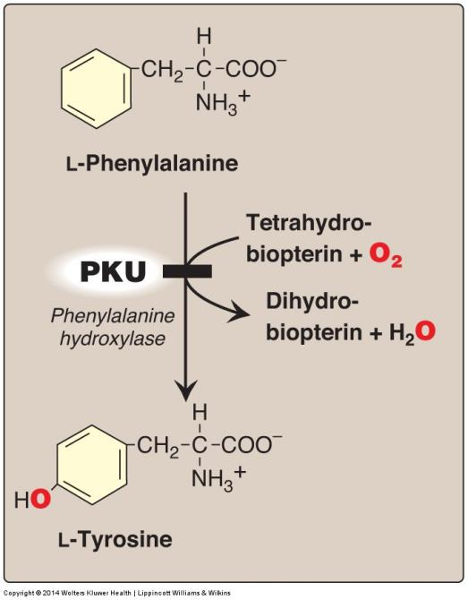
A deficiency in
phenylalanine
hydroxylase results
in the disease
phenylketonuria (PKU)

Slide 5
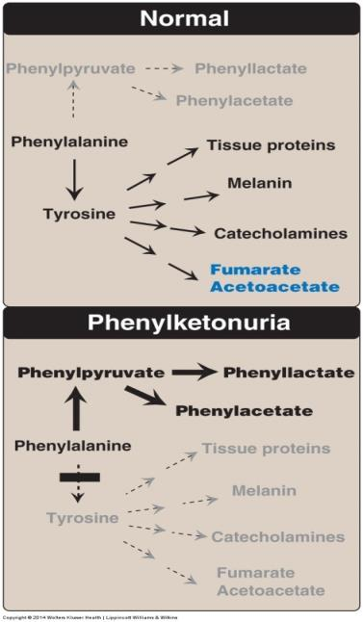
Phenylketonuria (Hyperphenylalanemia)
The most common clinically encountered inborn error of AA metabolism (prevalence 1:15,000).
Elevated levels of phenylalanine (10X normal), phenylpyruvate, phenyllactate, phenylacetate in blood and urine.
Symptoms: Hypopigmentation, due to inhibition of tyrosinase essential for melanin formation(patients often blond with fair skin and blue eyes); CNS symptoms: intellectual disability by age one year, developmental delay, microcephaly, and seizures in untreated PKU patients (now rare due to prenatal testing).
Treatment: dietary restriction of Phe

Slide 6
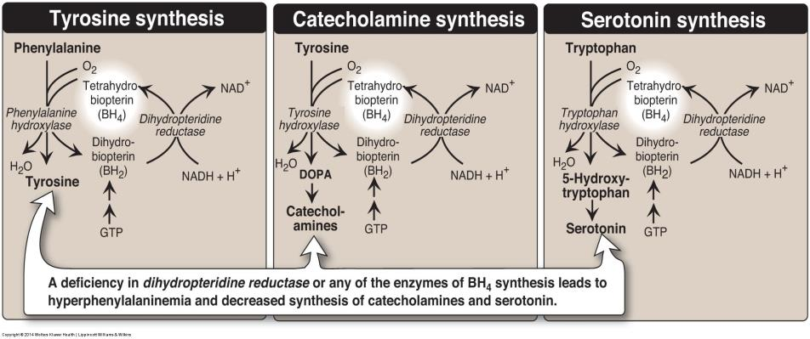
Hyperphenylalanemia may also be caused by deficiencies
in any of the several enzymes required to synthesize BH₄
or in dihydropteridine reductase, which regenerates
BH₄ from BH₂

Slide 7
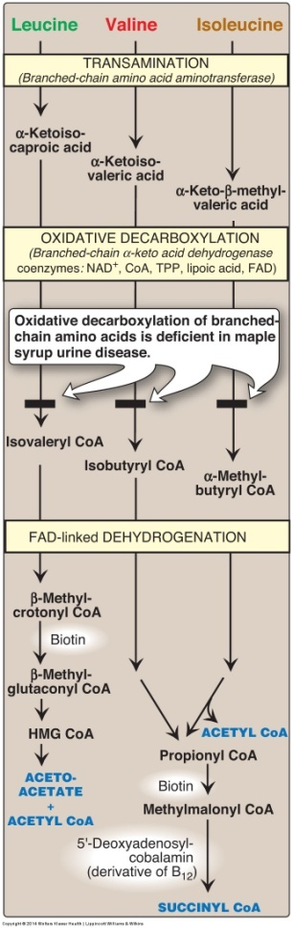
Maple syrup urine disease (MSUD)
Autosomal recessive (1:185,000).
Partial or complete deficiency in mitochondrial branched chain α-keto acid dehydrogenase (BCKD), that oxidatively decarboxylates Leu, Ile and Val.
These BCAAs and their corresponding α-keto acids accumulate in blood, causing interference with brain functions (especially Leu and α-Kic acid).
Symptoms: a characteristic maple syrup odor to the urine due to rise in Ile; feeding problems, vomiting, ketoacidosis, changes in muscle tone, neurologic problems that can result in coma; if untreated, disease is fatal; if treatment is delayed, intellectual disability results.
Treatment: Synthetic formula free of BCAAs supplemented with limited amounts of Leu, Ile and Val to allow normal growth and development without producing toxic levels.

Slide 8

Albinism
Results from an absent or defective copper-requiring tyrosinase deficiency (Incidence; <1:30,000).
Albinism appears in different forms: autosomal recessive inheritance is primary mode.
Symptoms: White hair, pink eyes, and hypopigmented pale skin; sensitive to sunlight (easy to sunburn and increased skin cancer); impaired vision, and photophobia.
Treatment: Protection from UV exposure.

Slide 9
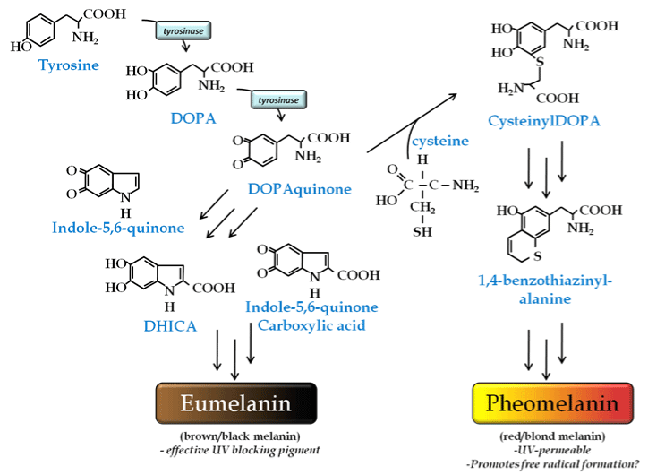
Melanin biosynthesis from tyrosine

Slide 10
Melanin
In humans, melanin is the primary determinant of skin color. It is also found in hair, the pigmented tissue underlying the iris of the eye, and the stria vascularis of the inner ear. In the brain, tissues with melanin include pigment-bearing neurons within areas of the brainstem, such as the locus coeruleus and the substantia nigra.
The melanin in the skin is produced by melanocytes, which are found in the basal layer of the epidermis. Albinism results from very little or no melanin synthesis in the body.
There are different types of melanin: pheomelanin and eumelanin are found in human skin and hair, but eumelanin is the most abundant melanin in humans.

Slide 11
Eumelanin
Eumelanin polymers are composed of numerous cross-linked 5,6-dihydroxyindole (DHI) and 5,6-dihydroxyindole-2-carboxylic acid (DHICA) polymers. Two types are recognized: black and brown. A small amount of black eumelanin in the absence of other pigments causes grey hair. A small amount of brown eumelanin in the absence of other pigments results in blond hair.
Pheomelanin
Pheomelanin imparts a pink to red hue and, thus, is found in particularly large quantities in red hair. Pheomelanin is particularly concentrated in the lips, nipples, glans of the penis, and vagina. In chemical terms, pheomelanin differs from eumelanin in that its oligomer structure incorporates benzothiazine and benzothiazole units that are produced, instead of DHI and DHICA, from tyrosine and cysteine.

Slide 12
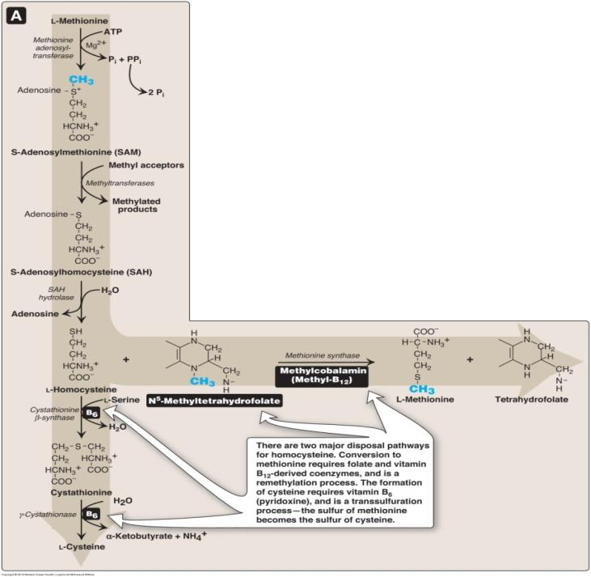
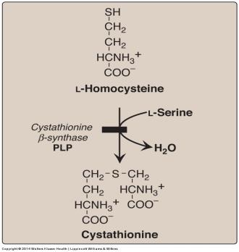
Homocystininuria
Group of rare disorders
involving defects in metabolism
of homocysteine (Hcy).
Patients exhibit lens dislocation,
skeletal abnormalities (long limbs
and fingers), intellectual disability,
increased risk for developing blood
clots.
Treatment includes restriction of
methionine and supplementation
with vitamins B₆, B₁₂, and folate.
Homocystinuria is
characterized by
high plasma and
urinary levels of
Hcy and
methionine.

Slide 13
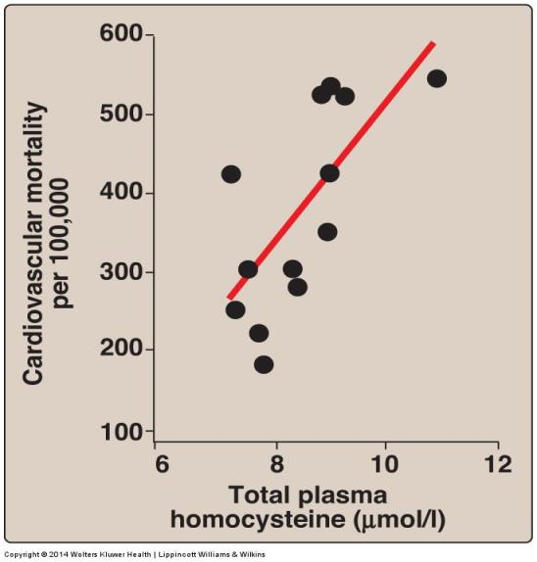
Association between cardiovascular disease
Mortality and total plasma homocysteine

Slide 14
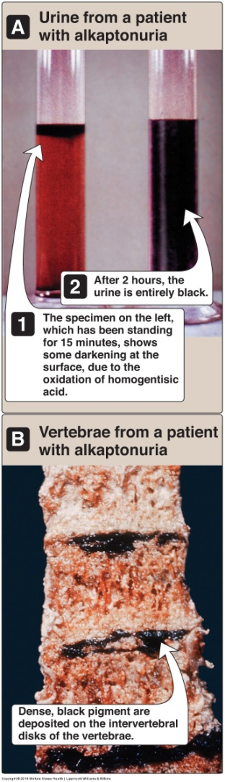
Alkaptonuria
A rare non-fatal metabolic condition
involving a deficiency in homogentisic acid
oxidase, resulting in the accumulation of homogentisic acid (HA)- ((2,5-dihydroxyphenyl) acetic acid), an intermediate in the degradative
pathway of tyrosine (see last slide).
The condition has 3 characteristic
symptoms: homogentisic aciduria (the HA in urine oxidizes to a dark pigment on standing), large joint arthritis that can be
severely crippling, and deposition of black pigment in cartilage and collagenous tissue.
Diets low in Phe and Tyr reduce the
levels of HA and decrease the amount of pigment deposited in body tissues.

Slide 15
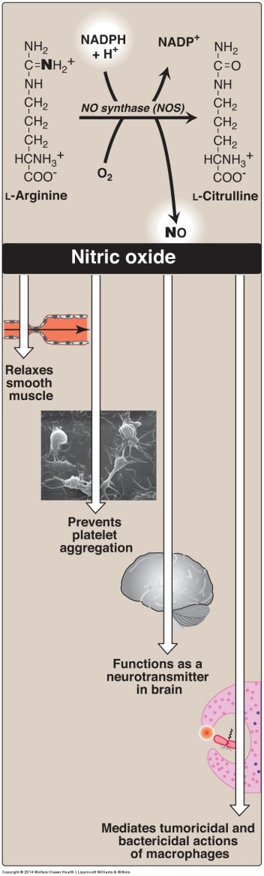
Synthesis and some of
the actions of
nitric oxide (NO)
Nitric oxide is synthesized from arginine by nitric oxide synthase (NOS).
There are 3 nitric oxide
synthases encoded by different genes: the endothelial (eNOS), neural (nNOS) and inducible (iNOS).
FMN, FAD, heme, and
tetrahydrobiopterin are coenzymes, and eNOS and nNOS are Ca²⁺-calmodulin dependent.

Slide 16
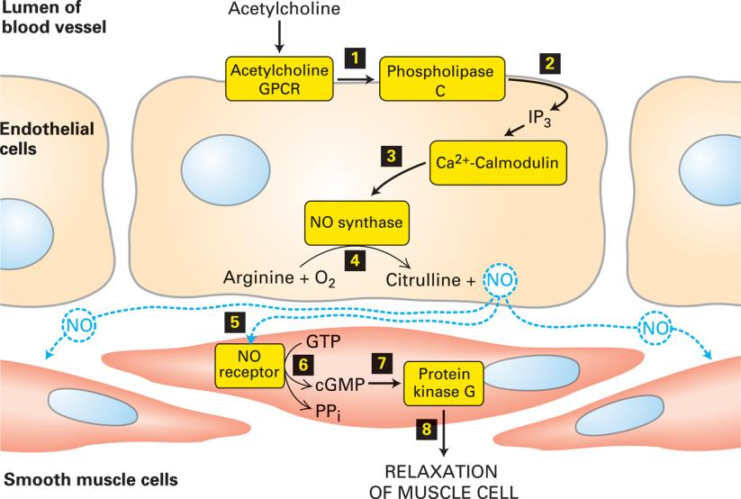
The Ca²⁺/nitric oxide (NO)/cGMP pathway
and the relaxation of arterial smooth muscle

Slide 17
Treatment of erectile dysfunction
The blood vessels in the corpora cavernosa of the penis
are expected to dilate profoundly in response to
parasympathetic nerve stimulation, with NO being the most
important mediator.
In this tissue, NO is formed mainly in the nerve terminals
and only to a lesser extent in the vascular endothelium.
As in other vascular beds, however, NO acts by stimulating
the soluble guanylate cyclase in vascular smooth muscle.
Erectile dysfunction (impotence) is treated with sildenafil
(Viagra) and related drugs that inhibit phosphodiesterase-5.
This cGMP-specific phosphodiesterase is responsible for
the degradation of cGMP in the vascular smooth muscle
of the penis.

Slide 18
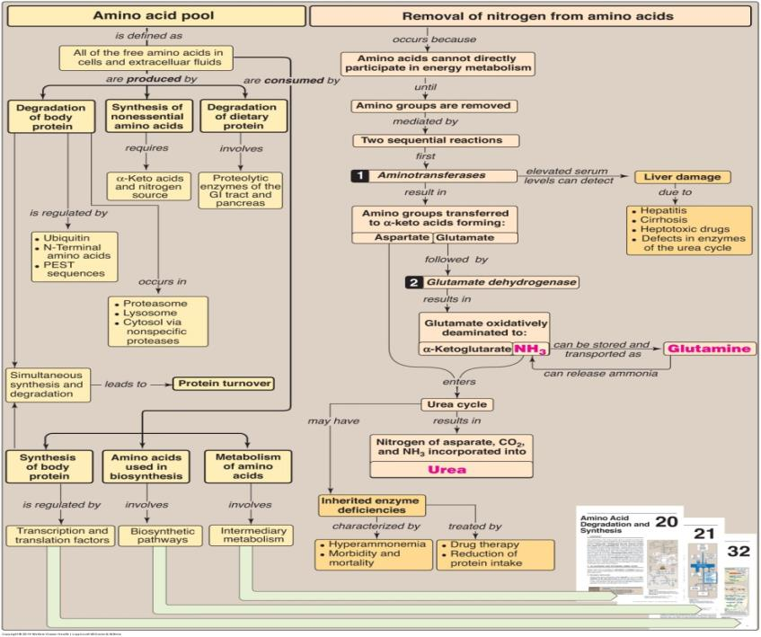
Key concept map for
nitrogen metabolism

Slide 19
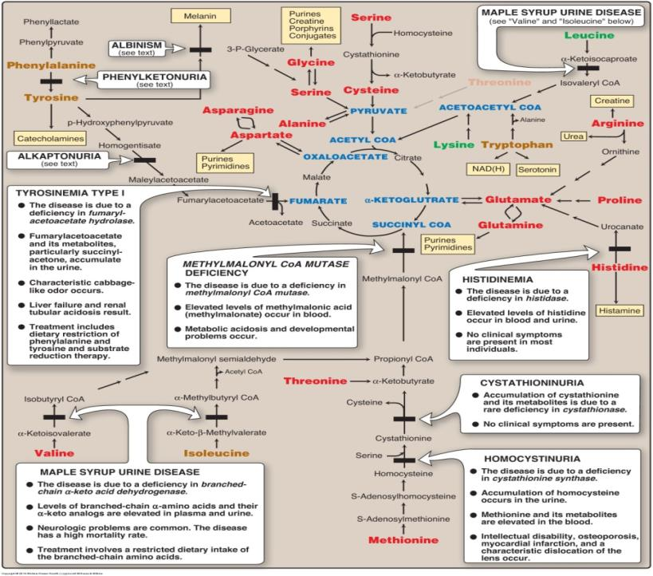
Summary
of the
metabolism
of amino
acids in
humans

