Slide 1
Prokaryotic Gene Regulation
April 22, 2015
Richard D. Howells, PhD
MSB E-643
howells@njms.rutgers.edu

Slide 2
Objectives
During this presentation, you may
catch up on needed sleep
recall the process of transcription
appreciate how the lac and trp operons are regulated in bacteria

Slide 3
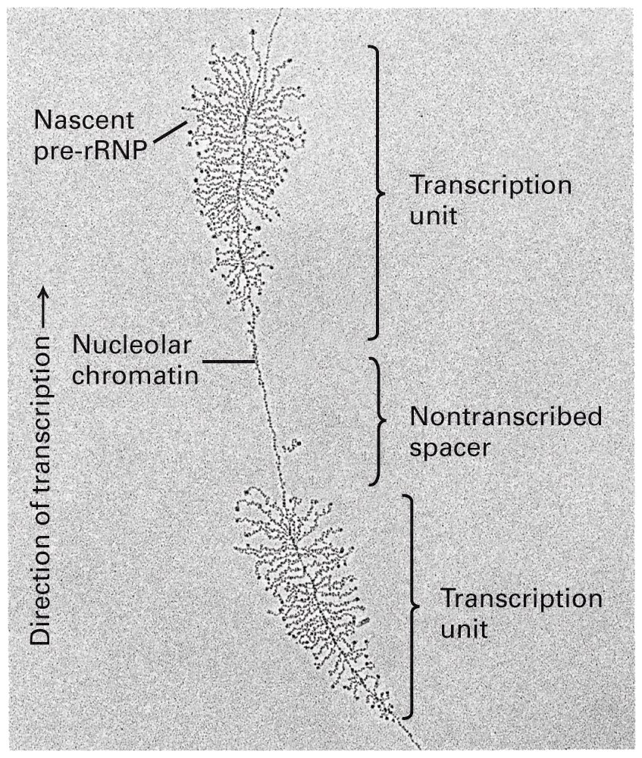
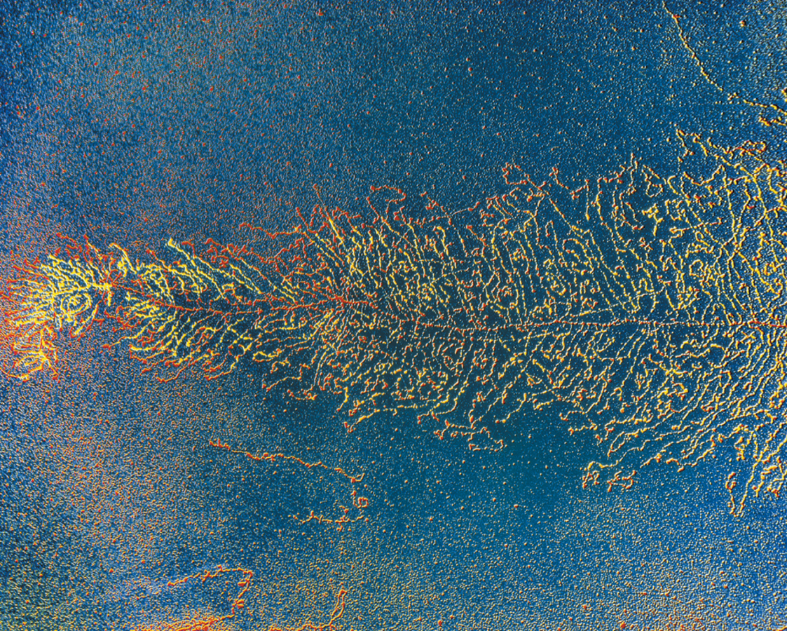
General structure of the tandem arrays of
pre-rRNA transcription units

Slide 4
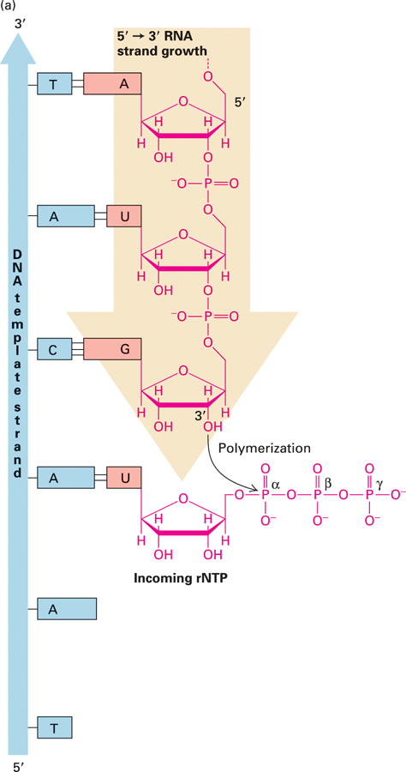
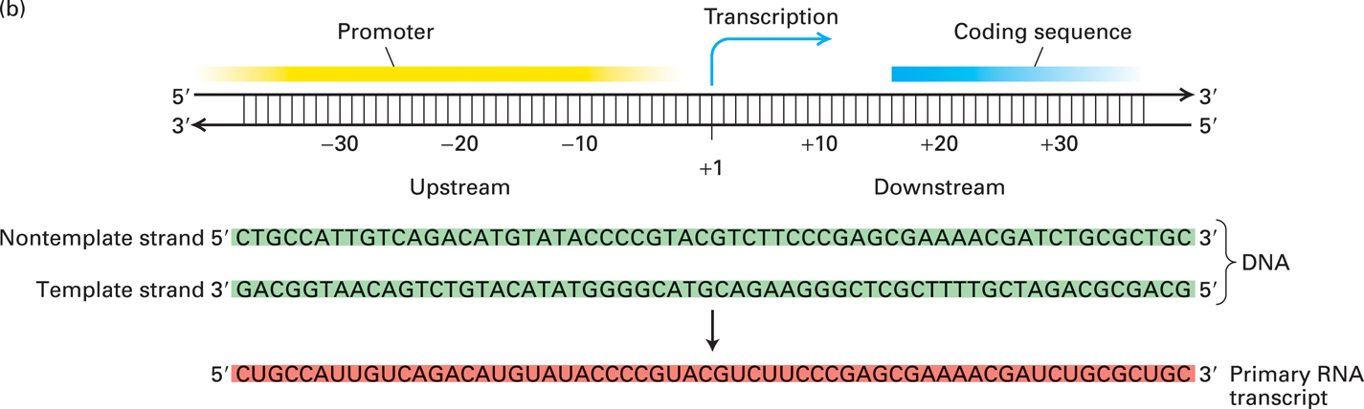
RNA is synthesized 5’ to 3’ based on the DNA sequence
of the template DNA strand
4

Slide 5
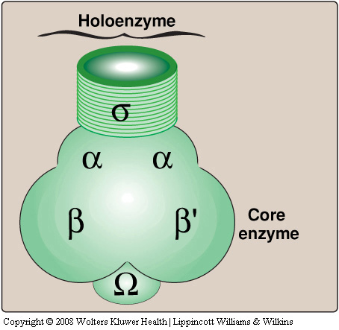
The bacterial RNA polymerase

Slide 6
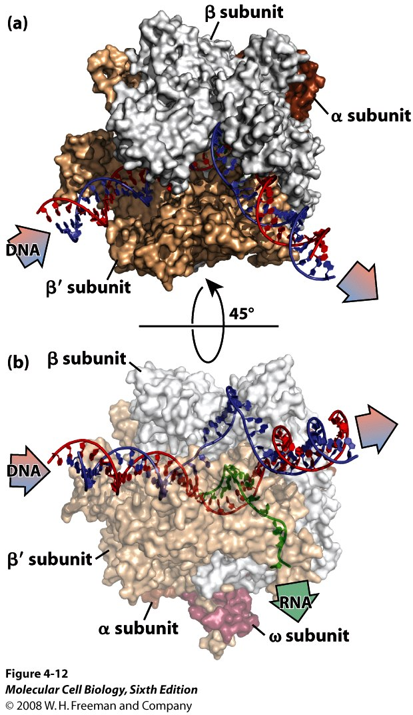
Bacterial
RNA Polymerase

Slide 7
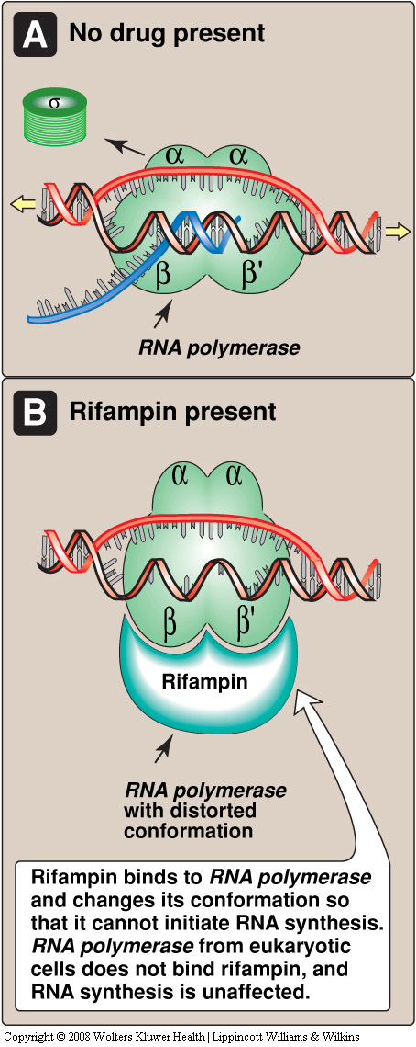
Inactivation of the
prokaryotic RNA
polymerase by
rifampin - a
drug used for
treatment of
tuberculosis

Slide 8
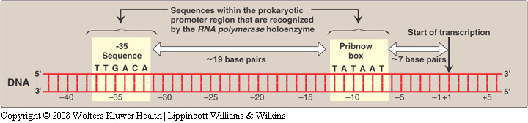
Prokaryotic promoter region: landmark for
site of transcription initiation

Slide 9
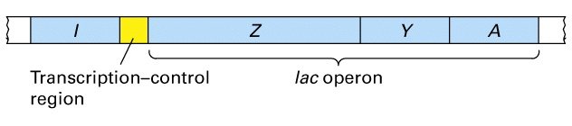
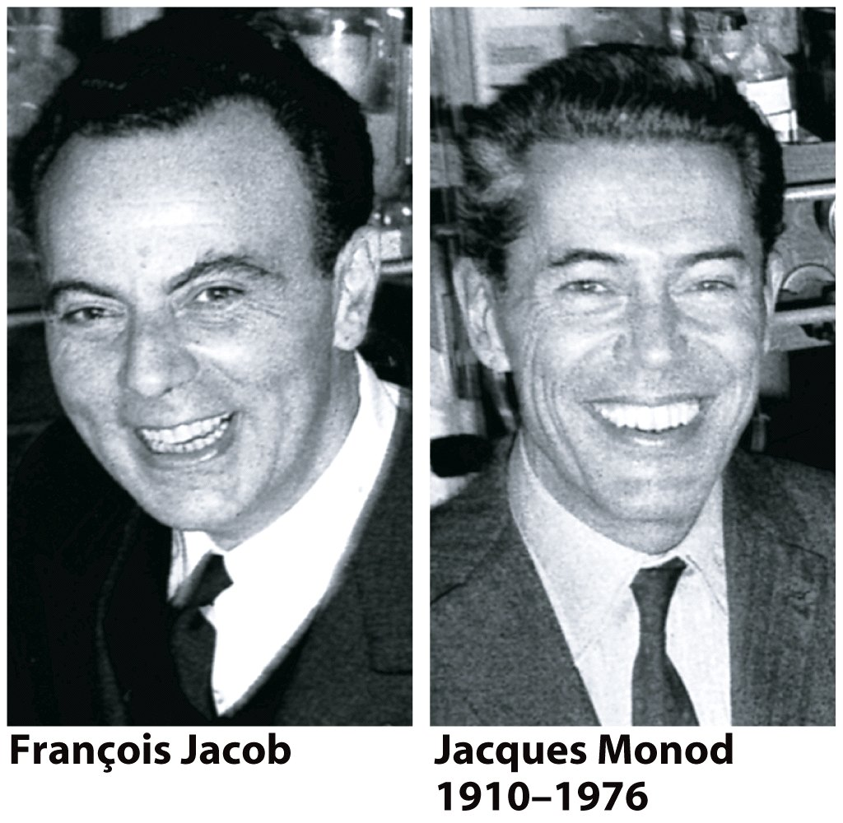
The Lactose (Lac) Operon of Escherichia coli
1920-2013

Slide 10
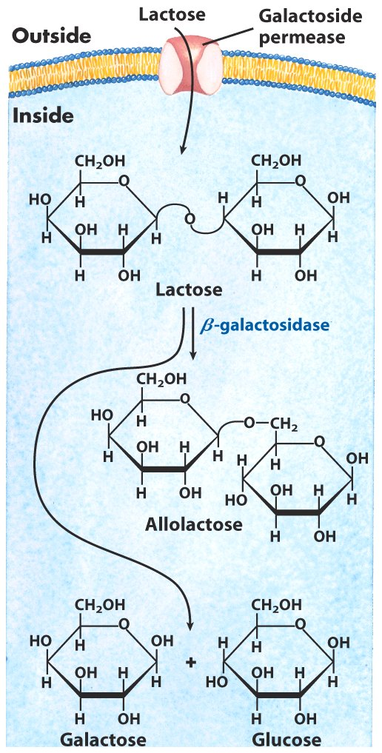
Lactose metabolism in E. coli

Slide 11
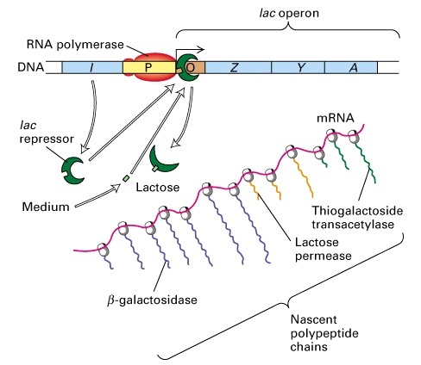
Transcriptional Regulation of the Lac Operon

Slide 12
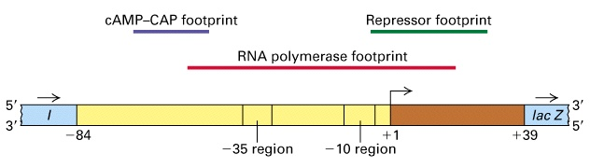
The Lac Operon Promoter

Slide 13
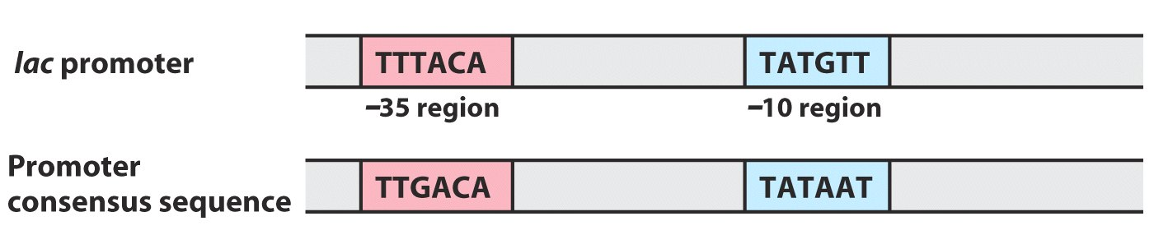
The lac promoter vs. the promoter consensus sequence

Slide 14
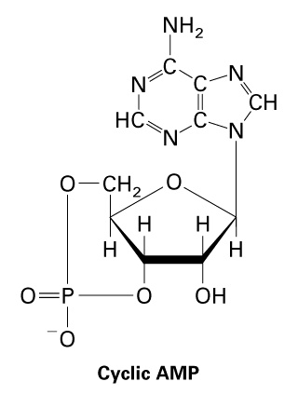
Structure of cAMP

Slide 15
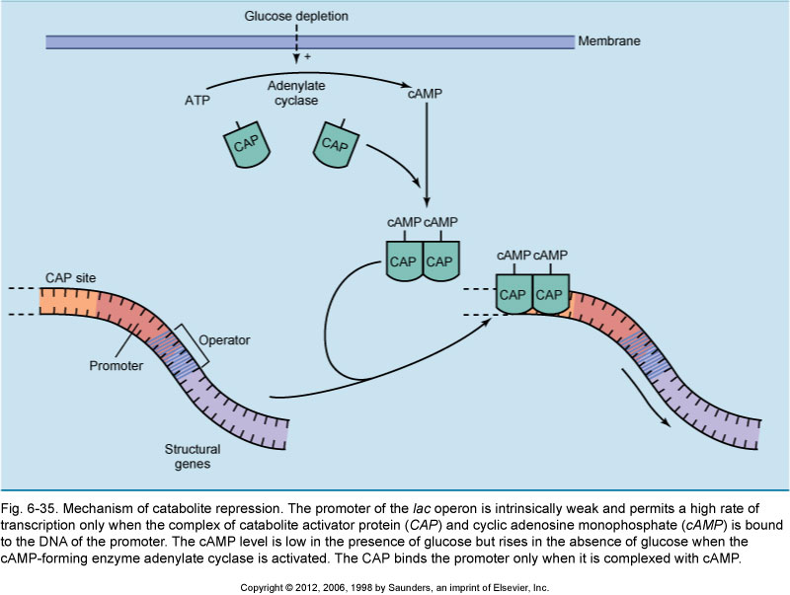
Control of the lac operon by glucose and cAMP

Slide 16
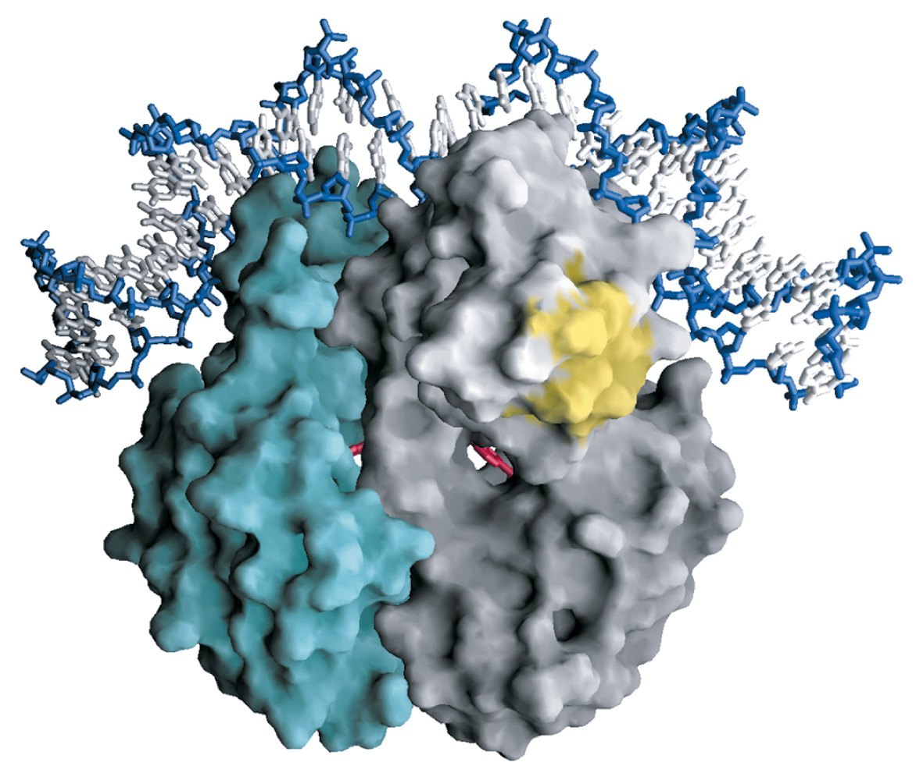
cAMP-CAP (CRP) homodimer (yellow domain interacts with RNA pol)

Slide 17
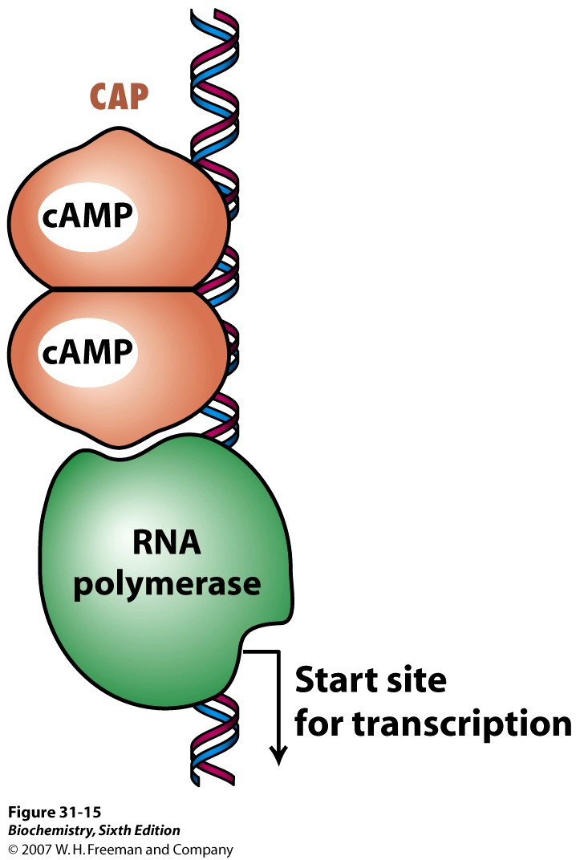
tTThe T
The cAMP-CAP complex
activates transcription
of the lac operon

Slide 18
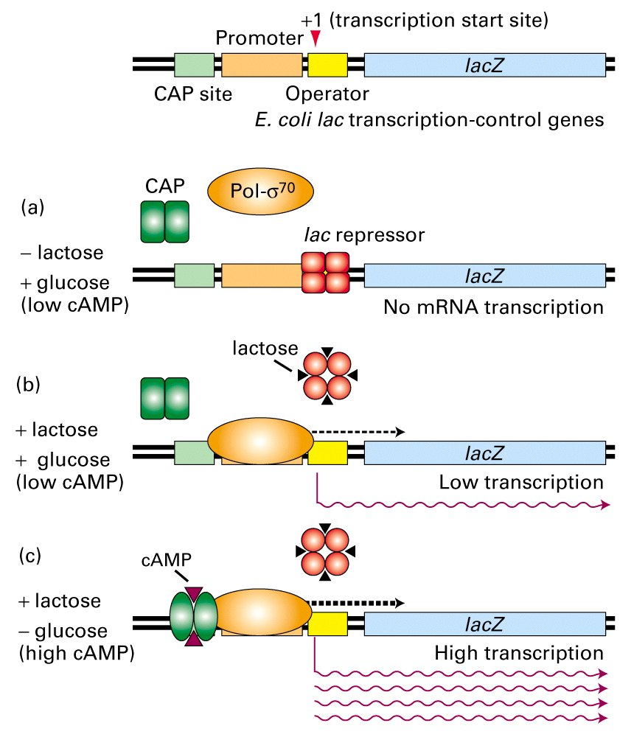
Lac Operon Regulation

Slide 19
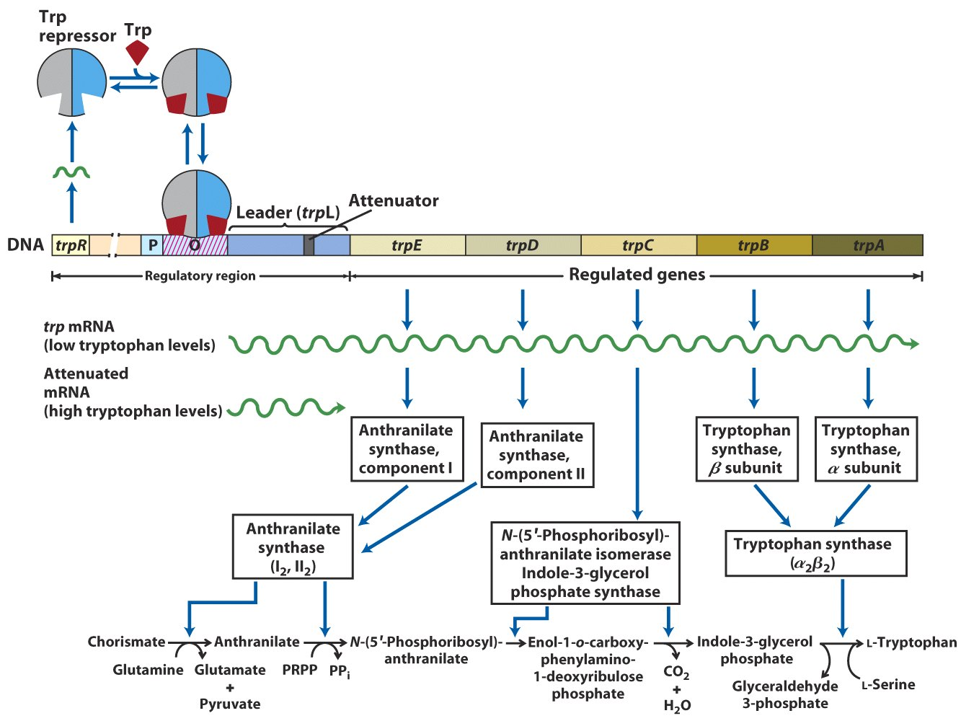
Regulation of the trp operon in E. coli

Slide 20
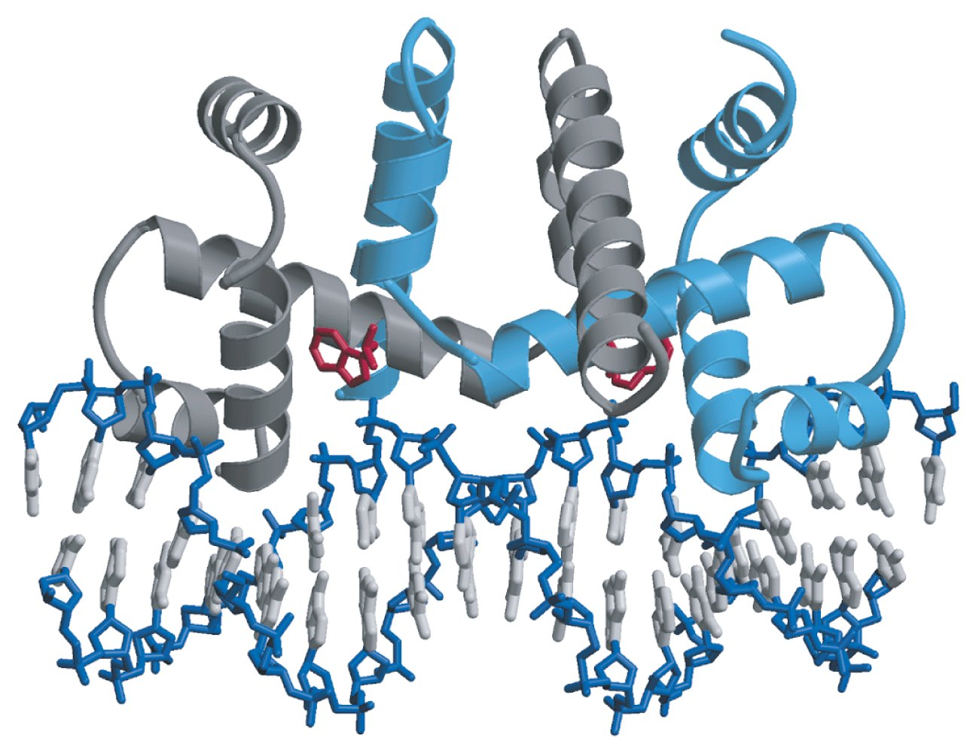
Trp repressor homodimer bound to Trp and the trp operator

Slide 21
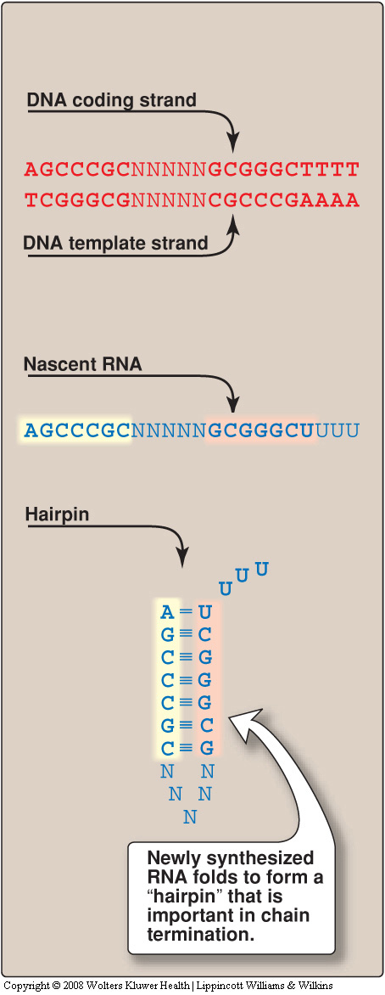
Rho-independent
termination of
transcription

Slide 22
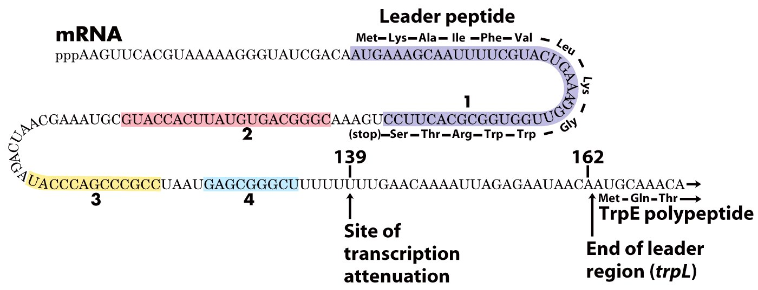
Transcriptional attenuation in the trp operon

Slide 23
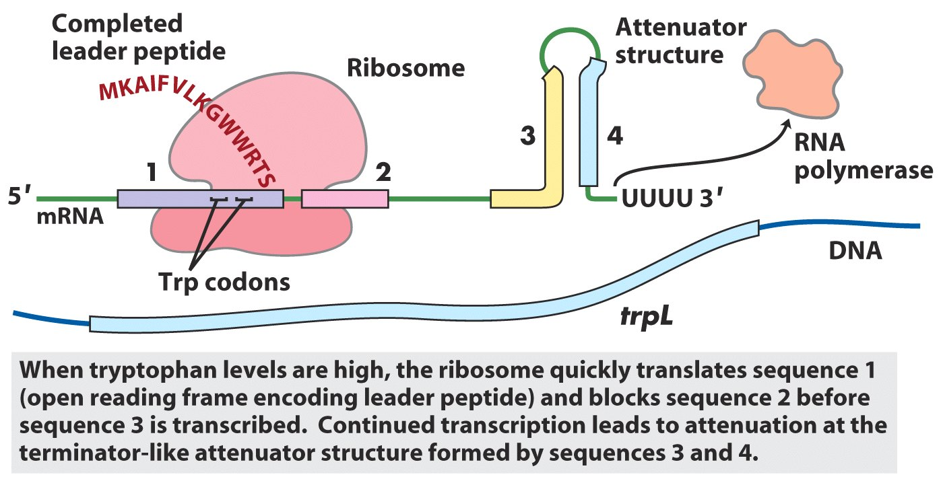
Transcriptional attenuation in the trp operon

Slide 24
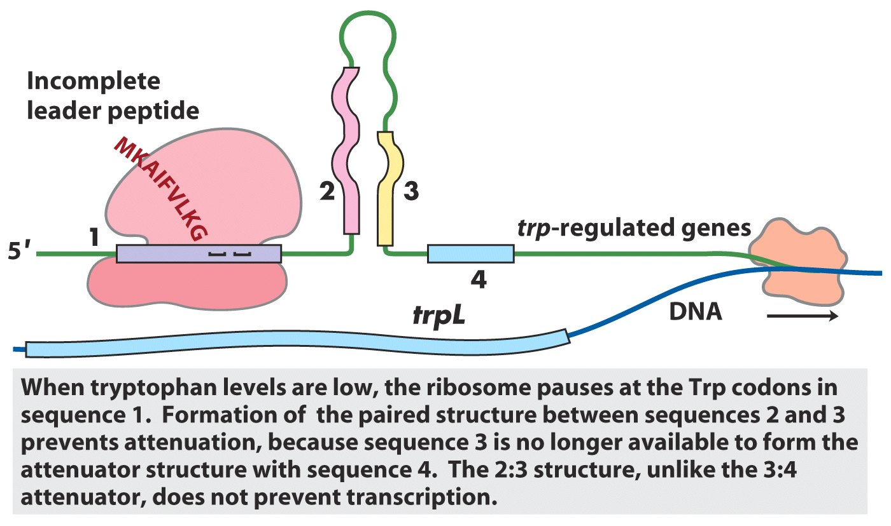
Transcriptional attenuation in the trp operon

Slide 25
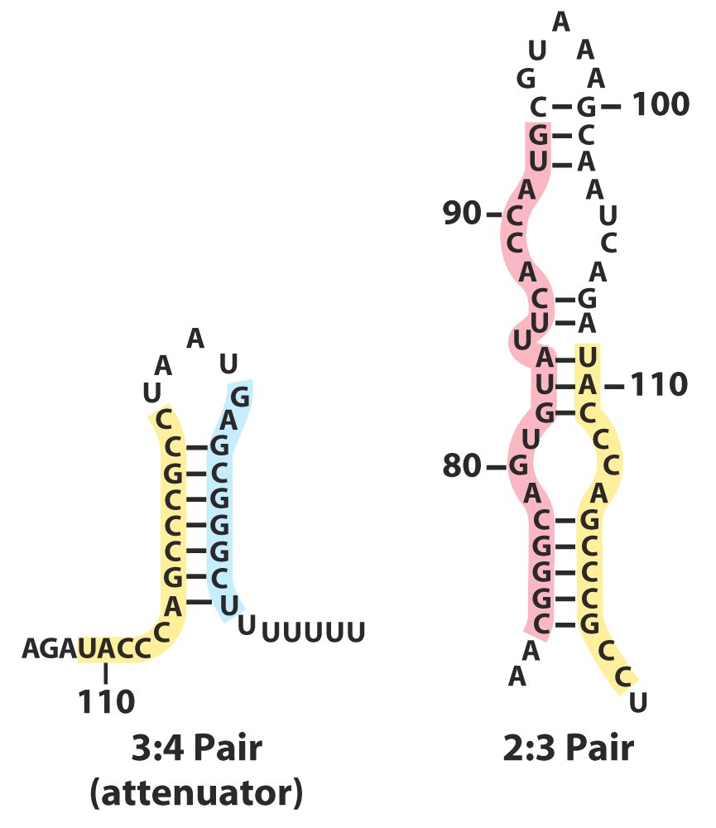
Attenuation in the trp operon
(does not cause attenuation)

Slide 26
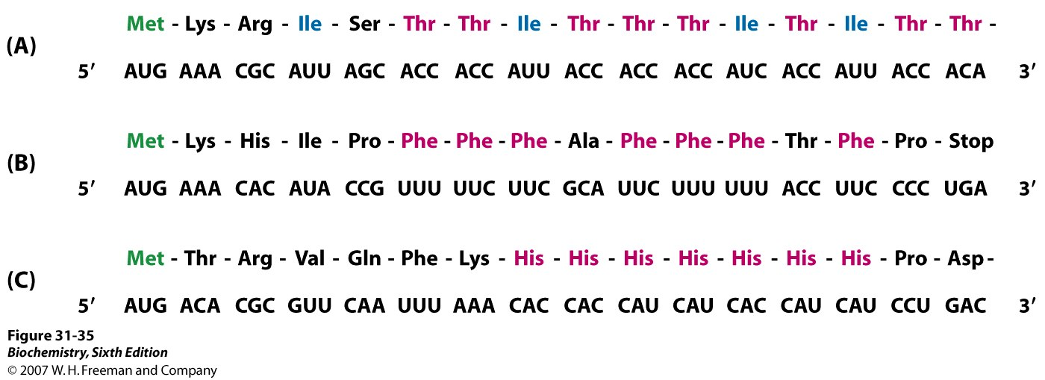
Leader sequences of other AA operons in E. coli subject to attenuation

