Slide 1
Eukaryotic Gene Regulation April 24, 2015
Richard D. Howells, PhD MSB E-643 howells@njms.rutgers.edu

Slide 2
Objectives
During this presentation you may
Catch another 40 winks, or
Understand key concepts regarding regulation of gene expression in eukaryotes

Slide 3
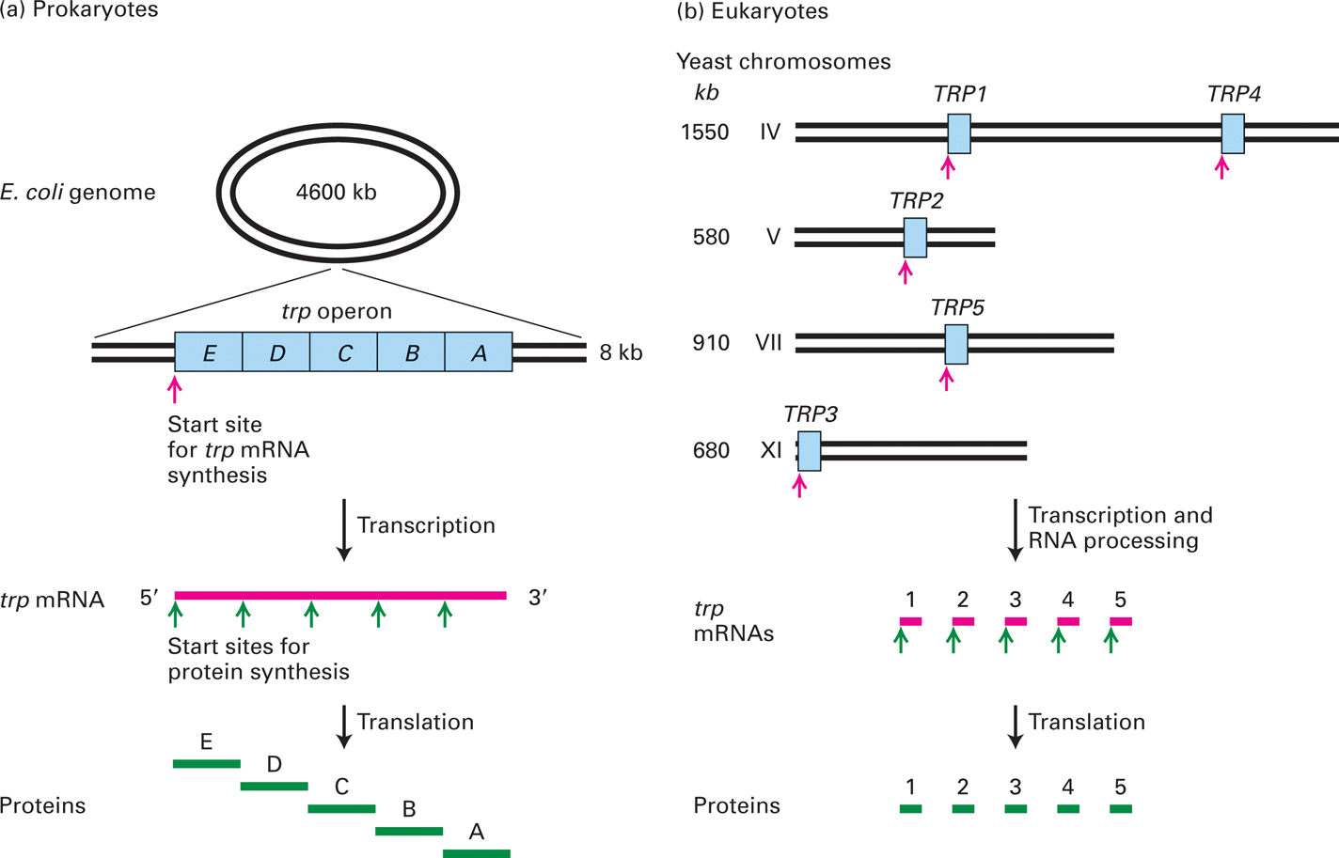
Gene organization in prokaryotes and eukaryotes
3

Slide 4
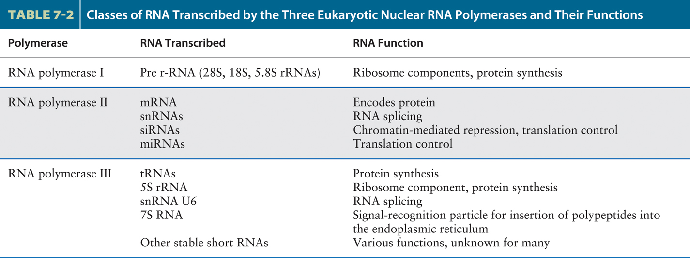
From Molecular Cell Biology, 7th ed., Lodish et al., 2012

Slide 5
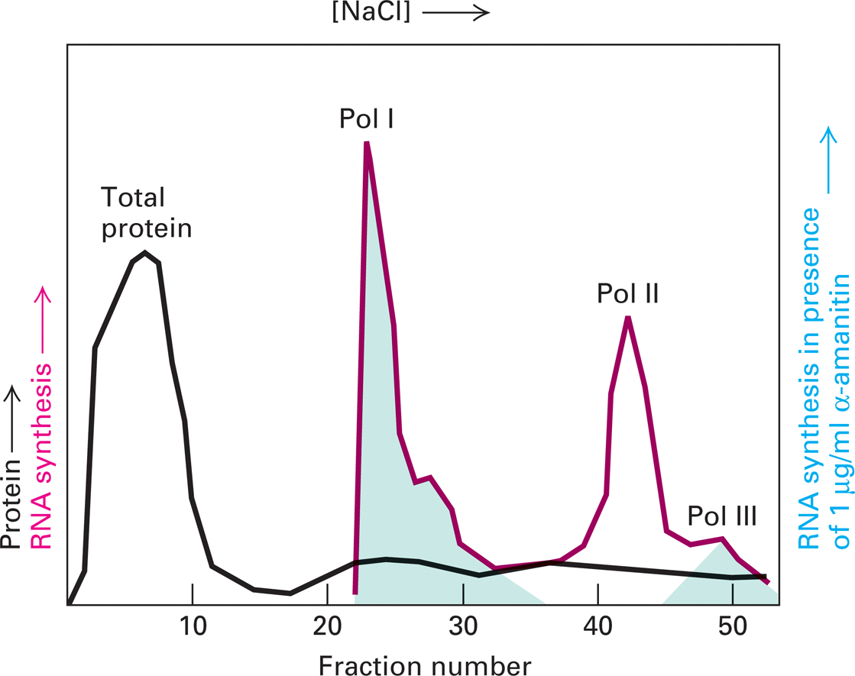
Column chromatography separates and identifies the three eukaryotic RNA polymerases, each with its own sensitivity to α-amanitin.

Slide 6
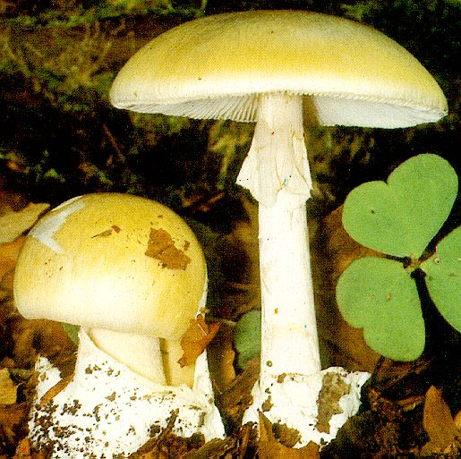
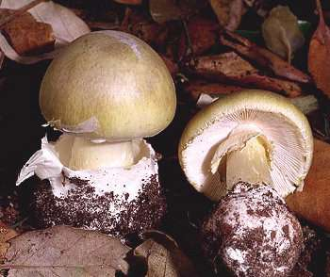
Amanita phalloides: the Death Cap
The poisonous mushroom, Amanita phalloides, contains -amanitin, a cyclic octapeptide that blocks elongation by RNA Pol II. It is lethal at 10 nM. The initial reaction to ingestion of the mushroom is gastrointestinal distress, and 48 h later the subject dies, usually from liver dysfunction.
6
6

Slide 7
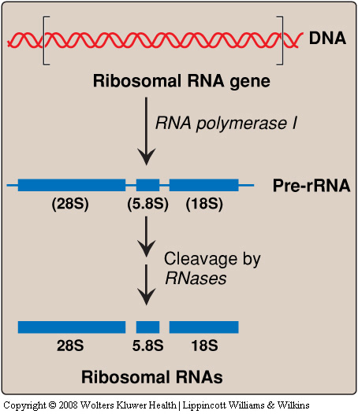

Slide 8
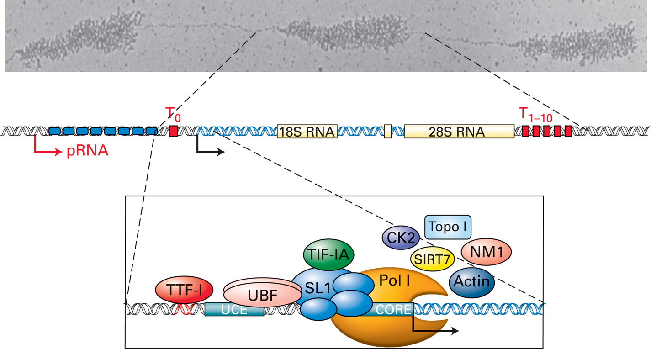
Transcription of the rRNA precursor RNA by RNA polymerase I
5.8S rRNA
8

Slide 9
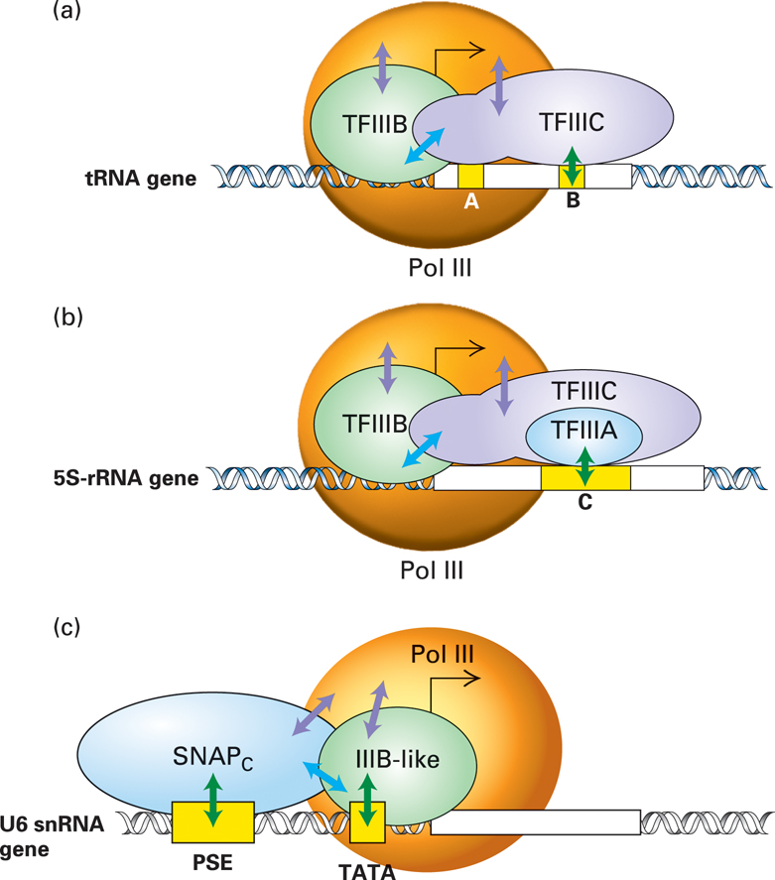
Transcription-control elements in genes transcribed by
RNA polymerase III

Slide 10
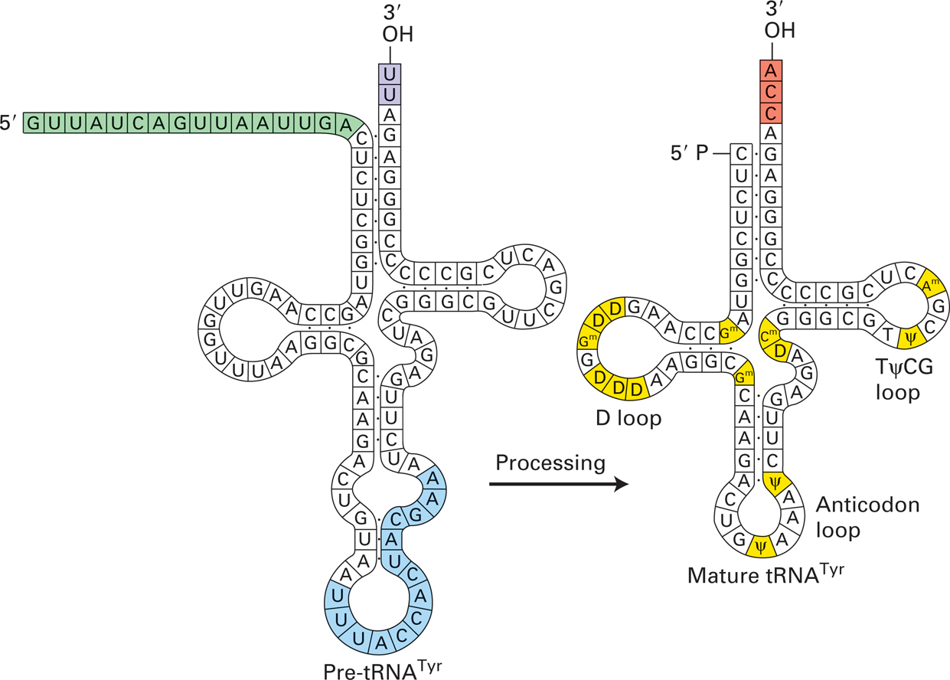
Changes that occur during the processing of tyrosine pre-tRNA.

Slide 11
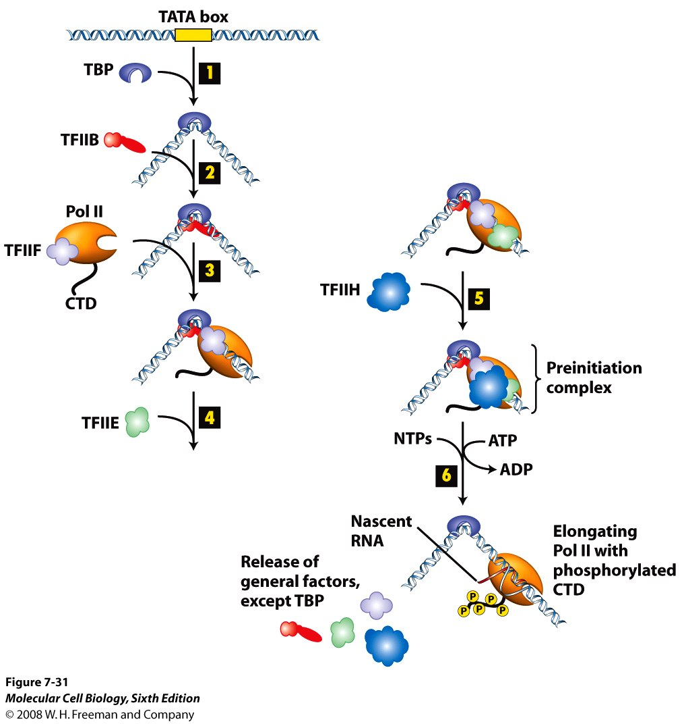
Pol II preinitiation complex
11

Slide 12
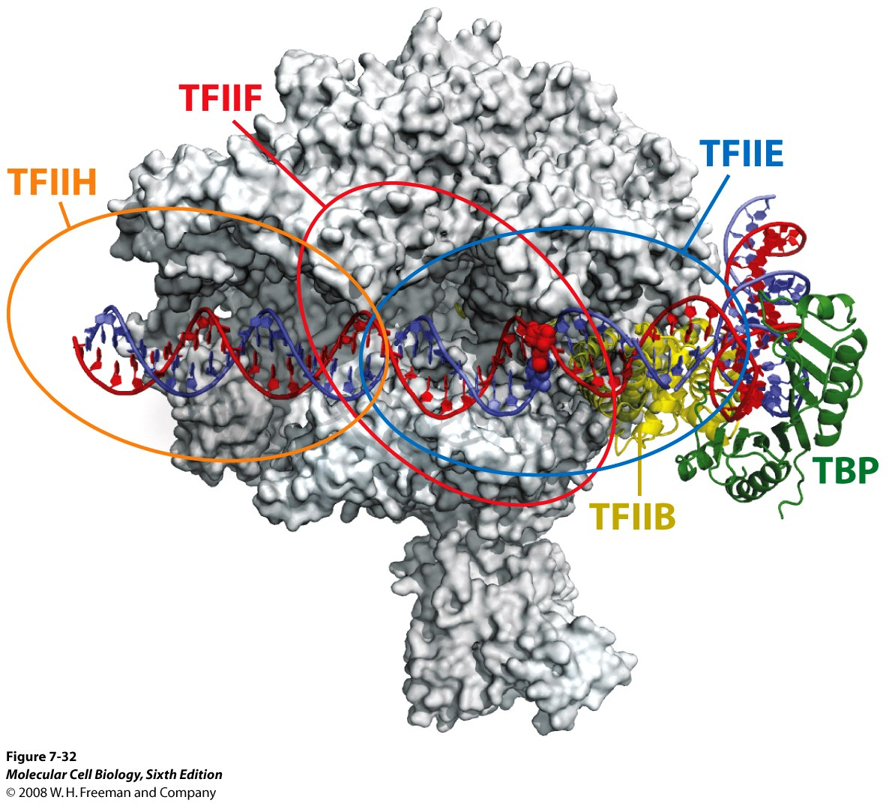
RNA Pol II
Preinitiation
Complex
12

Slide 13
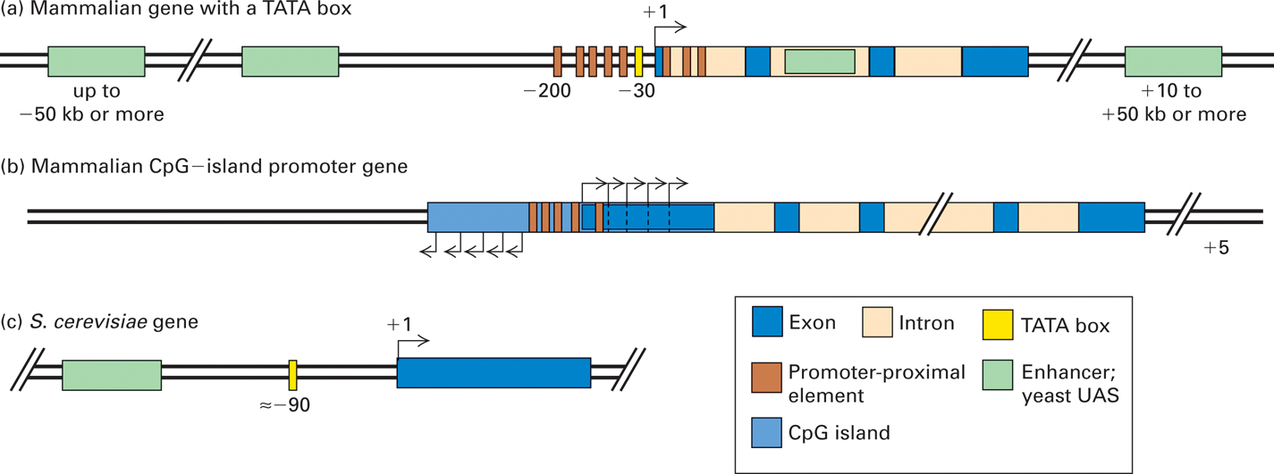
General organization of control elements that regulate gene expression in multicellular eukaryotes and yeast
13

Slide 14
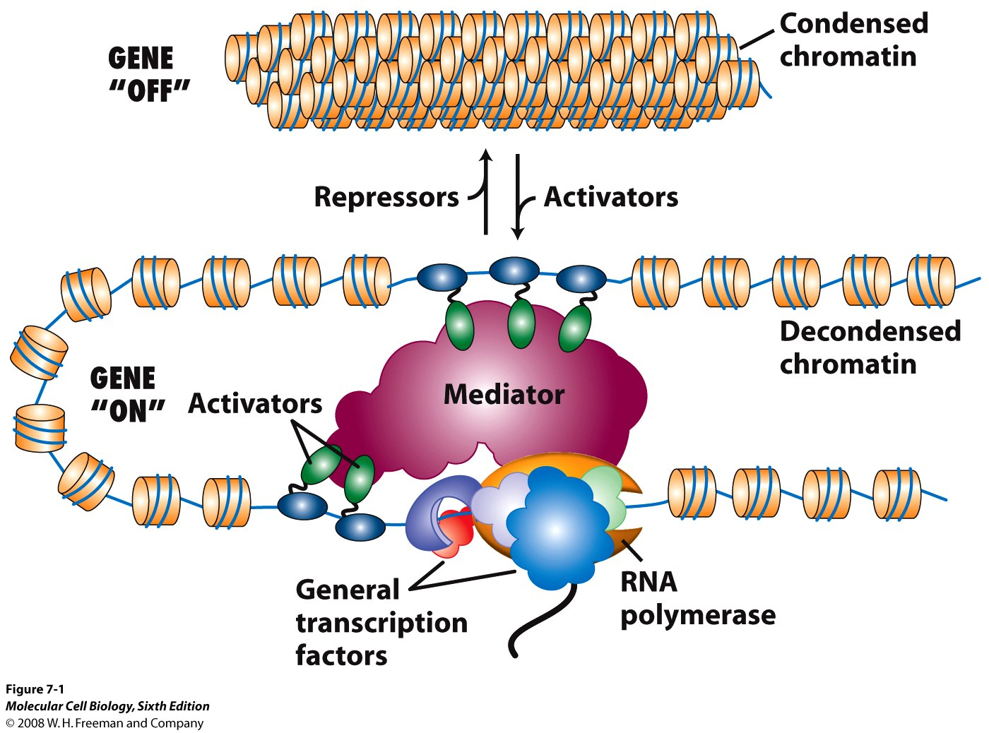
Model of several DNA-bound activators interacting with a single mediator complex
(Purple- TBP, Red- TFIIB, Blue- TFIIH, Green- TFIIE)
14

Slide 15
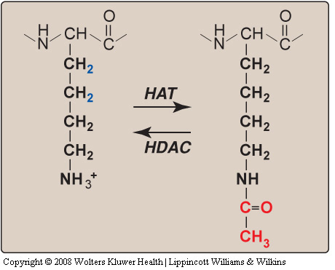
Regulation of gene expression via
post-translational modification of histone side chains
Acetylated
Lysine
Lysine
HAT: histone acetyltransferase activity
HDAC: histone deacetylase activity
15

Slide 16
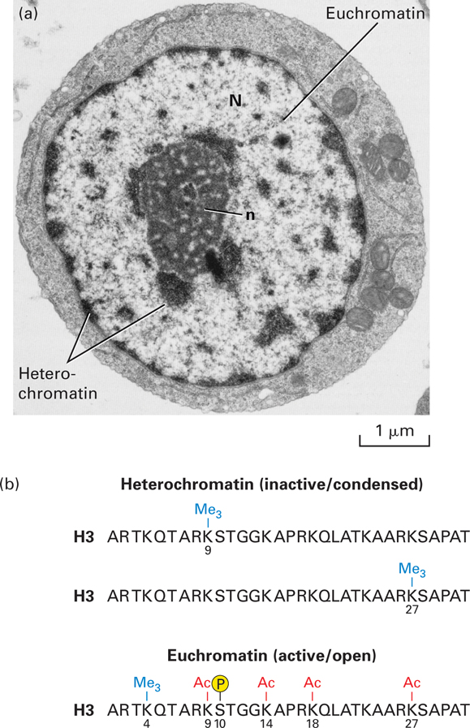
Heterochromatin versus euchromatin

Slide 17
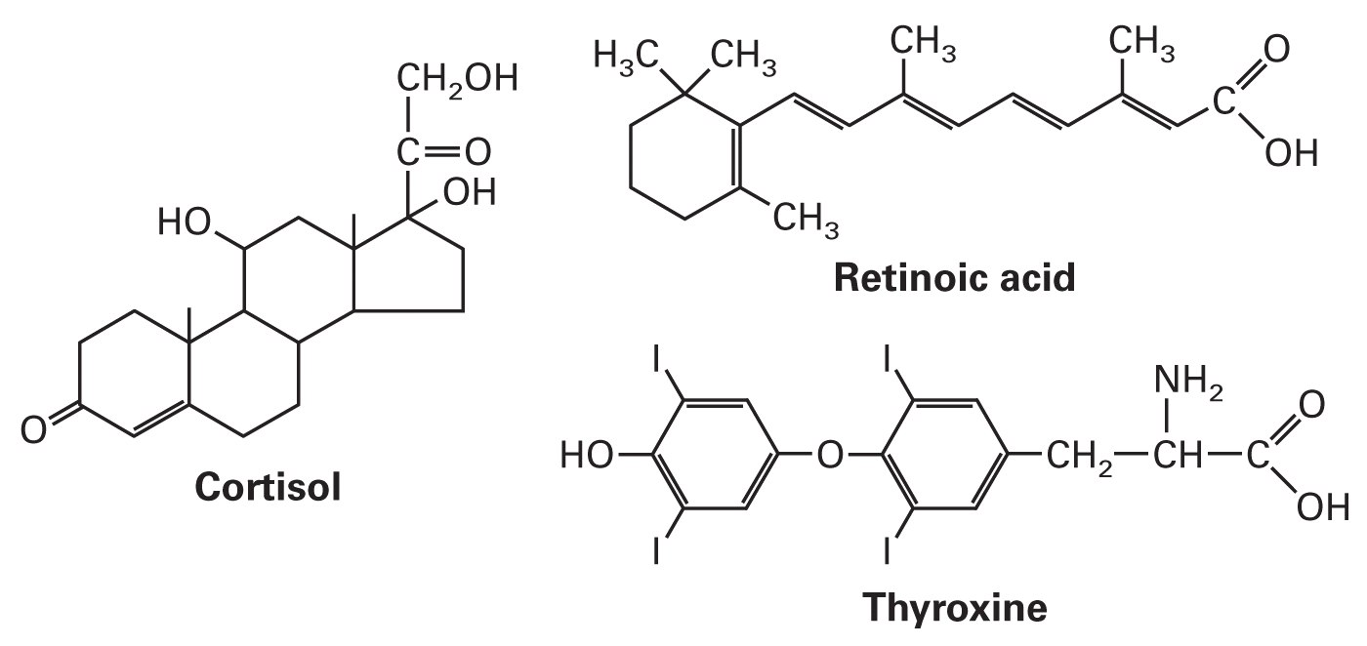
Hormones that bind specific receptors that are stimulated to become ligand-activated transcription factors
These and related lipid-soluble hormones bind to receptors located in the nucleus and cytoplasm. The hormone-receptor complex functions as a transcription factor in the nucleus.

Slide 18
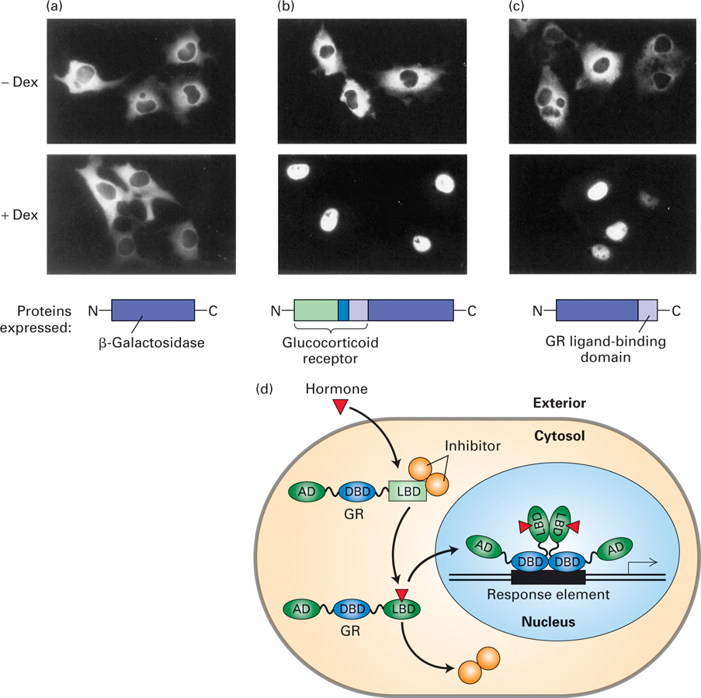
Fusion proteins
from expression vectors
demonstrate that
the hormone-binding
domain
of the
glucocorticoid
receptor (GR)
mediates translocation
to the nucleus
in the presence
of hormone
18
AD: activation domain; DBD: DNA binding domain; LBD: ligand binding domain

Slide 19
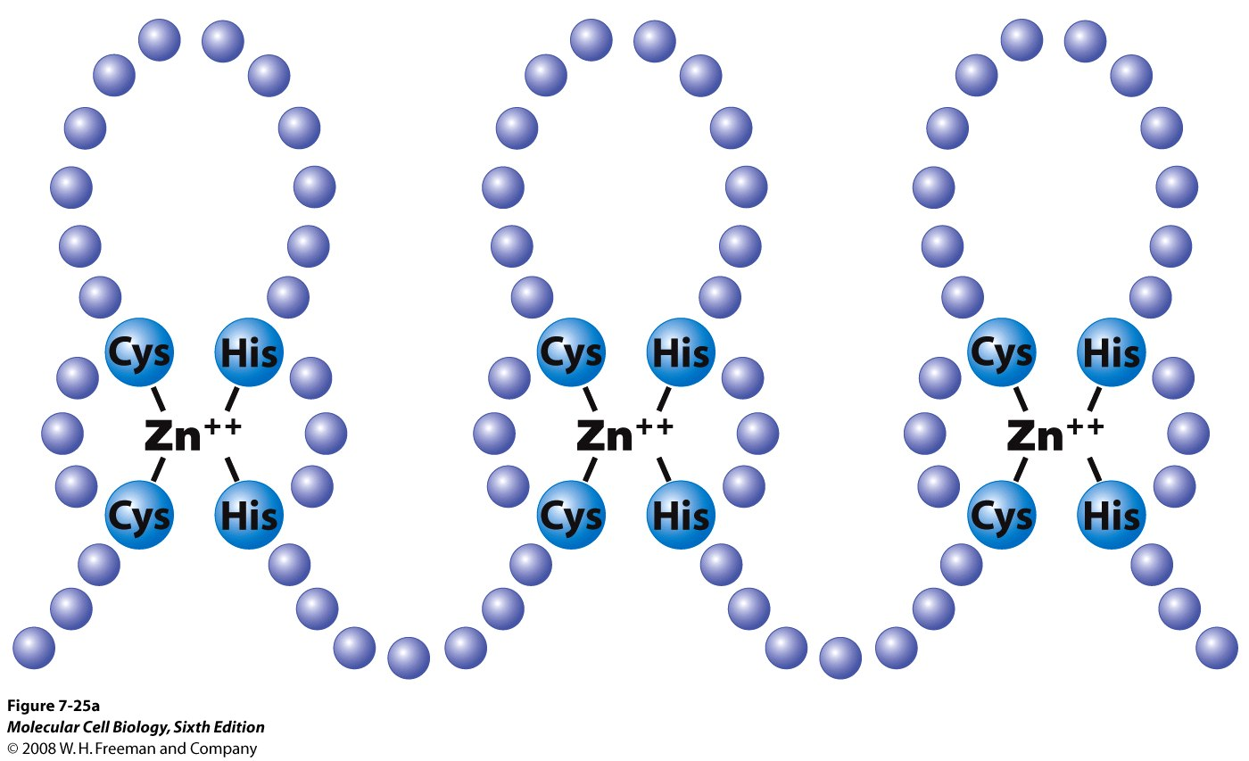
Zinc-finger domain

Slide 20
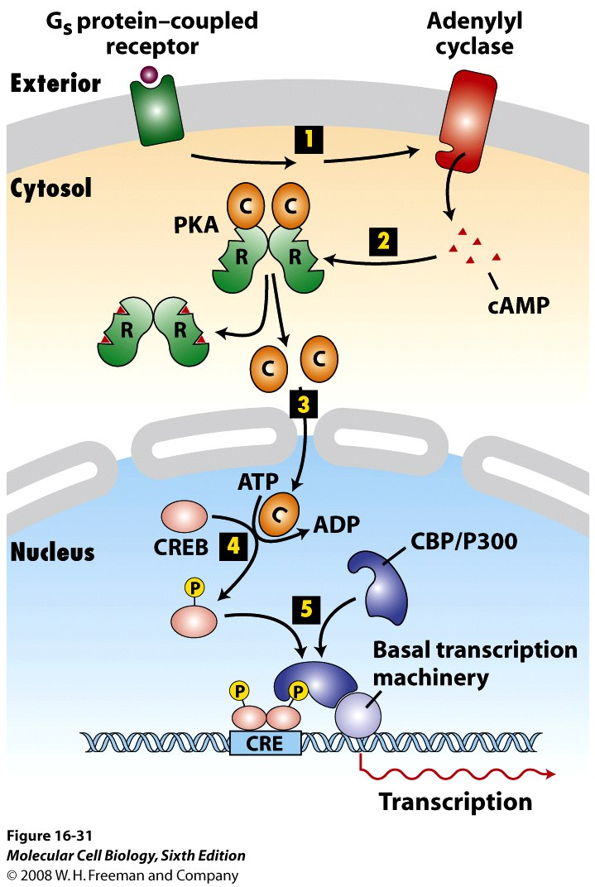
Activation of gene expression via elevated cAMP and phosphorylation of CREB
CRE: cAMP response element;
CREB: CRE binding protein; CBP: CREB binding protein

Slide 21
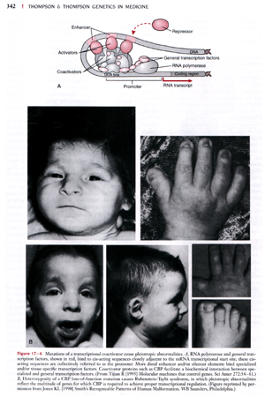
Mutation of CBP causes pleiotropic developmental abnormalities: Rubinstein-Taybi syndrome

Slide 22
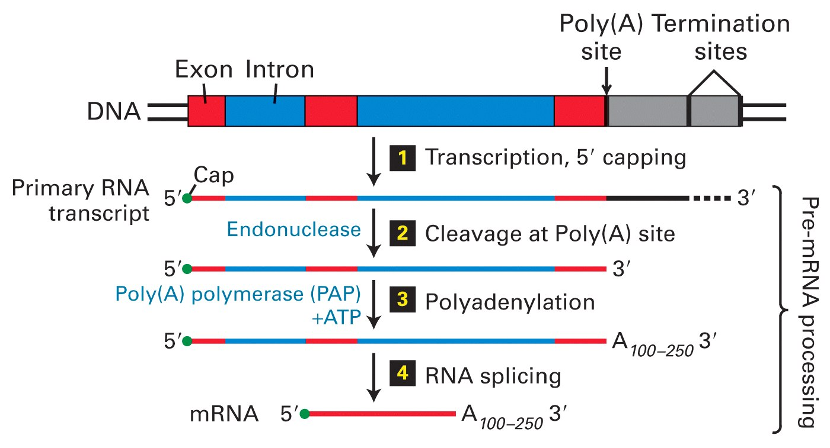
Overview of mRNA processing in eukaryotes
22

Slide 23
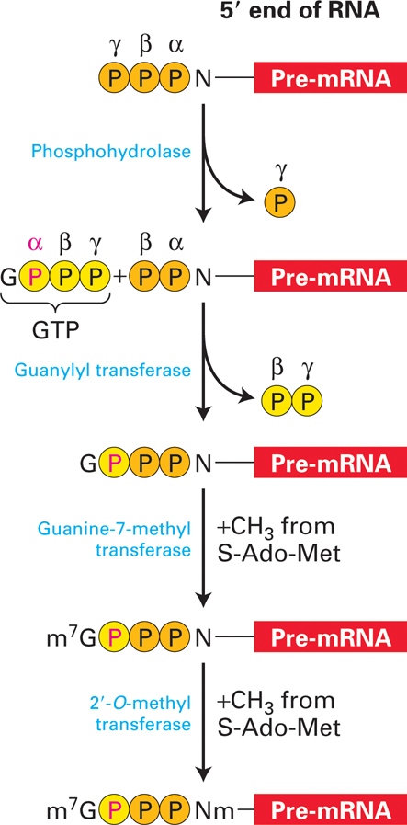
Synthesis of 5’-cap
on eukaryotic mRNAs
(N refers to the nucleotide
at the 5’-end of the
pre-mRNA transcript)
23

Slide 24
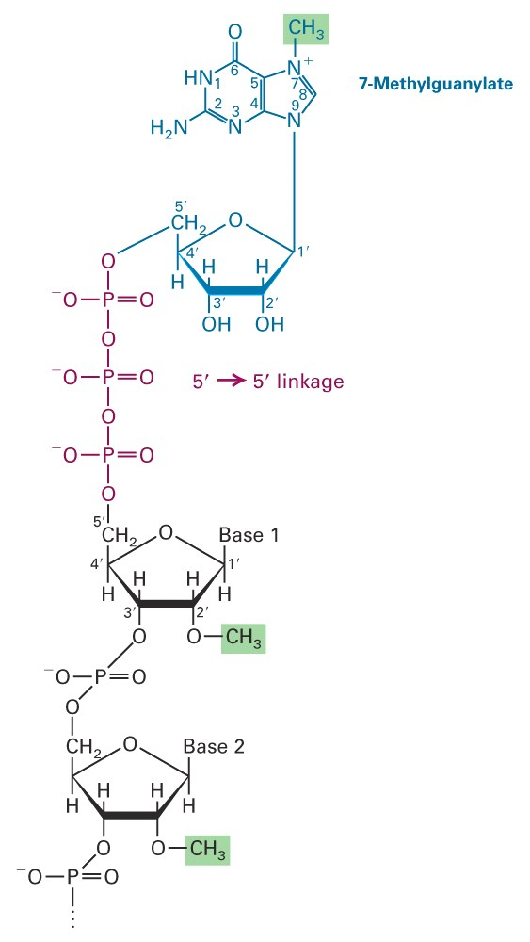
Structure of the 5’-methylated cap of eukaryotic mRNA
24

Slide 25
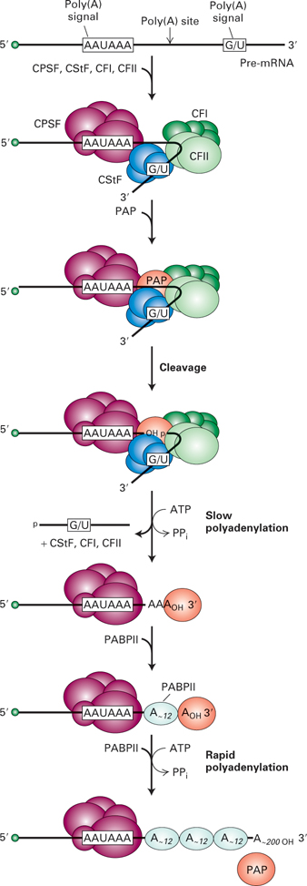
Model for cleavage and polyadenylation of pre-mRNAs in mammalian cells
CPSF- cleavage and
polyadenylation specificity factor
CStF- cleavage stimulatory factor
CFI, CFII- cleavage factors
PAP- poly(A) polymerase
PABP II- poly(A) binding protein II protein
25

Slide 26
Model of spliceosome-mediated splicing of pre-mRNA
26
26

Slide 27
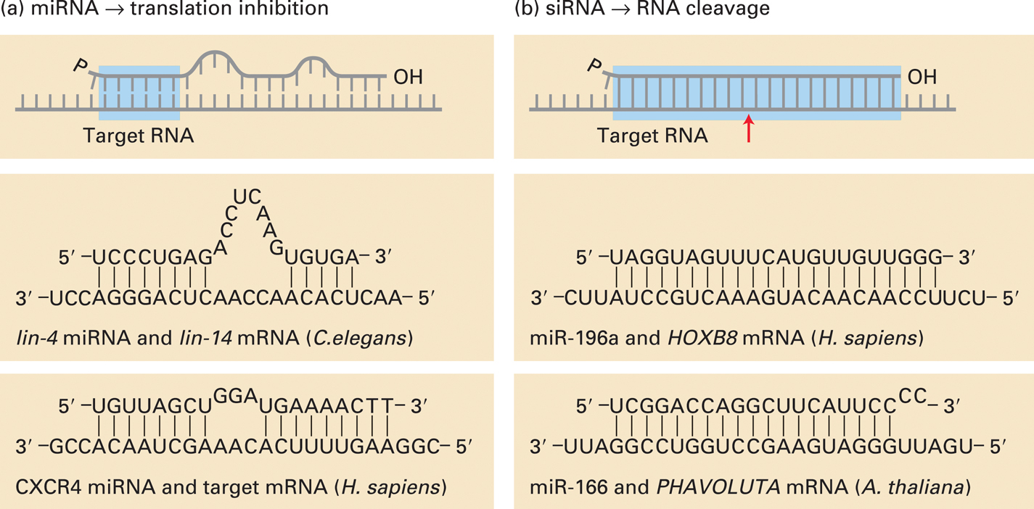
Base pairing with target RNAs distinguishes miRNA and siRNA
27
27

Slide 28
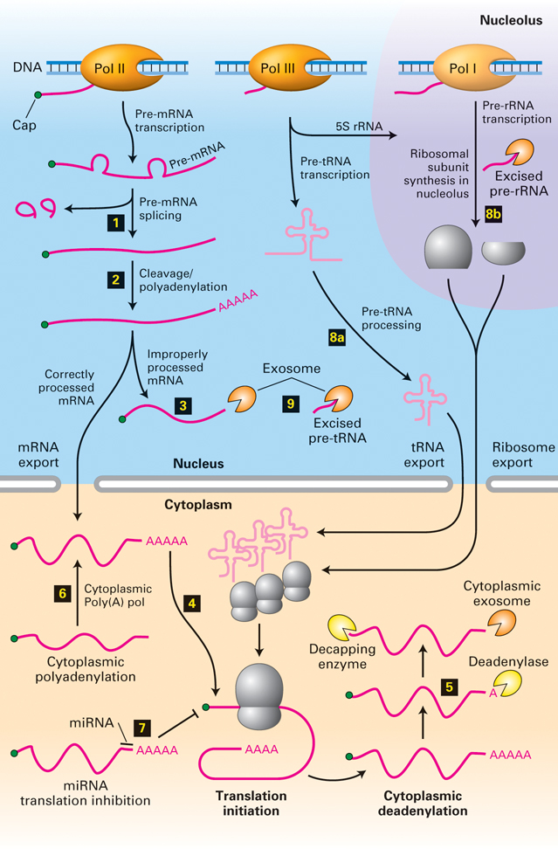
Overview of RNA
processing and
posttranscriptional
gene control
28
28

