Slide 1
Recombinant DNA Dr. R. Howells May 1, 2015
Dental Biochem Lecture 38

Slide 2
TECHNIQUES IN MOLECULAR BIOLOGY - OUTLINE
Protein fractionation
Protein electrophoresis and “Western Blotting”
Mass spectrometry for protein identification and sequencing
Molecular cloning
Polymerase chain reaction and DNA sequencing
Northern and Southern blotting
Studying DNA-protein interactions: gel shift assay and chromatin immunoprecipitation
Determining gene expression: Differential Display, microarrays, and Quantitative Real Time Reverse transcription PCR
Site-directed mutagenesis and blocking gene expression: Knock-out mice, RNA Interference, CRISPR-Cas
Suggested reading:
Lippincott’s Illustrated Reviews: Biochemistry, 6th ed., p. 465-488.
Meisenberg and Simmons, 3rd ed. p. 158-180

Slide 3
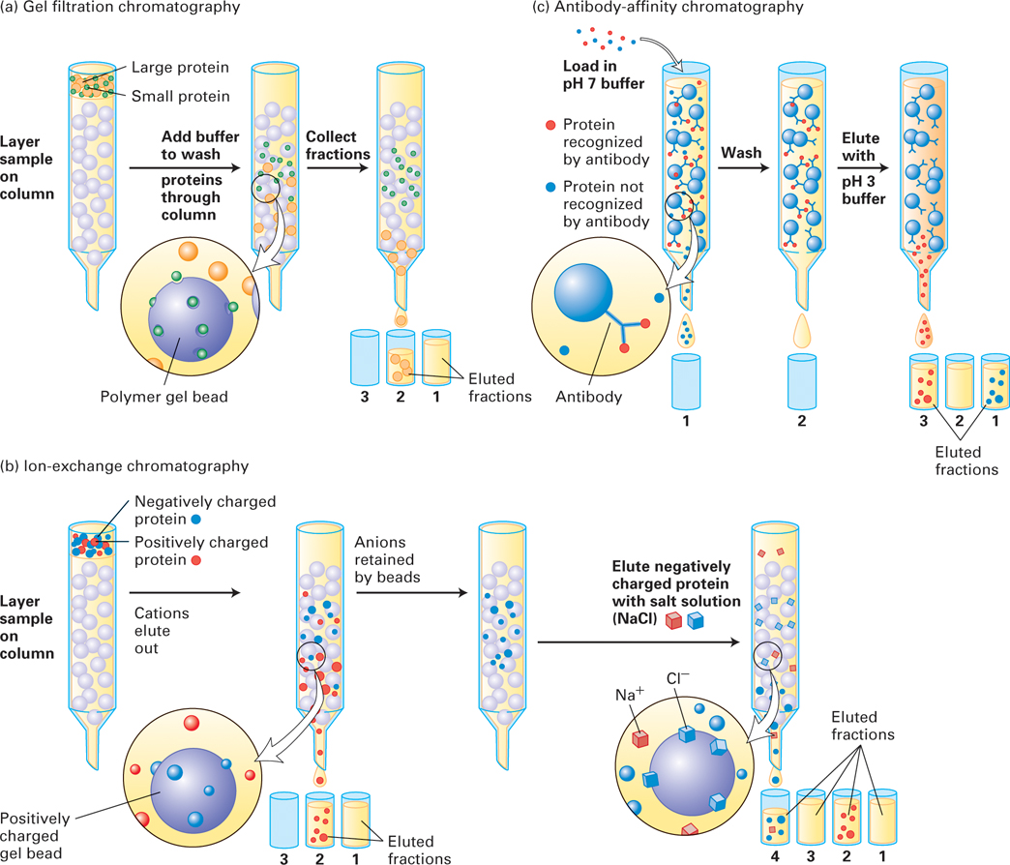
Three commonly used liquid chromatographic techniques separate proteins on the basis of mass, charge, or affinity for a specific binding partner

Slide 4
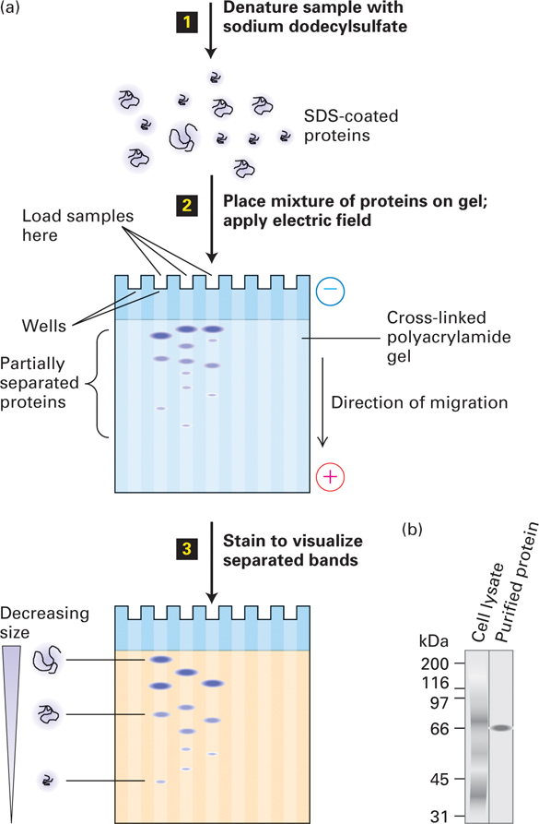
SDS-polyacrylamide gel electrophoresis (SDS-PAGE) separates proteins primarily on the basis of their masses

Slide 5
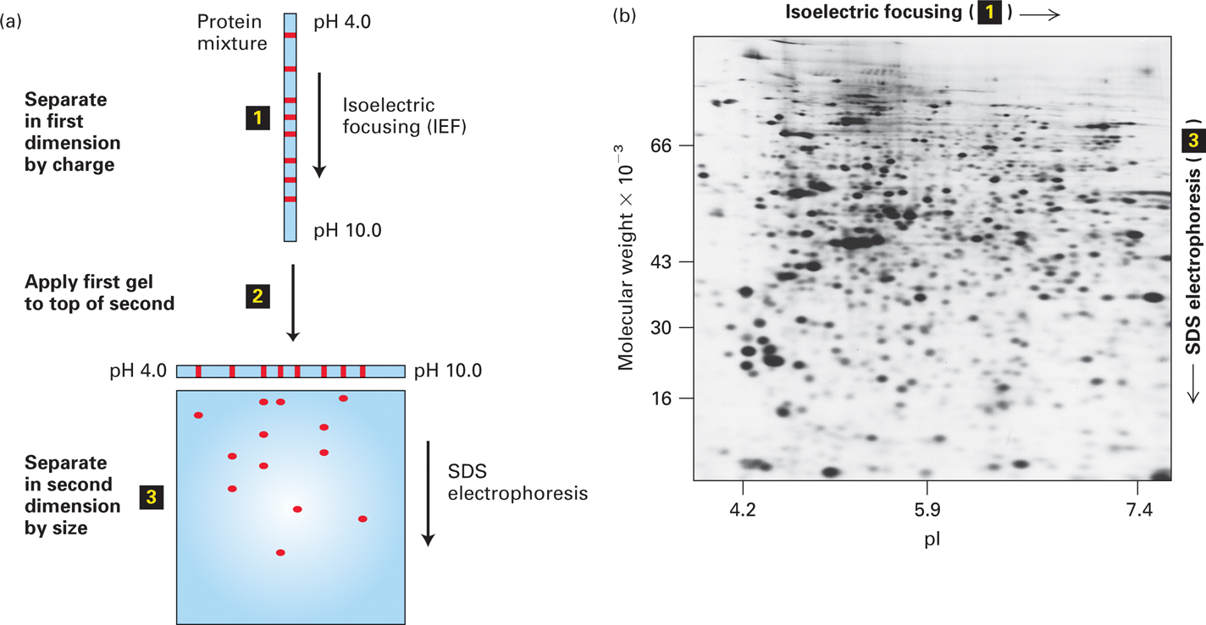
Two-dimensional gel electrophoresis separates proteins on the basis of charge and mass

Slide 6
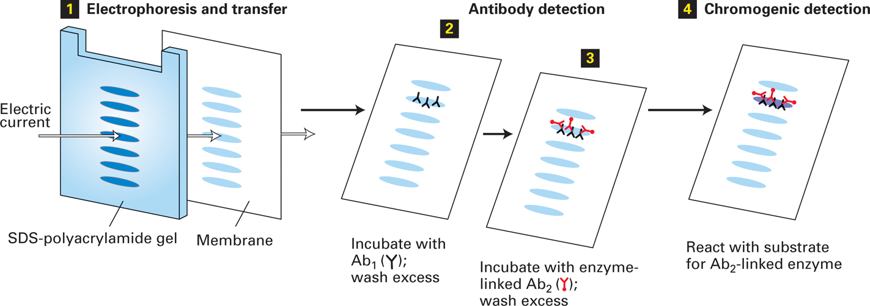
Western blotting (immunoblotting) combines several techniques
to resolve and detect a specific protein.

Slide 7
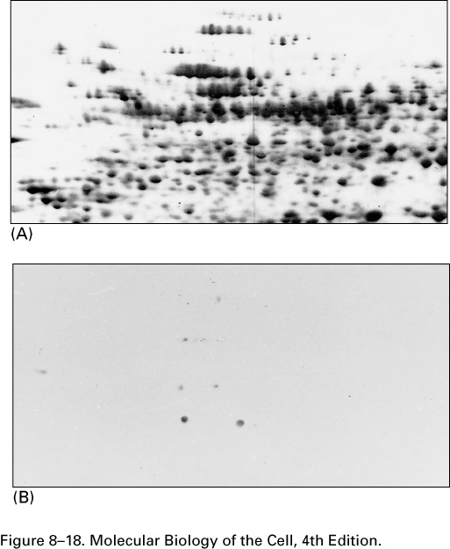
2-D PAGE
Western blotting
with P-Thr
specific antibodies

Slide 8
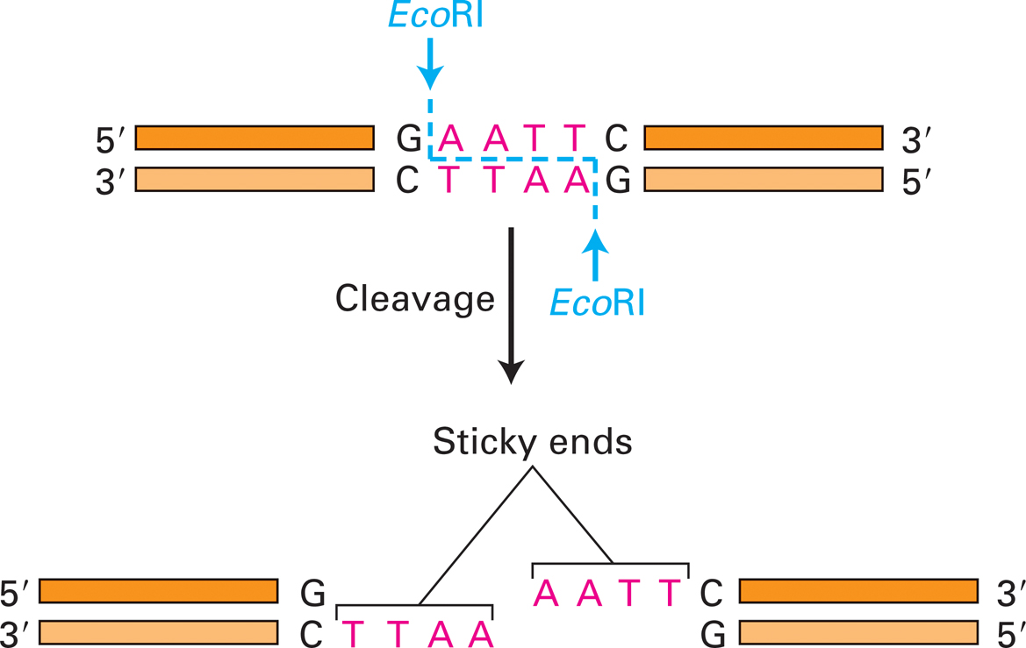
Toward molecular cloning:
Cleavage of DNA by the restriction endonuclease EcoRI

Slide 9
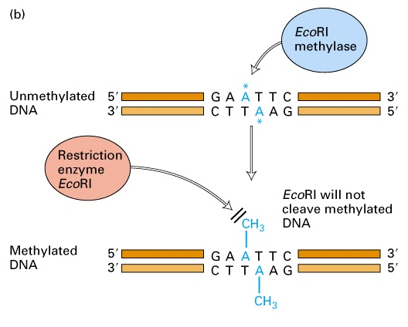
For each restriction enzyme, bacteria also produce a site-specific methylase that protects their own DNA from cleavage

Slide 11
Examples of True Palindromes
Able was I ere I saw Elba.
Madam in Eden, I’m Adam.
As I pee, sir, I see Pisa!
A man, a plan, a canal: Panama.

Slide 12
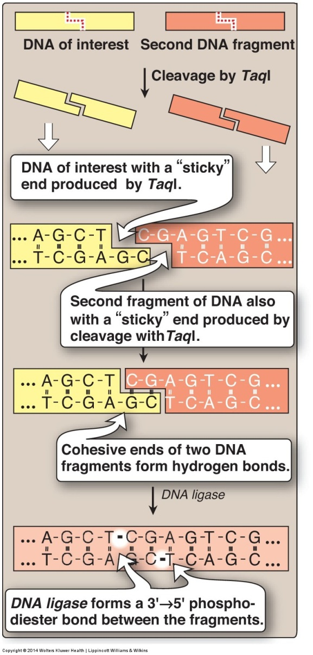
Formation of recombinant
DNA following ligation
of restriction fragments

Slide 13
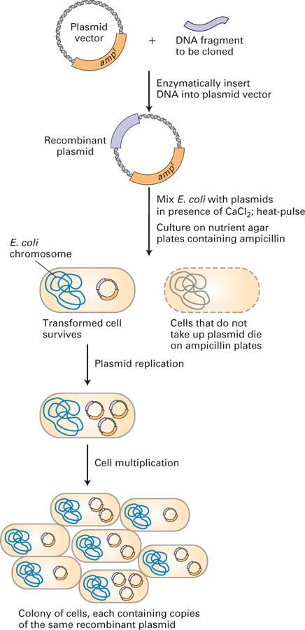
DNA cloning in a
plasmid vector
permits amplification
of a DNA fragment

Slide 14
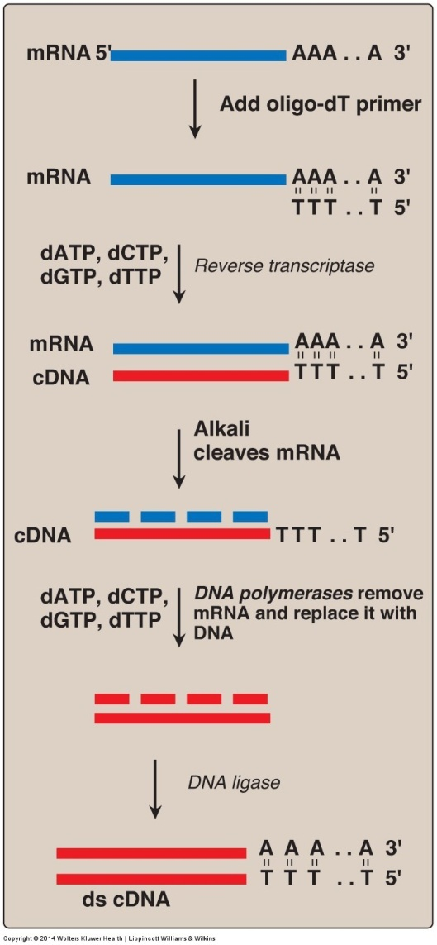
Synthesis of cDNA
from mRNA using
reverse transcriptase

Slide 15
TECHNIQUES IN MOLECULAR BIOLOGY
4. Southern and Northern blotting
Southern and Northern blotting are used to identify species of DNA and RNA, respectively. The nucleic acids are separated by electrophoresis and then transferred to a filter by a blotting procedure. The presence of specific nucleic acid sequences can be identified by hybridization with a radioactive or fluorescent probe.

Slide 16
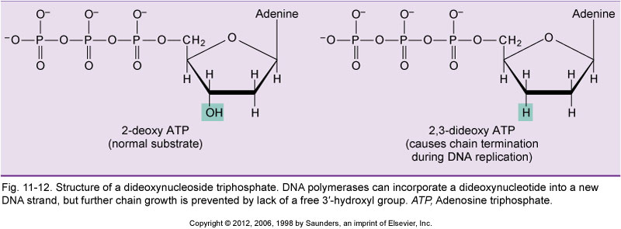
DNA sequencing using the Sanger
dideoxy chain termination method

Slide 17
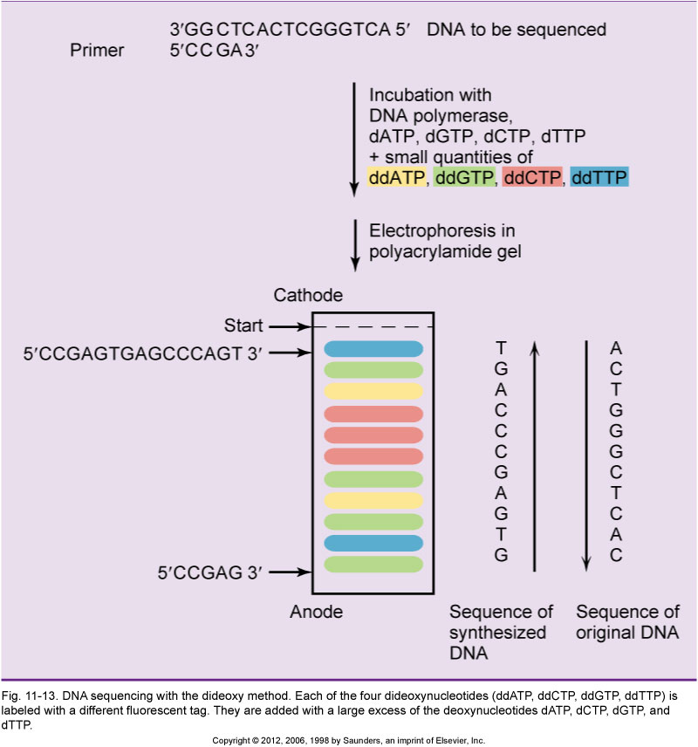

Slide 18
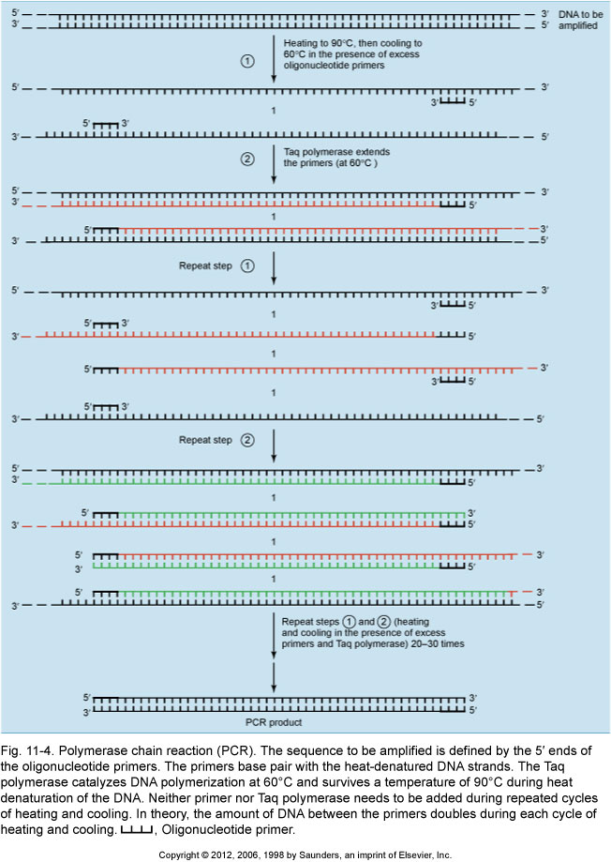
The
Polymerase
Chain
Reaction
(PCR)

Slide 19
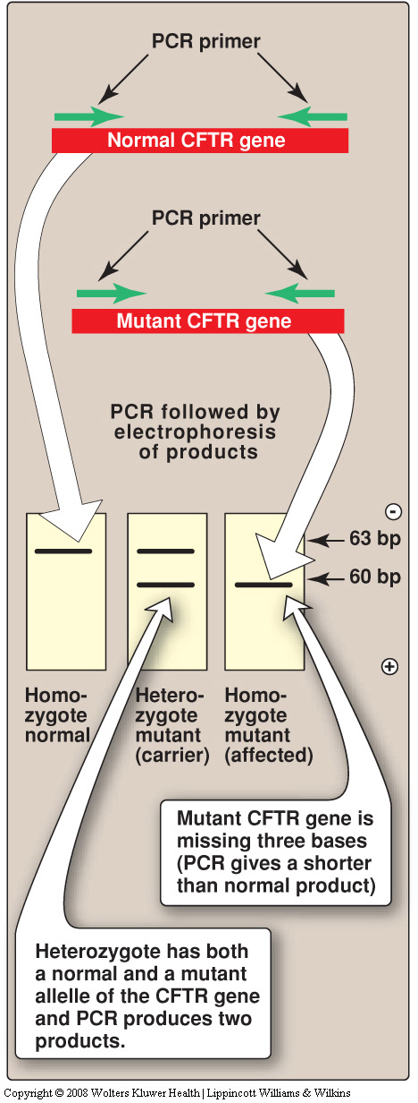
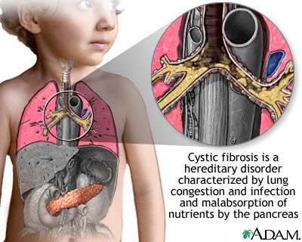
PCR to screen for cystic fibrosis
CF is an autosomal recessive disease that
affects the pulmonary and digestive
systems. In >70% of patients, a 3 base
deletion in the coding region of the CFTR
gene (cystic fibrosis transmembrane
conductance regulator) results in a F508
mutation that prevents normal folding of the
channel, leading to destruction of the protein
by the proteasome.
The 3 bp deletion in the CFTR gene can be
detected by PCR.

Slide 20
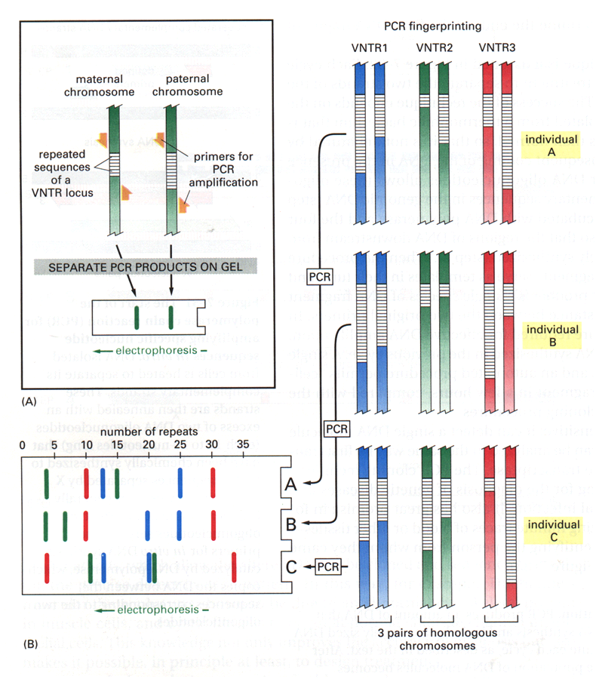
Assay of Variable Number of Tandem Repeats

Slide 21
TECHNIQUES IN MOLECULAR BIOLOGY
8. Determining changes in gene expression between 2 or more samples (eg., normal tissue vs. cancer, +/- drug treatment, etc.): Microarrays, RNA Seq, and Quantitative Real Time Reverse Transcription PCR

Slide 22
Microarray analysis of
differential gene expression
using DNA microarrays (chips)

Slide 23
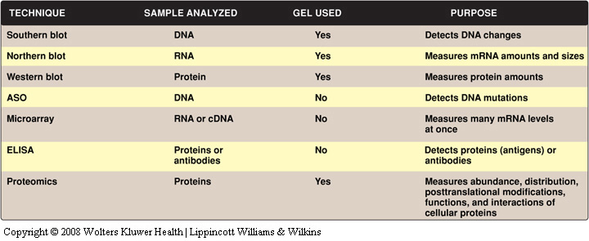

Slide 24
A sampling of recombinant proteins used clinically

Slide 25
CRISPR-Cas9 for Genome Engineering
Recent advances in genome engineering technologies based on the CRISPR-associated RNA-guided endonuclease Cas9 are enabling the systematic interrogation of mammalian genome function. Analogous to the search function in modern word processors, Cas9 can be guided to specific locations within complex genomes by a short RNA search string. Using this system, DNA sequences within the endogenous genome and their functional outputs are now easily edited or modulated in virtually any organism of choice. Cas9-mediated genetic perturbation is simple and scalable, empowering researchers to elucidate the functional organization of the genome at the systems level and establish causal linkages between genetic variations and biological phenotypes. Derived from a remarkable microbial defense system, Cas9 is driving innovative applications from basic biology to biotechnology and medicine.
Of the current generation of genome editing technologies, the most rapidly developing is the class of RNA-guided endonucleases known as Cas9 from the microbial adaptive immune system CRISPR (clustered regularly interspaced short palindromic repeats), which can be easily targeted to virtually any genomic location of choice by a short RNA guide.
Hsu, Lander and Feng, Cell 157, June 5, 2014 ª2014 Elsevier Inc.

Slide 26
(C) The Cas9 nuclease from the microbial CRISPR adaptive immune system is localized to specific DNA sequences via the guide sequence on its guide RNA (red), directly base-pairing with the DNA target. Binding of a protospacer-adjacent motif (PAM, blue) downstream of the target locus helps to direct Cas9-mediated DSBs.

Slide 27
Gene therapy of adenosine
deaminase deficiency

