Slide 1
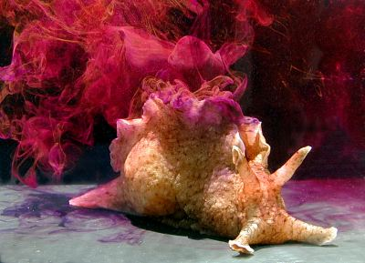
Neurobiochemistry May 13, 2015
Richard D. Howells, PhD
Science is a wonderful thing if one does not have to earn one’s living at it.
Albert Einstein

Slide 2
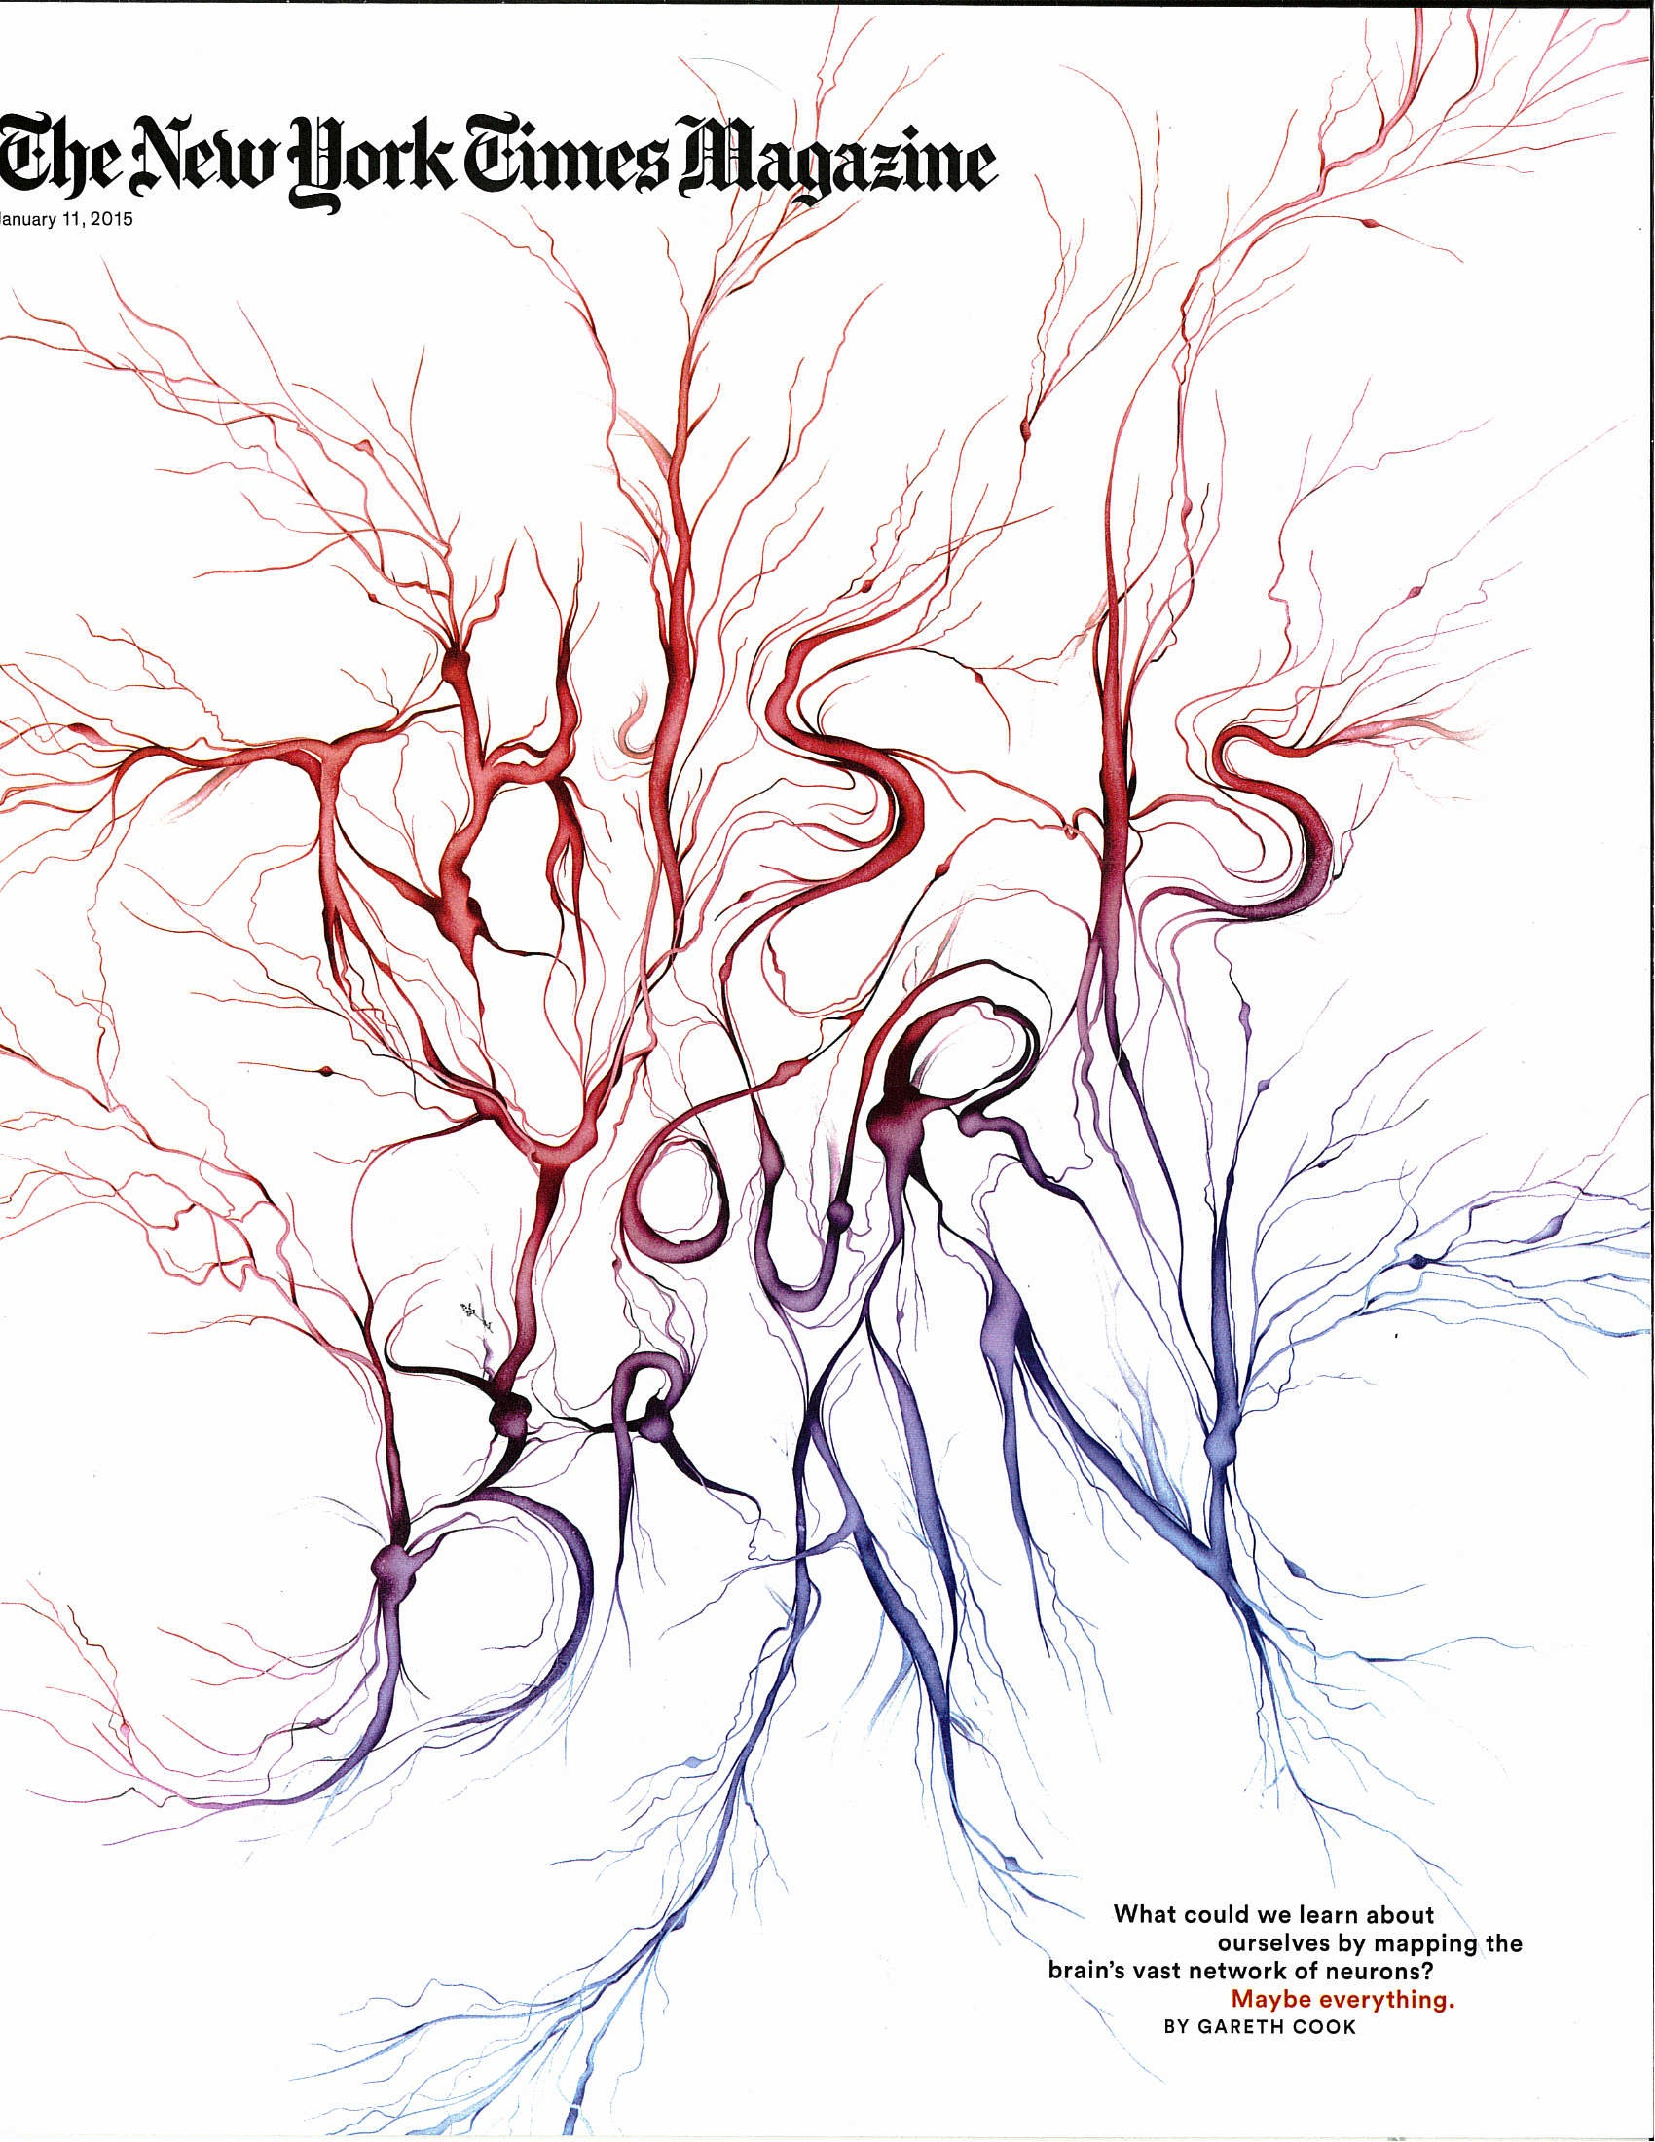
The 1.3 kg human brain contains 10¹¹ neurons and >10¹⁴ synapses, and 10¹² glial cells (astrocytes and oligodendrocytes)

Slide 3
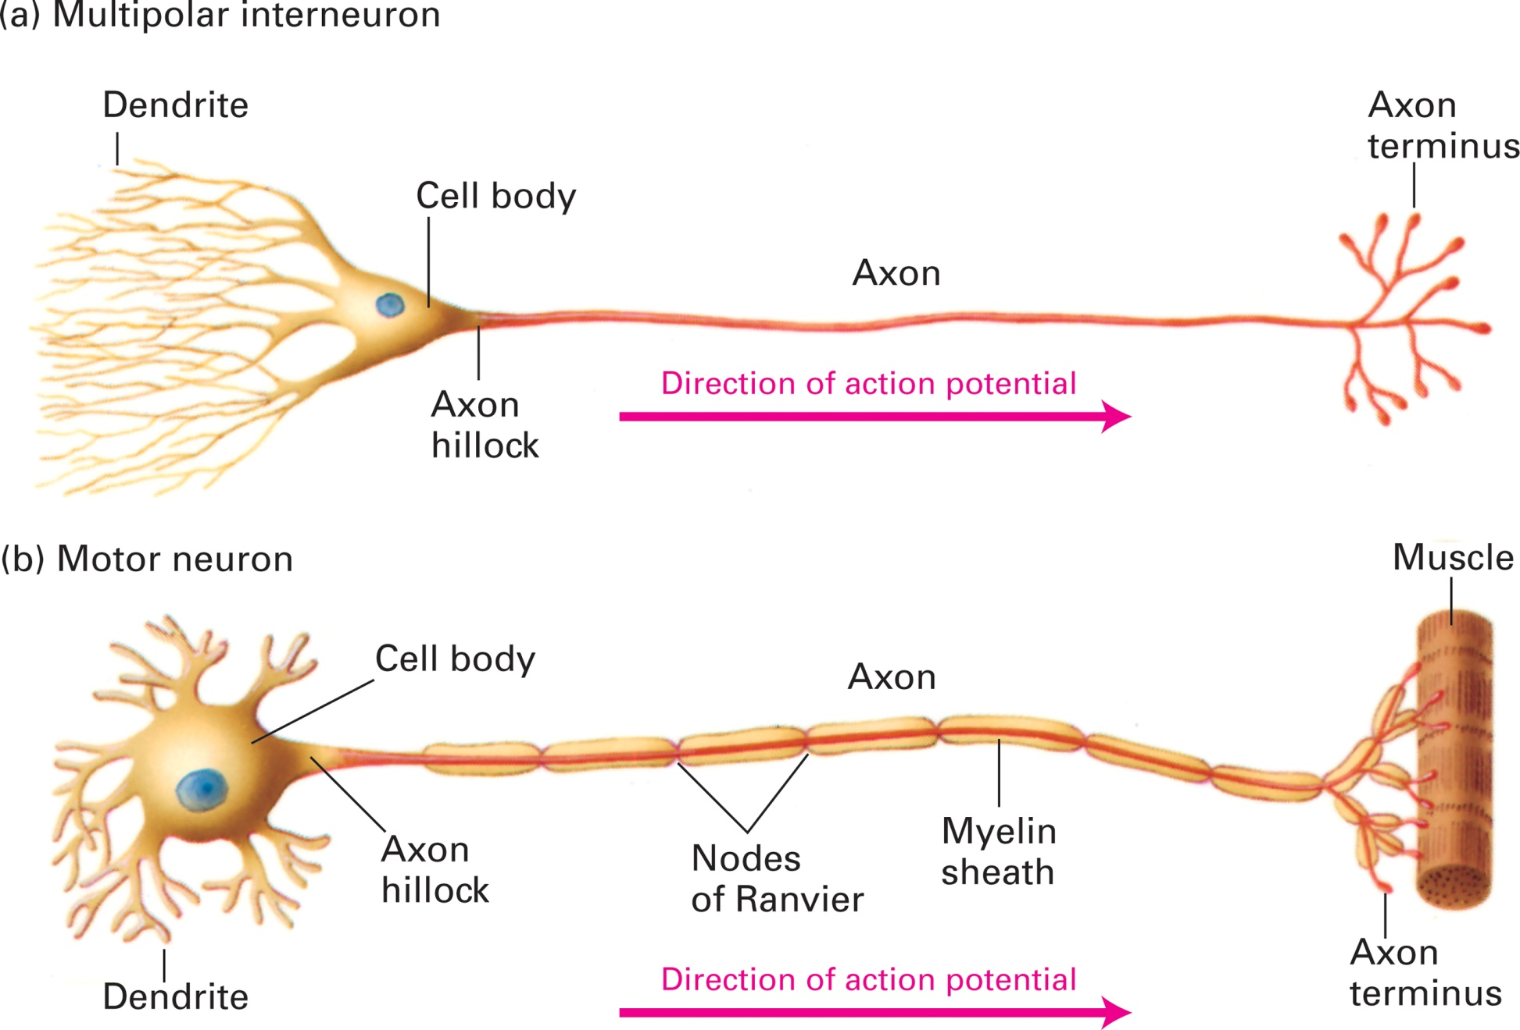
Typical morphology of two types of mammalian neurons

Slide 4
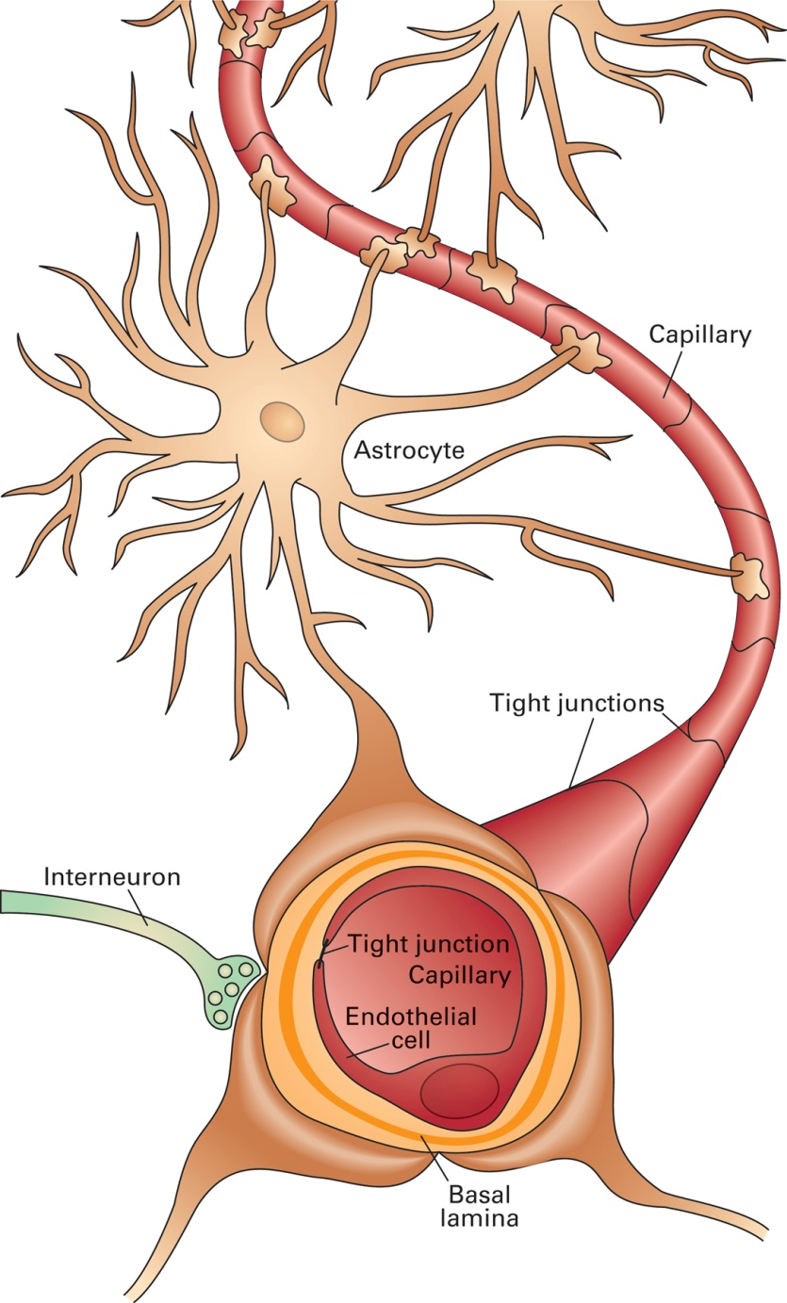
Astrocytes interact with endothelial cells at the blood-brain barrier

Slide 5
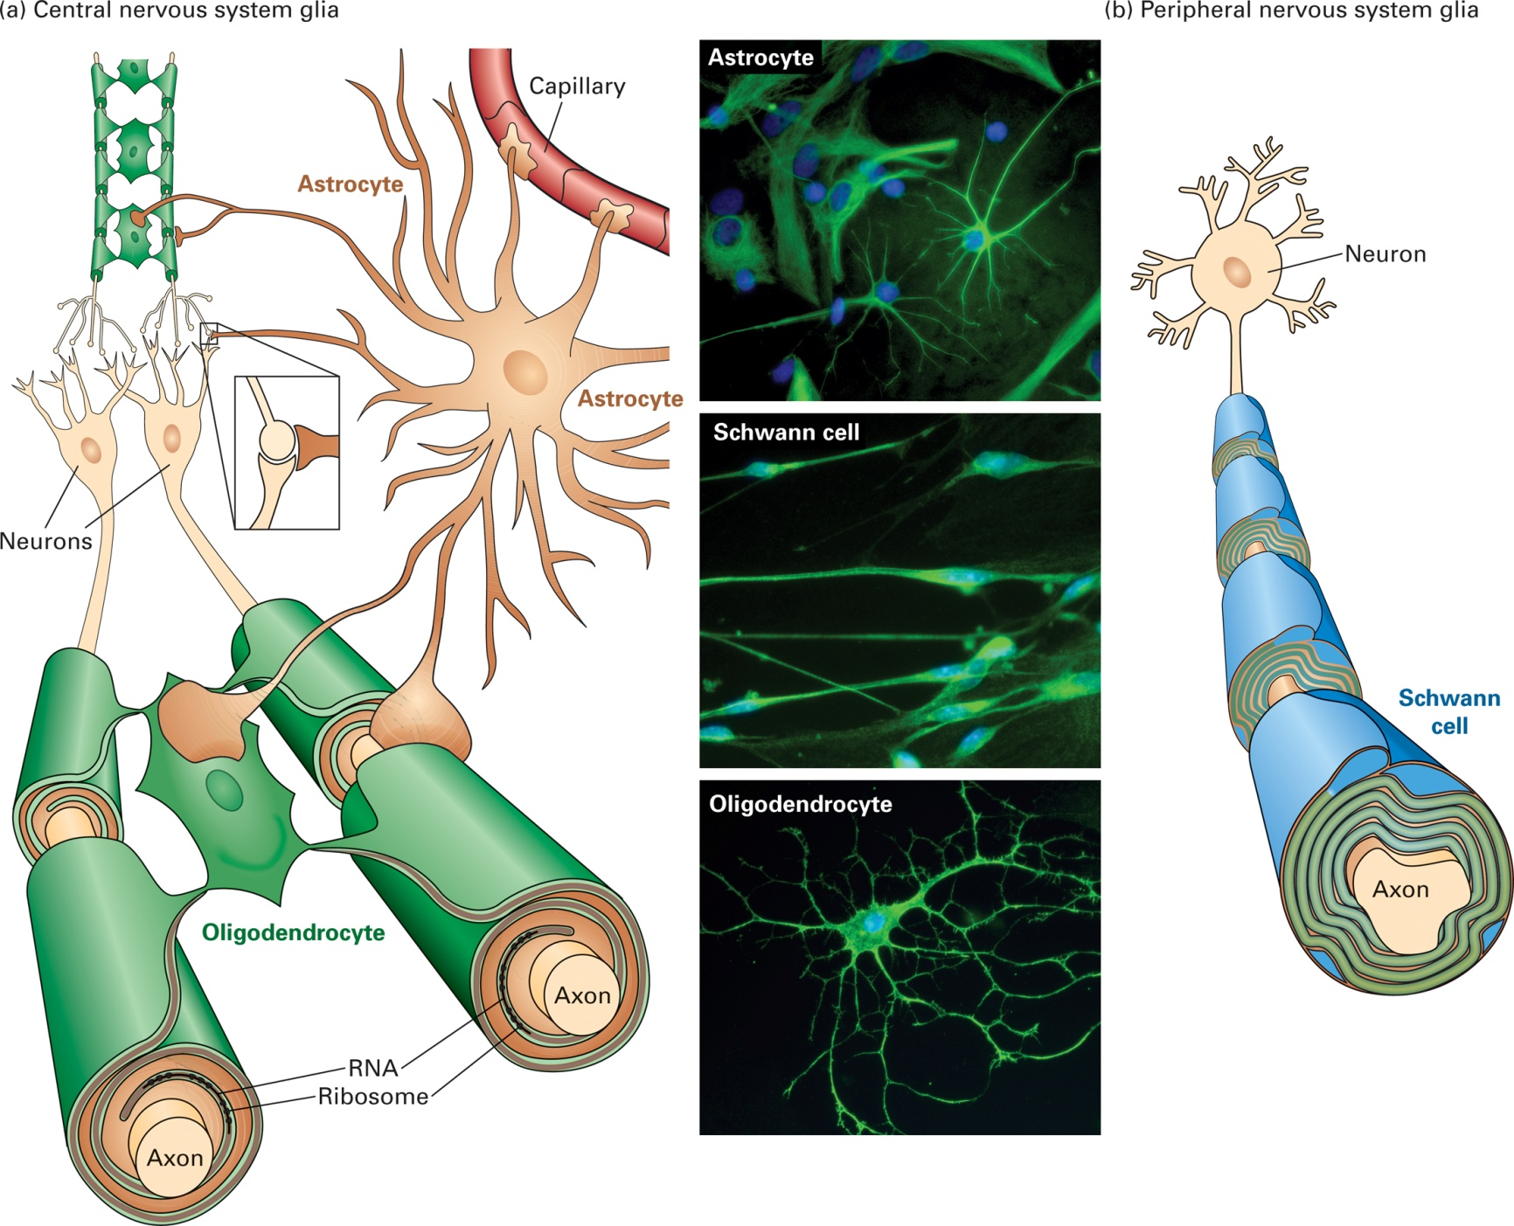
Three types of glial cells

Slide 6
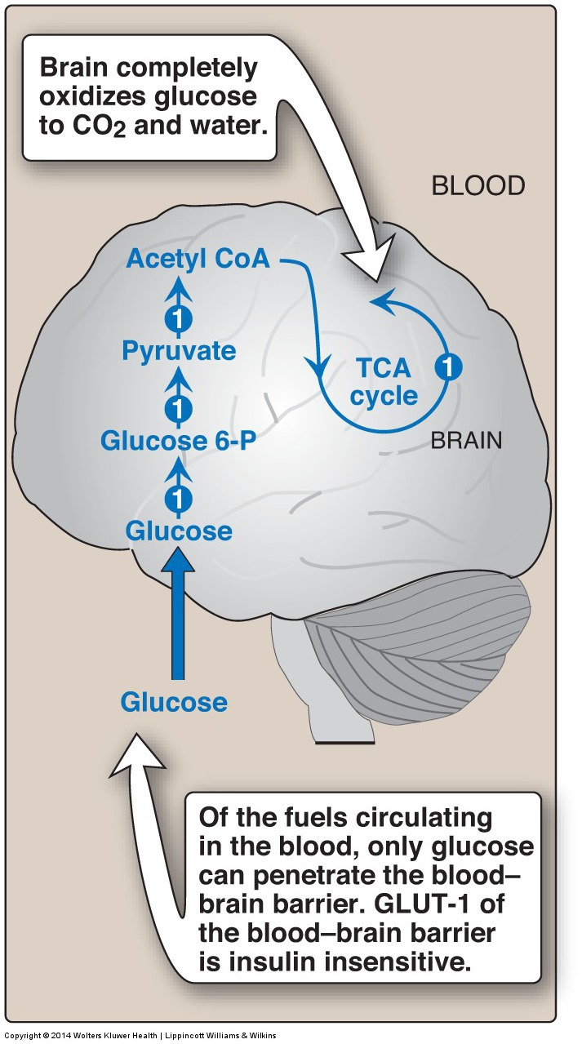
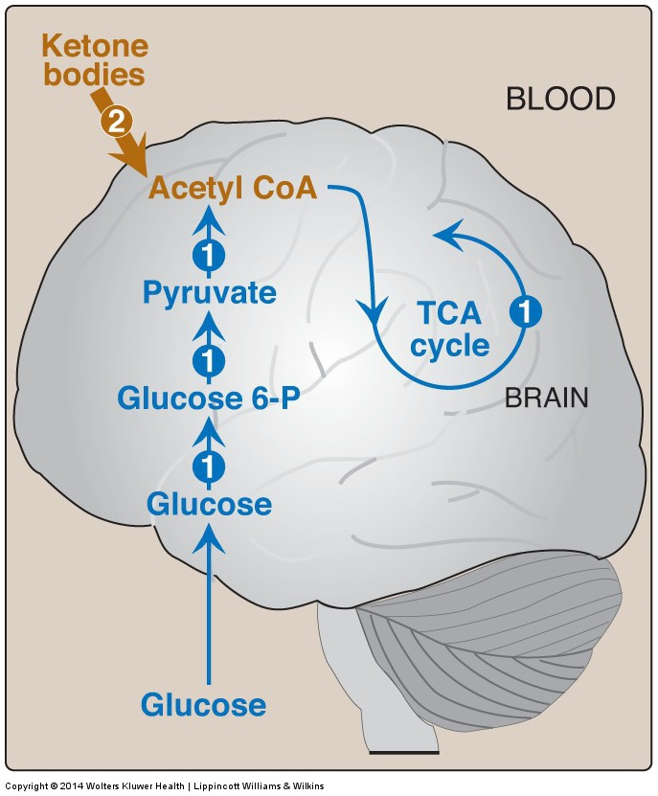
Major metabolic pathways in the brain
in the absorptive state
during fasting
Notes:
Major metabolic pathways in brain in the absorptive state. [Note: The numbers in circles, which appear both in the figure and in the text, indicate important pathways for carbohydrate metabolism.] CoA = coenzyme A; TCA = tricarboxylic acid; P = phosphate; GLUT = glucose transporter.
Major metabolic pathways in the brain during fasting. [Note: The numbers in the circles, which appear both in the figure and in the corresponding citation in the text, indicate important pathways for metabolism of fat or carbohydrates.] CoA = coenzyme A; TCA = tricarboxylic acid; P = phosphate.

Slide 7
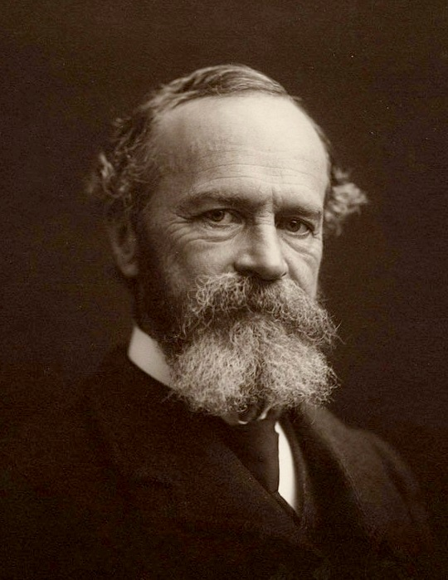
William James, MD
"I originally studied medicine in order to be a physiologist, but I drifted into psychology and philosophy from a sort of fatality. I never had any philosophic instruction, the first lecture on psychology I ever heard being the first I ever gave”.
In the 19th century, James and other psychologists
articulated mental processes as associations.
Currently, groups are attempting to map the entire human connectome
(ie. what is the wiring diagram of the 10¹¹ neurons).

Slide 8
Eric Kandel, MD, 2000 Nobel Laureate, and his
studies on memory in Aplysia californica

Slide 9
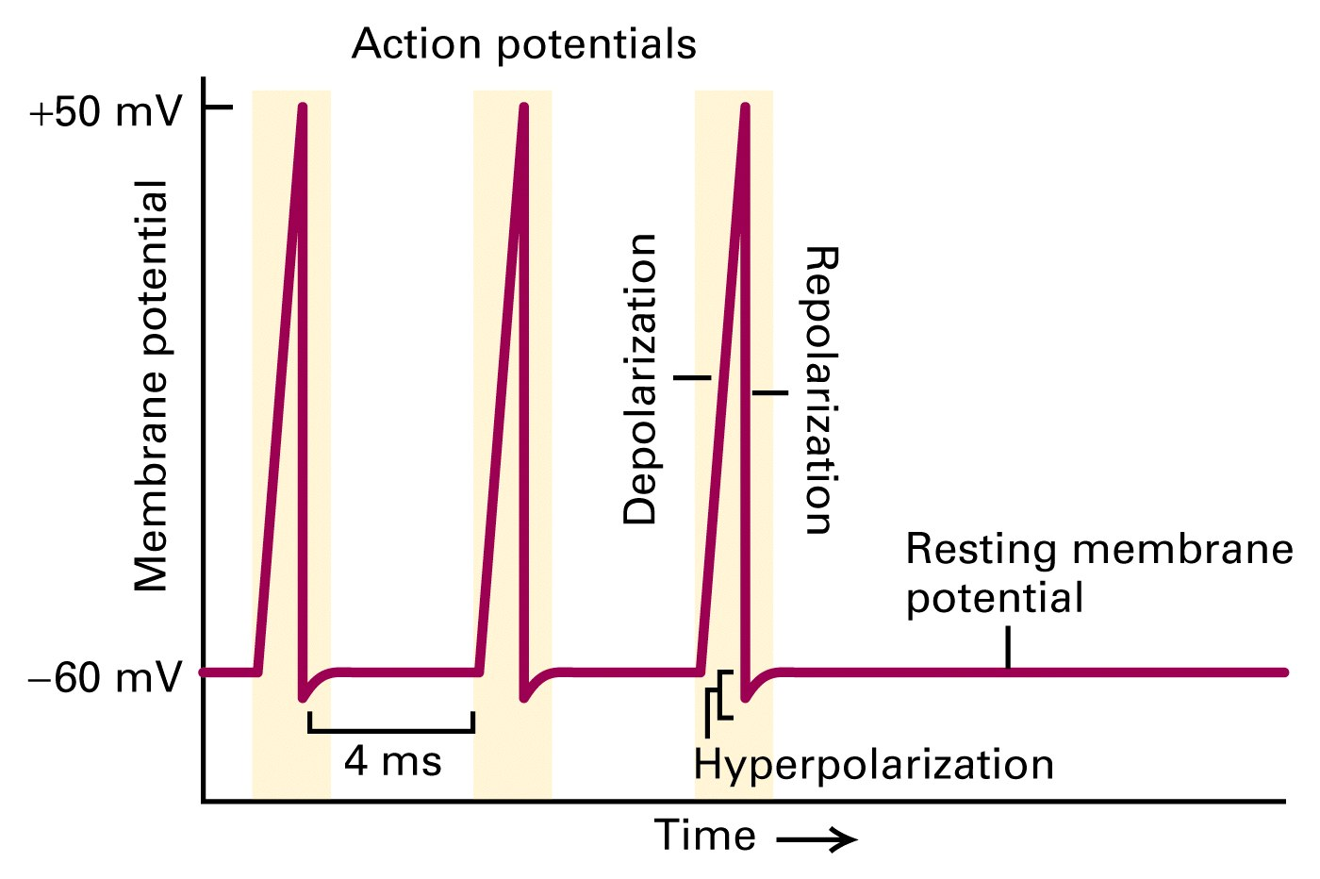
Recording of an axonal membrane potential over time reveals the amplitude and frequency of action potentials
The depolarization phase is due to the opening of voltage-gated sodium channels;
The repolarization phase is due to the opening of voltage-gated potassium channels.

Slide 10
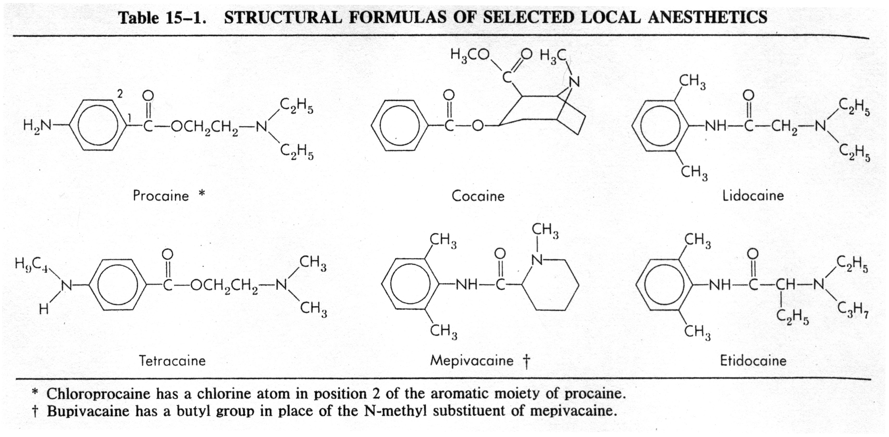
Local anesthetics block voltage-gated sodium channels

Slide 11
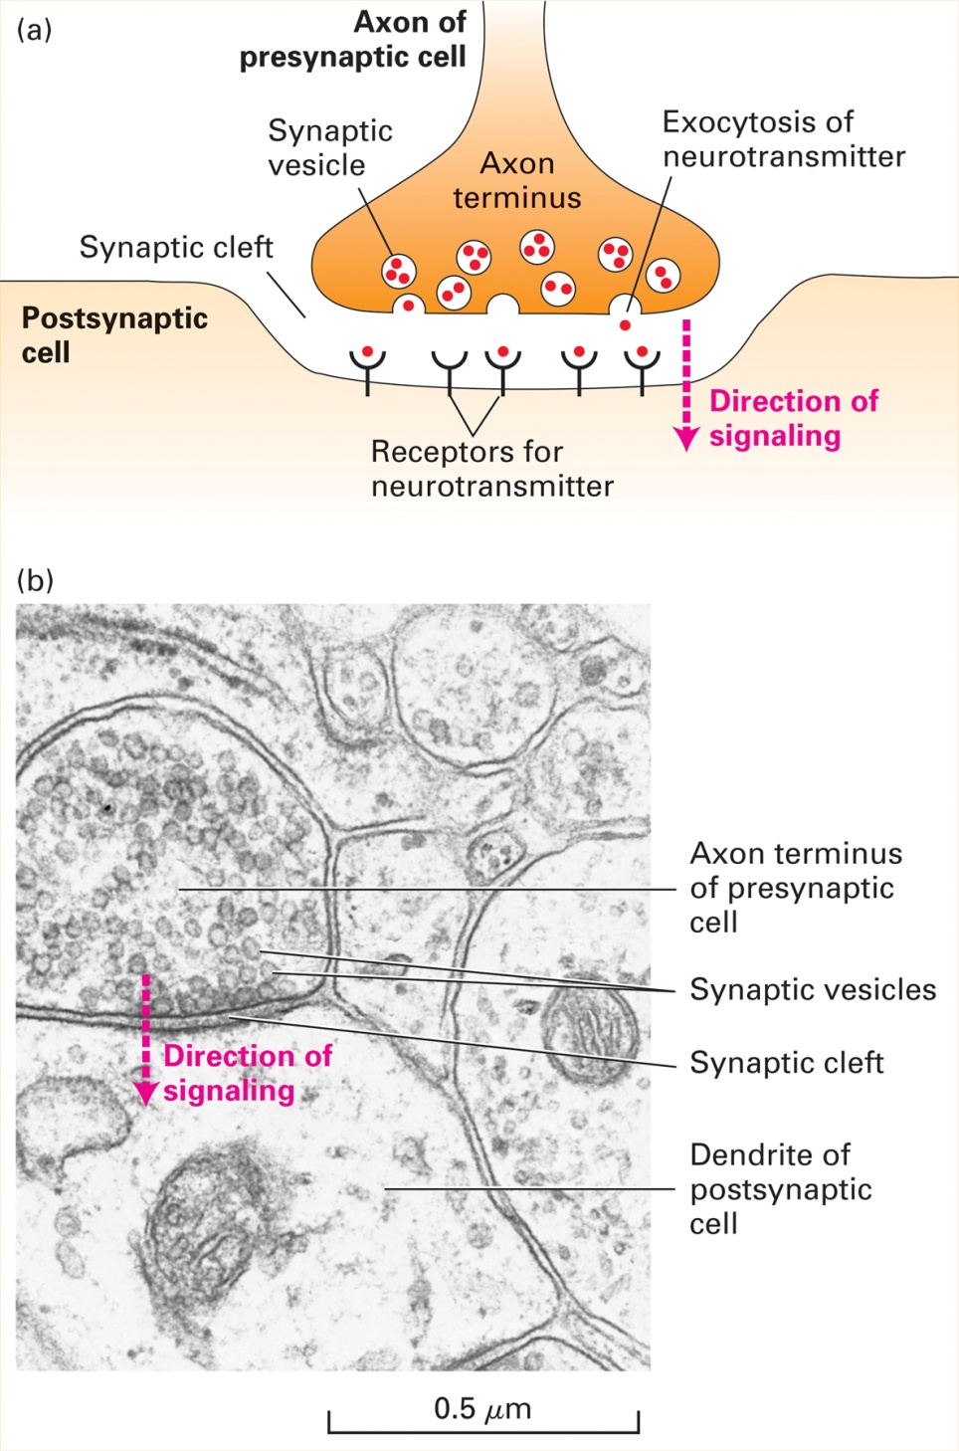
A Chemical Synapse

Slide 12
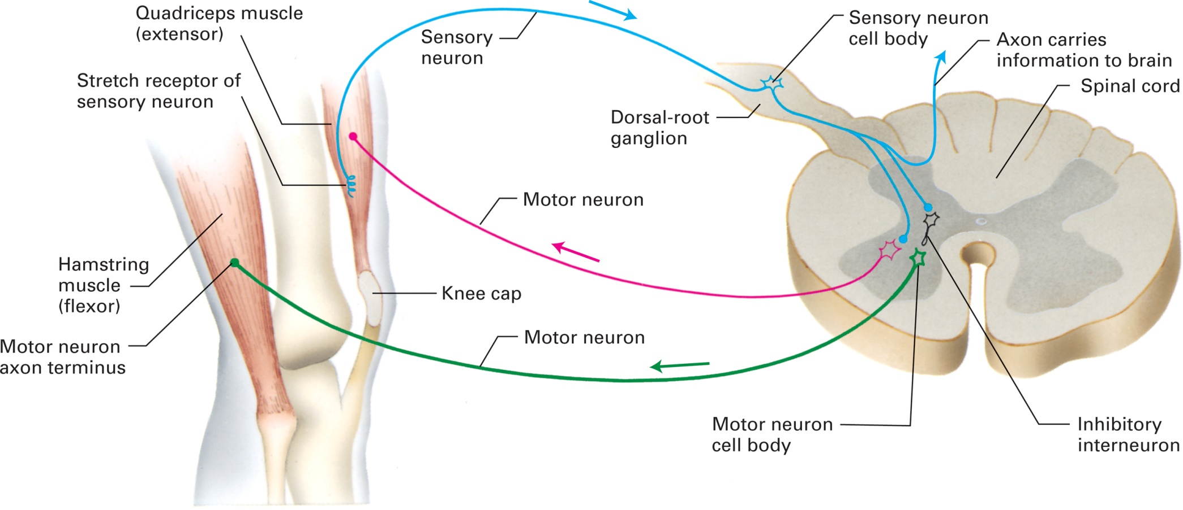
The knee-jerk reflex

Slide 13
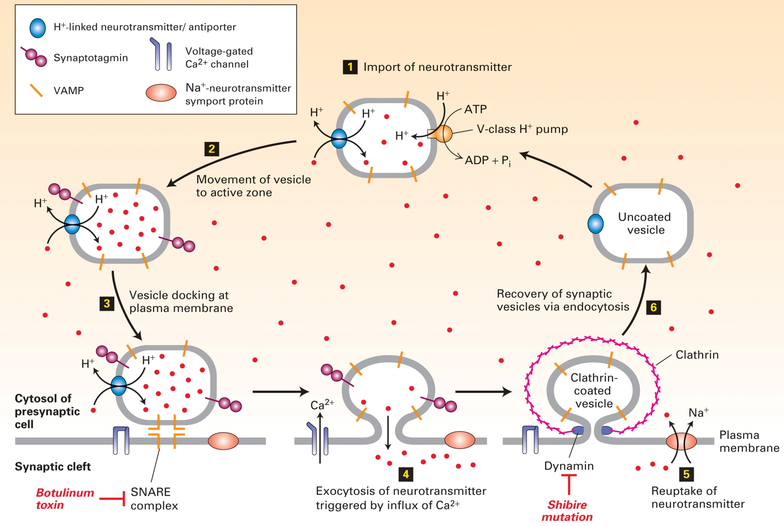
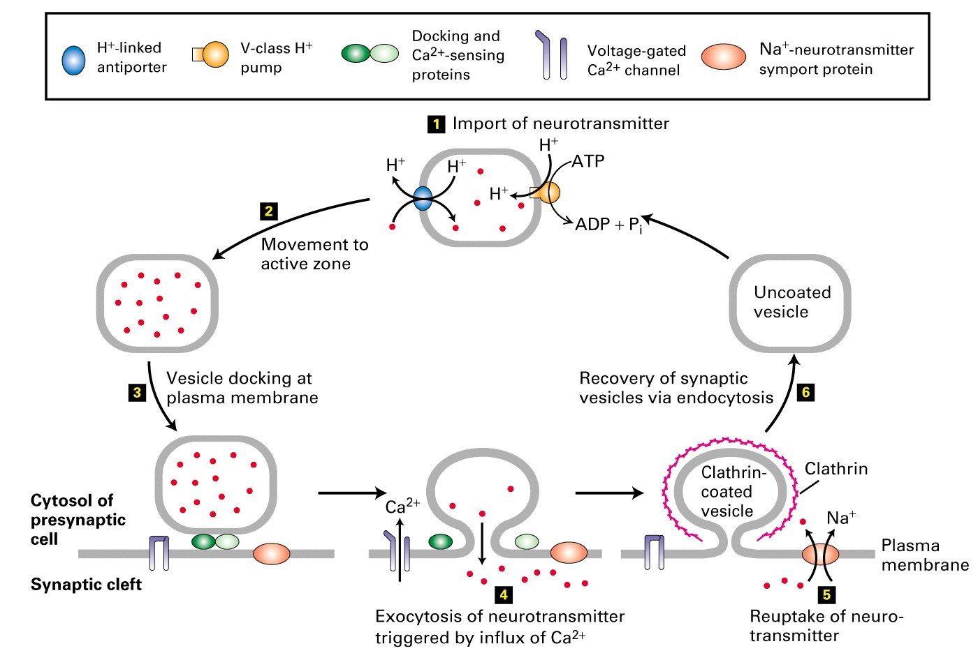
Calcium-dependent neurotransmitter release

Slide 14
Neurotransmitters
amines | Acetylcholine, dopamine, norepinephrine, epinephrine, serotonin
amino acids | Glutamate, glycine, GABA
purines | ATP, adenosine
gases | Nitric oxide
peptides | opioid peptides, somatostatin, and many others

Slide 15
Synthesis and degradation of acetylcholine
acetylcholinesterase
Choline and acetate

Slide 16
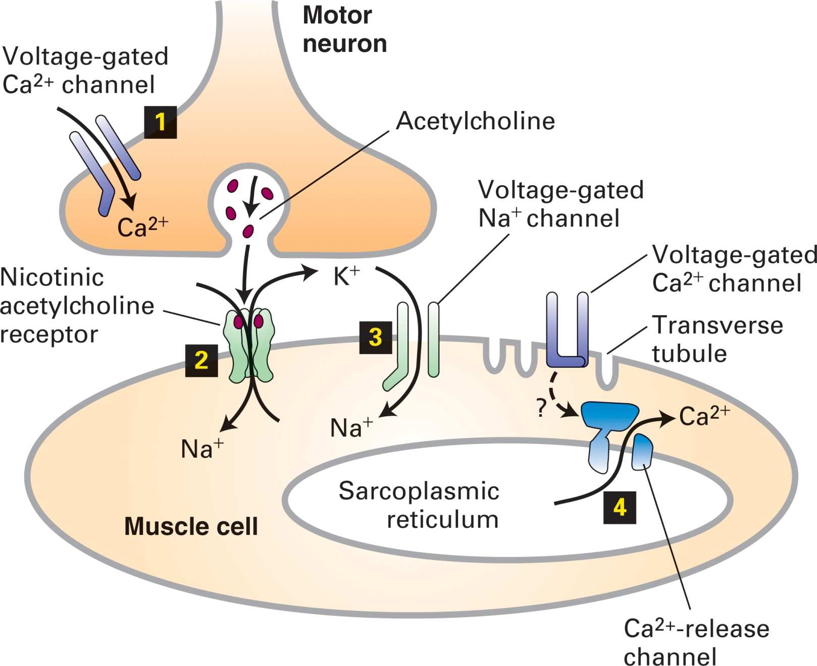
Sequential activation of gated ion channels at a neuromuscular junction

Slide 17
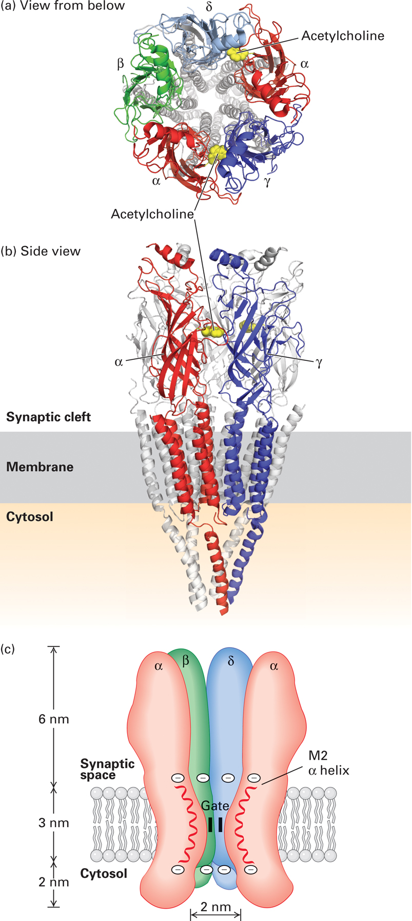
Three-dimensional structure of the nicotinic acetylcholine receptor

Slide 18
Myasthenia gravis
Prototype human autoimmune disease: antibodies are produced against nicotinic AcCh receptors in muscle
Affects 25,000 people in US
Antibodies interfere with synaptic transmission and causes muscle weakness
Cranial muscles and limb muscles affected
Severity of symptoms varies from day to day giving rise to periods of remission or exacerbation
Muscle weakness is reversed by drugs that inhibit acetylcholinesterase, the enzyme that degrades AcCh; thymectomy also helps
Rare, heritable form of myasthenia exists: not autoimmune, mutations in AcCh signaling genes

Slide 19
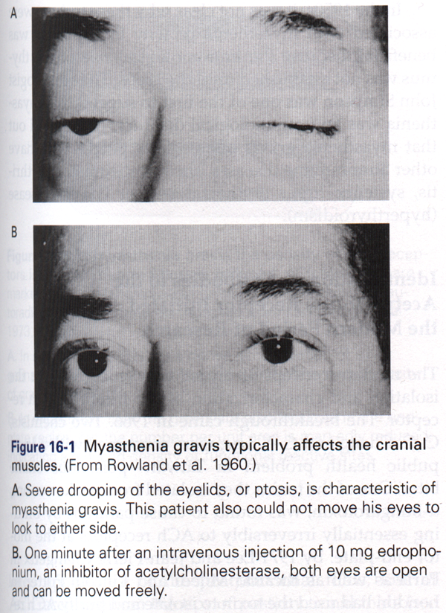
Myasthenia gravis

Slide 20
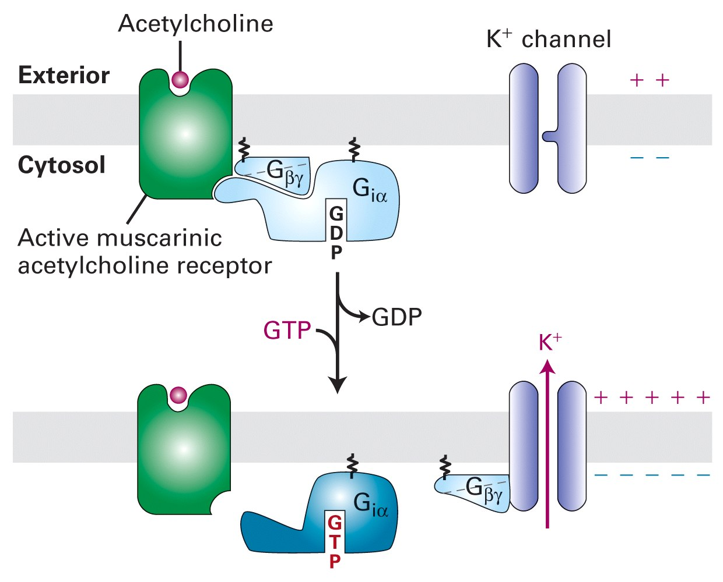
Muscarinic AcChR (a G protein-coupled receptor, GPCR): cardiac hyperpolarization following vagal stimulation

Slide 21
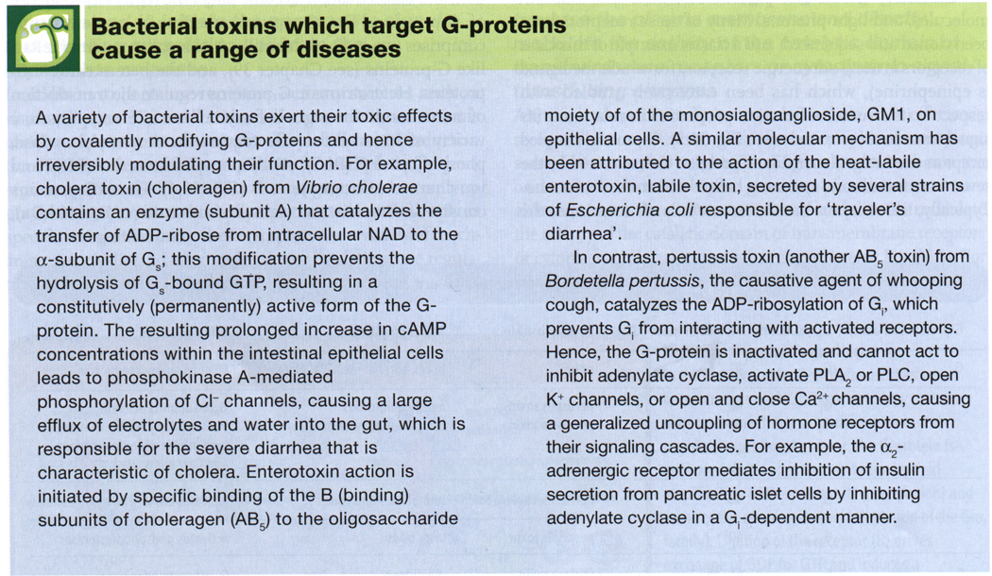

Slide 22
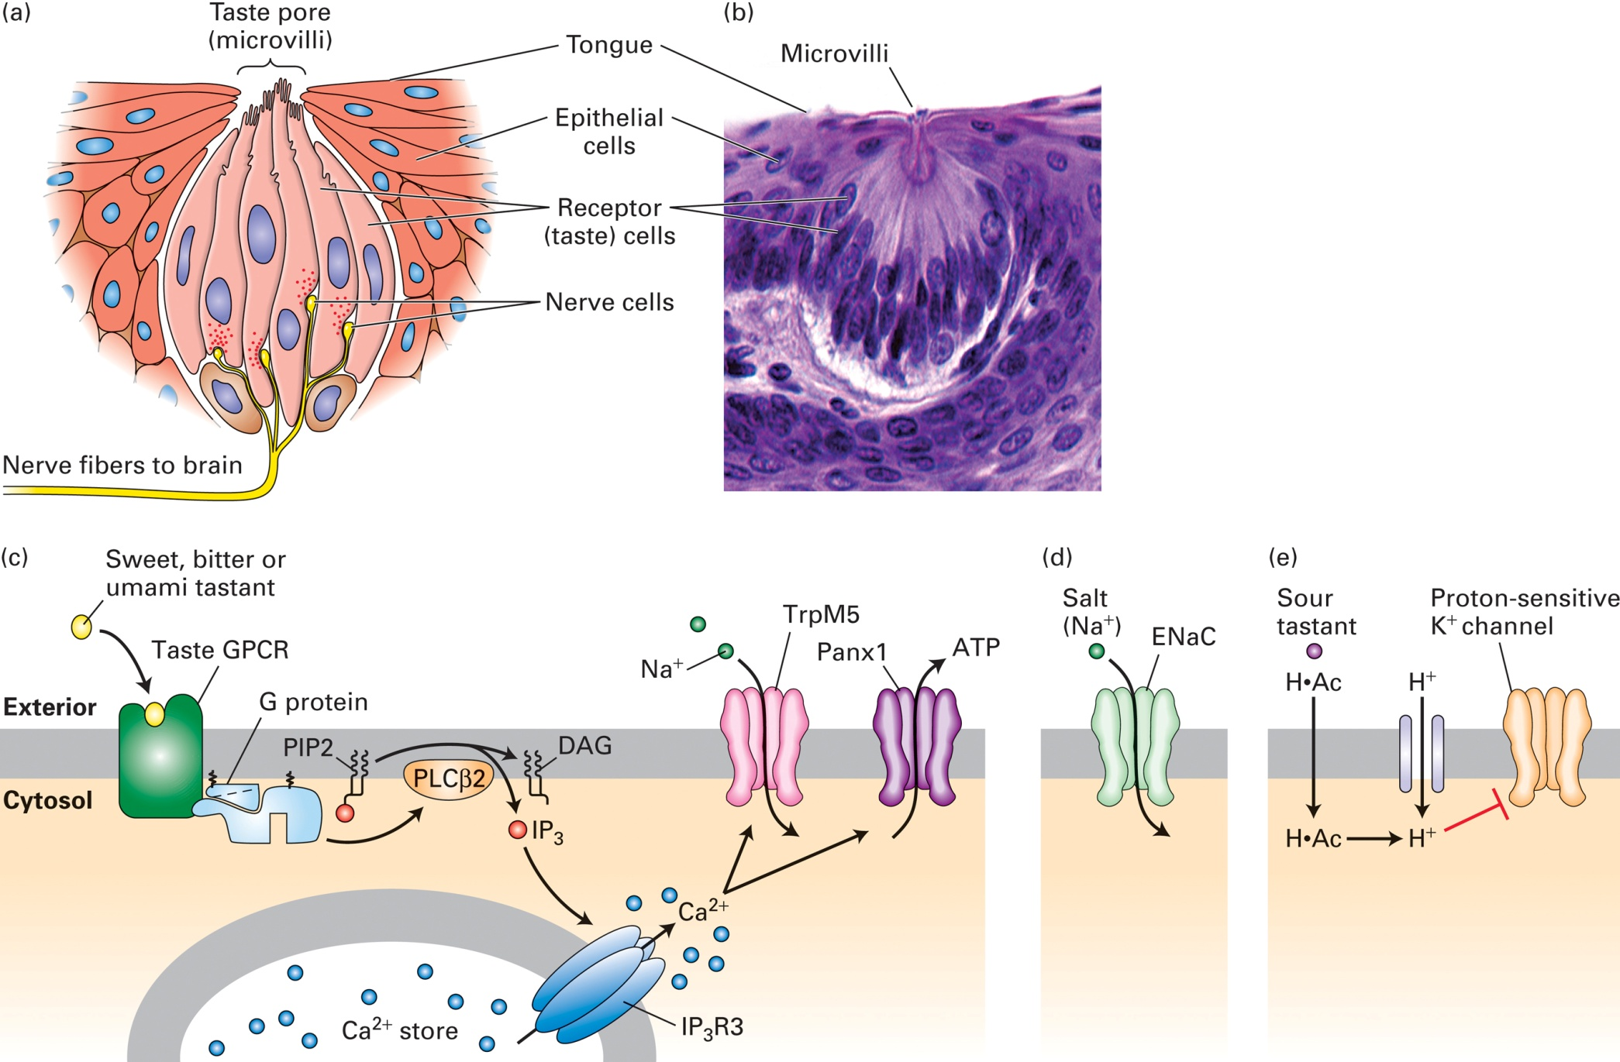
The sense of taste

Slide 23
Parkinson disease
Common neurological disorder affecting 1 million people in US
Symptoms: paucity of spontaneous movement, tremor at rest, muscle rigidity, shuffling gait, mask-like facial expression, autonomic disturbances, depression, cognitive impairment
Results from degeneration of dopamine neurons in the substantia nigra pars compacta
Oral administration of L-DOPA was found beneficial but effects diminish >5 years

Slide 24
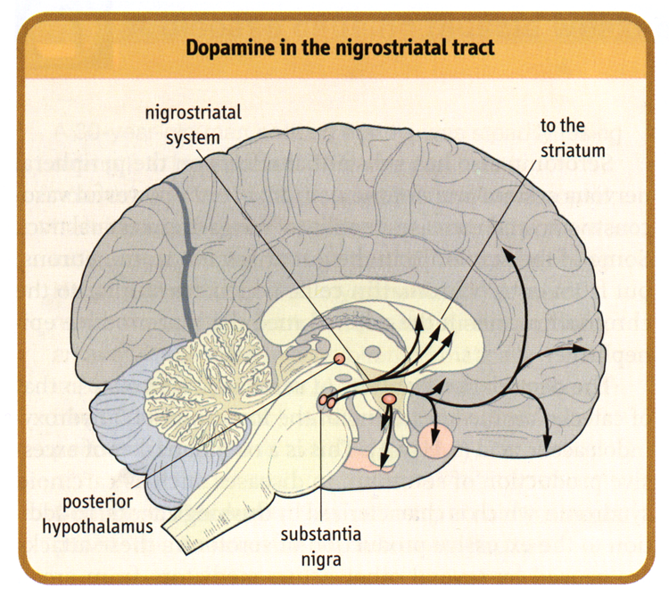

Slide 25
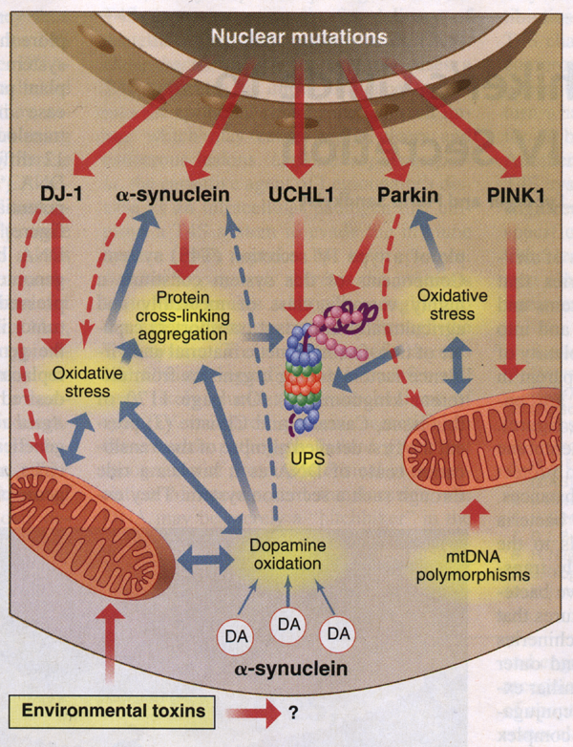
Five nuclear genes are known to carry mutations that cause rare inherited forms (<10%) of Parkinson Disease

Slide 26
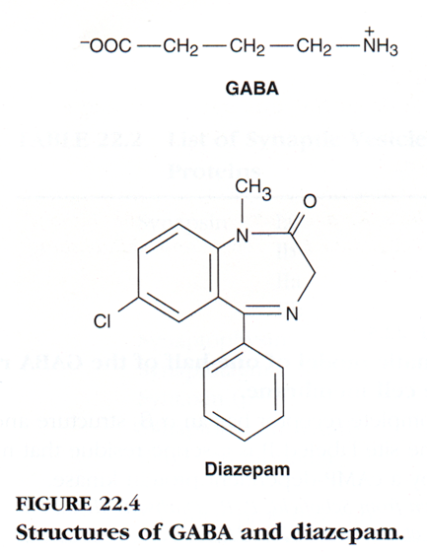
Benzodiazepines (like diazepam (Valium), flurazepam) facilitate GABAergic transmission

Slide 27
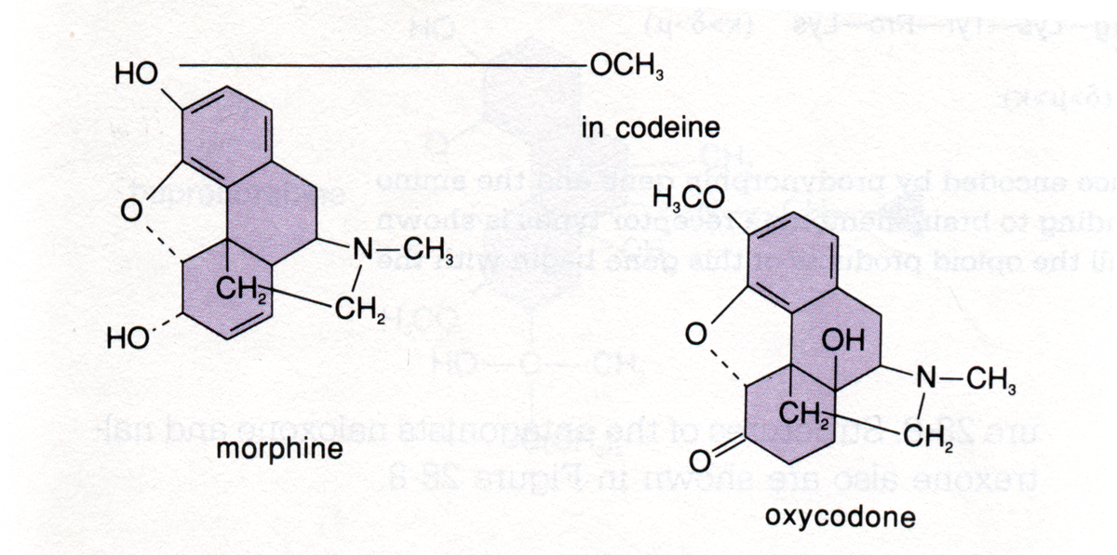
Opiate analgesics: exert their activity by binding to opioid receptors in brain (GPCRs)

Slide 28
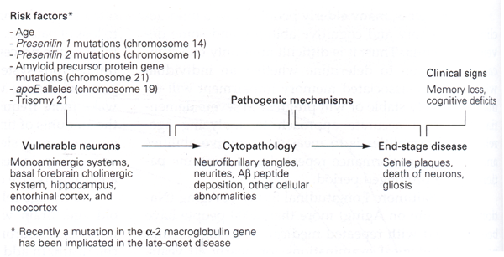
Characteristics of Alzheimer Disease
Affects 7% of people >65 y (5 million in USA)
Classical pathology: neurofibrillary tangles and senile plaques in neocortex and hippocampus
Patients show abnormalities of memory, problem solving, judgement, and behavior
Several genetic risk factors for Alzheimer disease have been identified, all of which cause deposition of Aβ amyloid peptide

Slide 29
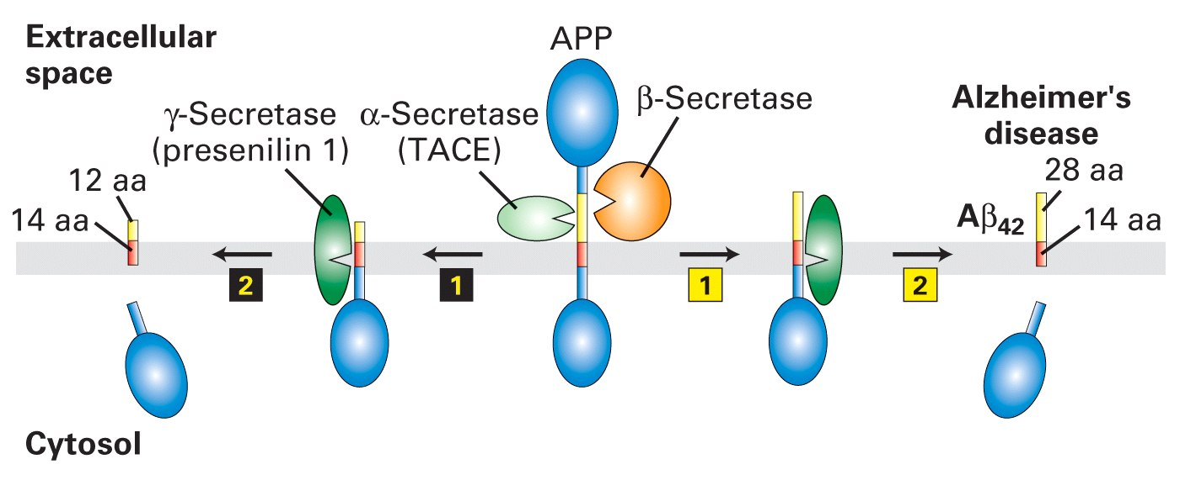
Proteolytic cleavage of amyloid precursor protein (APP)
γ-Secretase

Slide 30
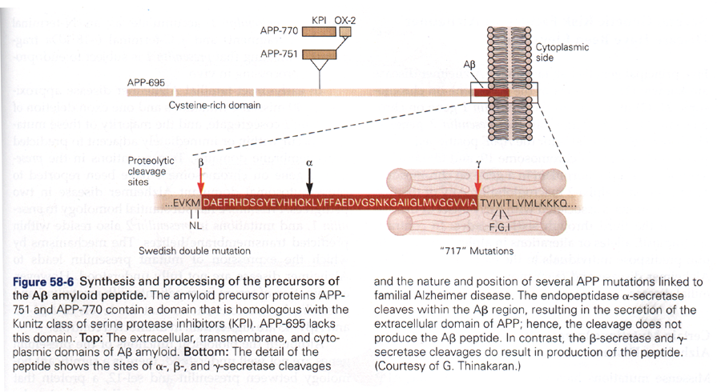
Generation of Aβ amyloid peptide: causative agent of Alzheimer Disease?
*Evidence suggests presenilins are tightly linked to γ-secretase-mediated cleavage and play
an important role in amyloid precursor protein (APP) cleavage.

Slide 31
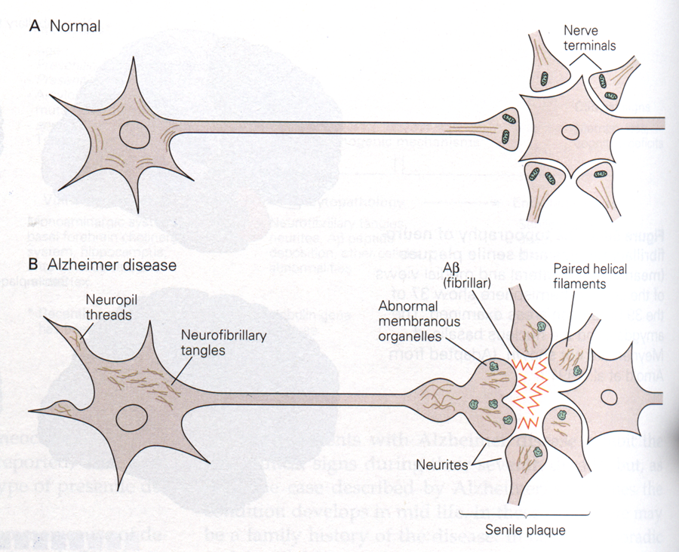
Neuropathy of Alzheimer Disease
Hyperphosphorylated
tau protein

