Slide 1
Cancer, Oncogenes and Tumor Suppressors Lecture 43 May 15, 2015
Professor Richard D. Howells, PhD
howells@njms.rutgers.edu
Colon cancer cells

Slide 2
Normal and Malignant Cell Growth
Different cells have different lifetimes: intestinal epithelial cells and certain white blood cells exist a few days before they die and are replaced; red blood cells have a 120 d half- life
Cells in many adult tissues do not proliferative except during healing processes (e.g. hepatocytes, heart muscle cells, neurons). Such cells can remain functional over long periods or even for the lifetime of an organism
Some cells lose the fine controls that regulate cell division and apoptosis as a result of accumulated multiple mutations that may lead to tumor formation
Cancer is due to failures of the mechanisms that control the
growth and proliferation of cells
Cancer causes nearly a quarter of the annual deaths in the US

Slide 4
Development of Cancer Requires Several Mutations: the multi-hit model
The incidence of most types of cancer increases exponentially with age
Animal studies on kinetics of tumor appearance in transgenic mice with overexpressed oncogenes supports the multi-hit model: there is cooperativity of oncogenic mutations
Current estimates suggest 5-6 “hits” or mutations must accumulate as malignant cancer cells emerge

Slide 5
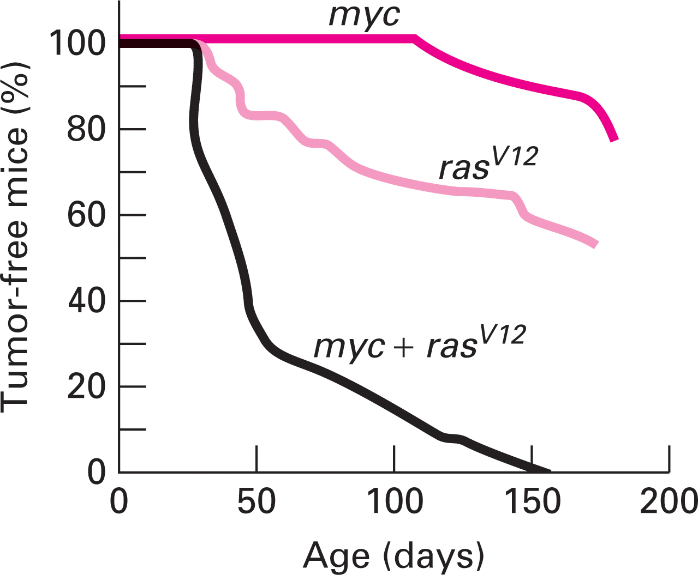
The kinetics of tumor appearance in female mice carrying either one or two oncogenic transgenes shows the cooperative nature of multiple mutations in cancer induction.

Slide 6
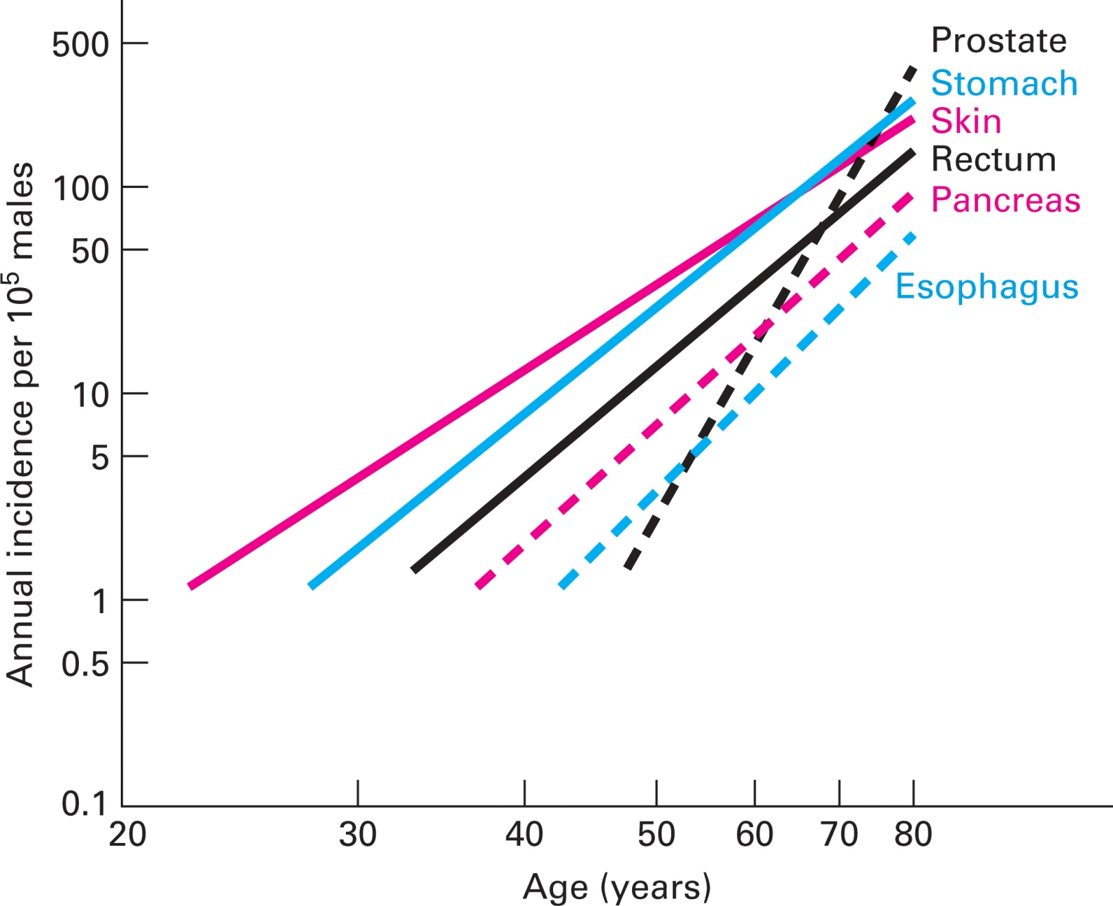
The incidence of human cancers increases as a function of age

Slide 7
Cancer Stem Cells
Most types of tumors exhibit cell heterogeneity
Cancer stem cells are thought to give rise to some cells with high replicative capabilities and others with more limited replicative potential
In multiple myeloma, the majority of cells (95%) express a marker called CD138, the small population of cells that lack CD138 has considerably greater ability than the rest of the cells to start tumor growth

Slide 8
The relationship between the number of stem cell divisions in the lifetime
of a given tissue and the lifetime risk of cancer in that tissue
linear correlation = 0.804
65% of the cancer risk among
different tissues can be
explained by the total number
of stem cell divisions
in those tissues
Tomasetti and Vogelstein
Science 347: 78-81, 2015

Slide 9
Hallmarks of Cancer: The Next Generation
Douglas Hanahan, Robert A. Weinberg
Cell
Volume 144, Issue 5, Pages 646-674 (March 2011)
DOI: 10.1016/j.cell.2011.02.013

Slide 10
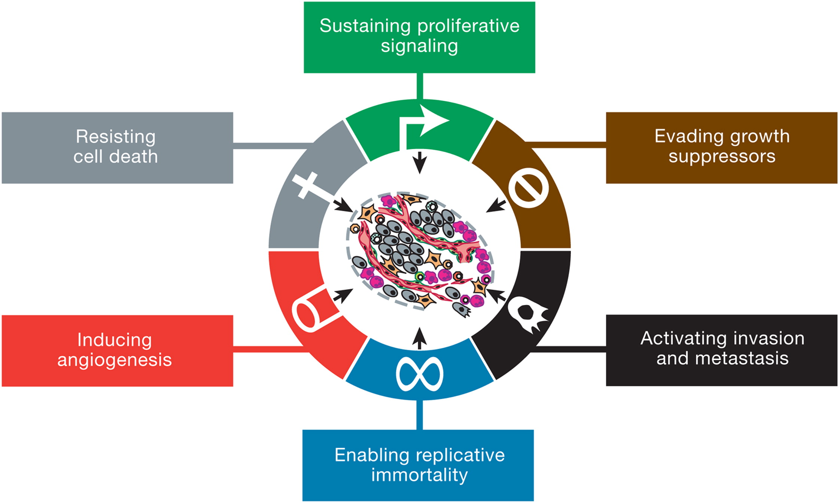
The Hallmarks of Cancer
Notes:
This illustration encompasses the six hallmark capabilities originally proposed in our 2000 perspective. The past decade has witnessed remarkable progress toward understanding the mechanistic underpinnings of each hallmark.

Slide 11
Causes of Cancer
Mutations in 3 broad classes of genes have been implicated
in the onset of cancer: proto-oncogenes, tumor-suppressor
genes and caretaker genes
Proto-oncogenes normally promote cell growth; mutations
change them into oncogenes whose products are excessively
active in growth promotion. Oncogenic mutations usually result
in either increased gene expression or production of a
hyperactive product (dominant gain of function)
Tumor-suppressor genes normally restrain cellular growth, so
mutations that inactivate them allow inappropriate cell division
(recessive loss of function)
Caretaker genes such as DNA repair enzymes, normally protect
the integrity of the genome; when they are inactivated, cells acquire
mutations at increased rates

Slide 12
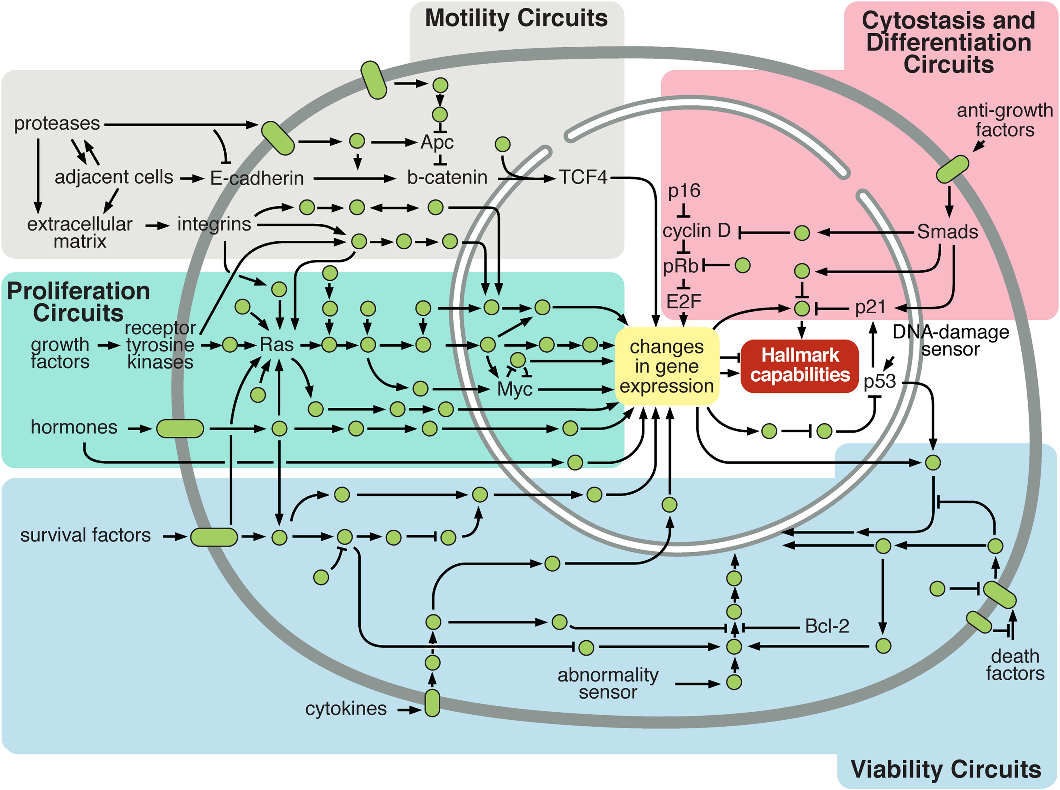
Intracellular Signaling Networks Regulate the Operations of the Cancer Cell
Notes:
An elaborate integrated circuit operates within normal cells and is reprogrammed to regulate hallmark capabilities within cancer cells. Separate subcircuits,
depicted here in differently colored fields, are specialized to orchestrate the various capabilities. At one level, this depiction is simplistic, as there is considerable
crosstalk between such subcircuits. In addition, because each cancer cell is exposed to a complex mixture of signals from its microenvironment, each of these
subcircuits is connected with signals originating from other cells in the tumor microenvironment, as outlined in Figure 5.

Slide 13
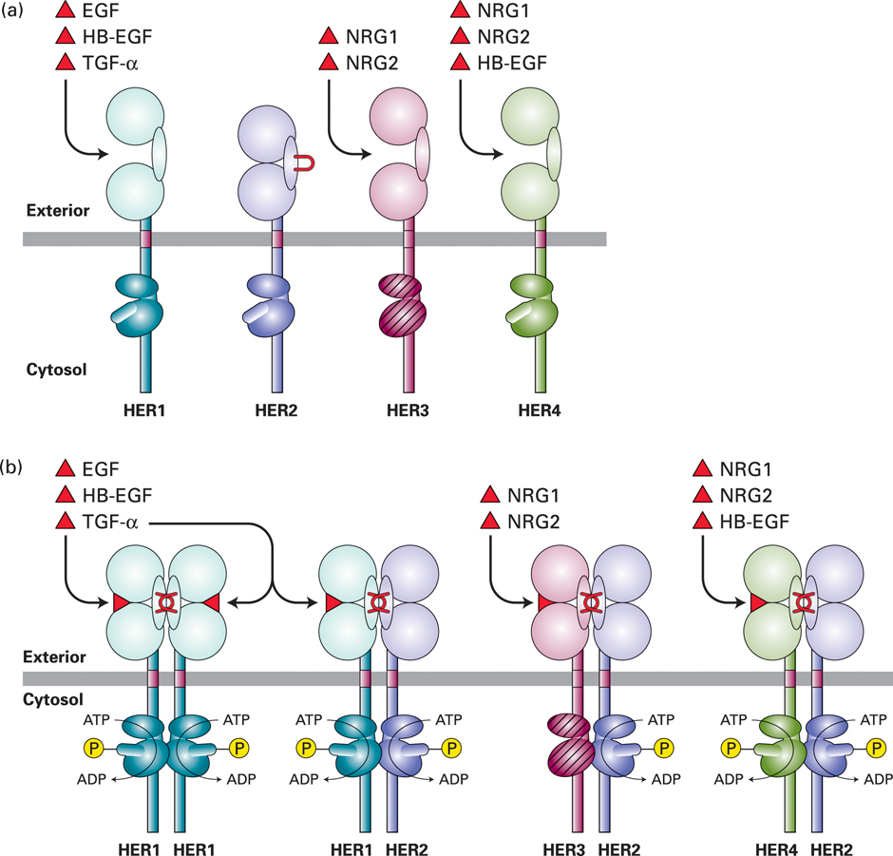
Amplification
of the HER2
gene occurs
in 25% of breast cancers resulting in amplified expression of the HER2 protein (a type of epidermal growth factor (EGF) receptor in the tumor cells
Notes:
HER2 forms heterodimers with ligand-bound HER1, HER3, and HER4 and facilitates signaling by all EGF family members.

Slide 14
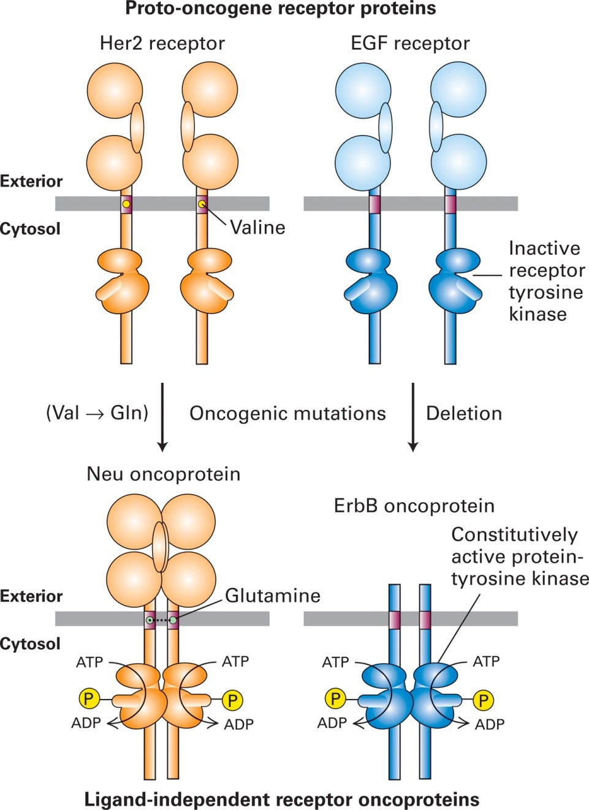
Effects of oncogenic mutations in proto-oncogenes that encode cell-surface receptors.

Slide 15
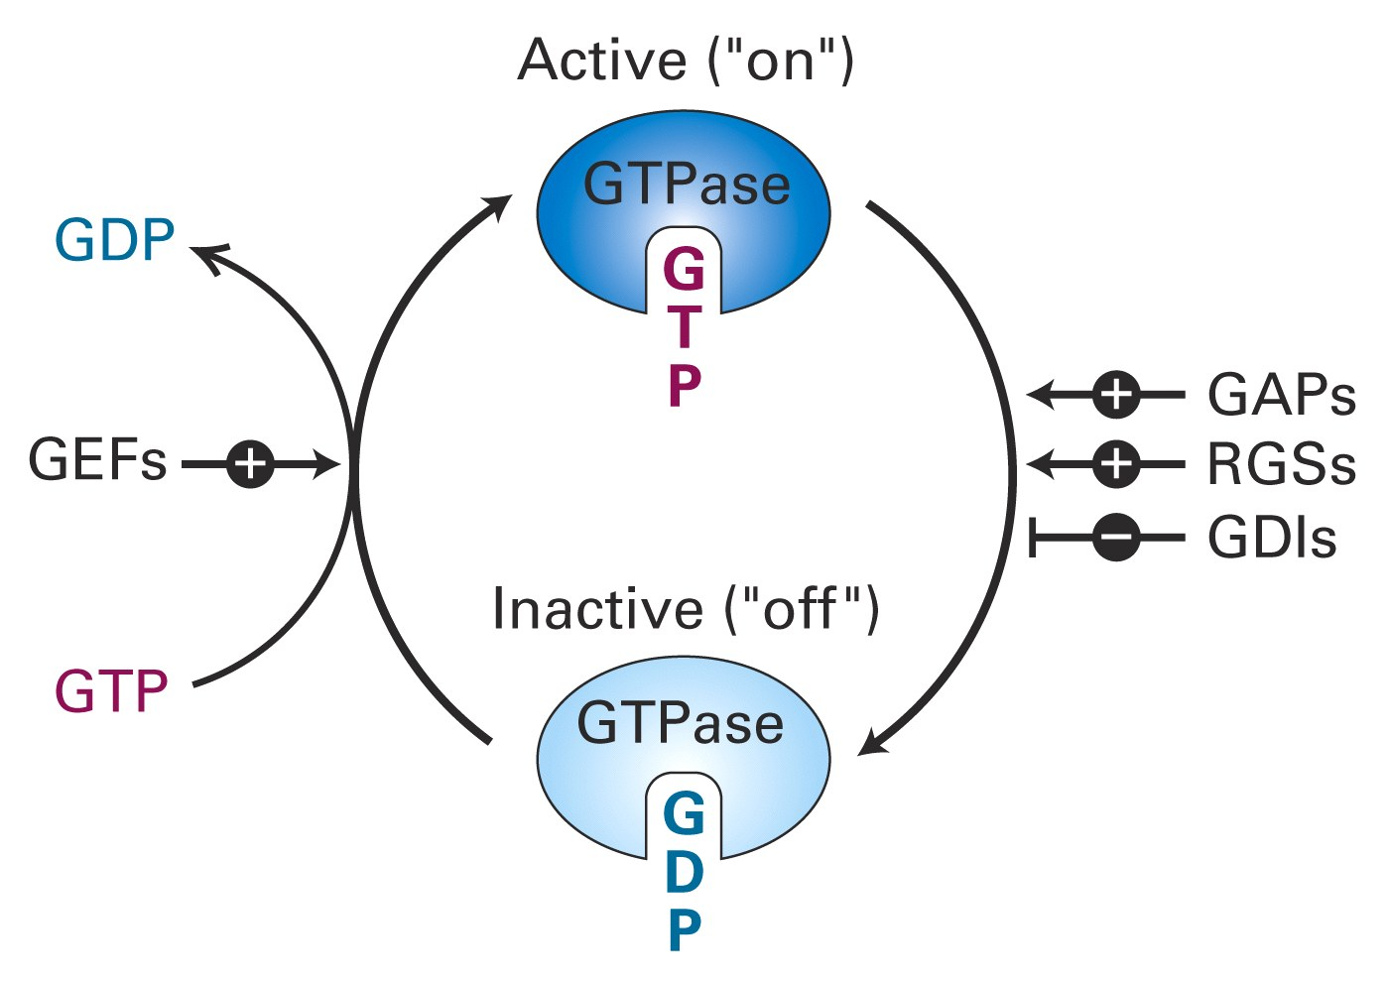
Ras proto-oncogene regulation
GDP: guanosine diphosphate
GTP: guanosine triphosphate
GEF: guanine nucleotide exchange factor
GAP: GTPase activating protein
RGS: Regulator of G protein signaling
GDI: inhibit GTP hydrolysis
Oncogenic Ras^{V12} cannot
hydrolyze bound GTP

Slide 16
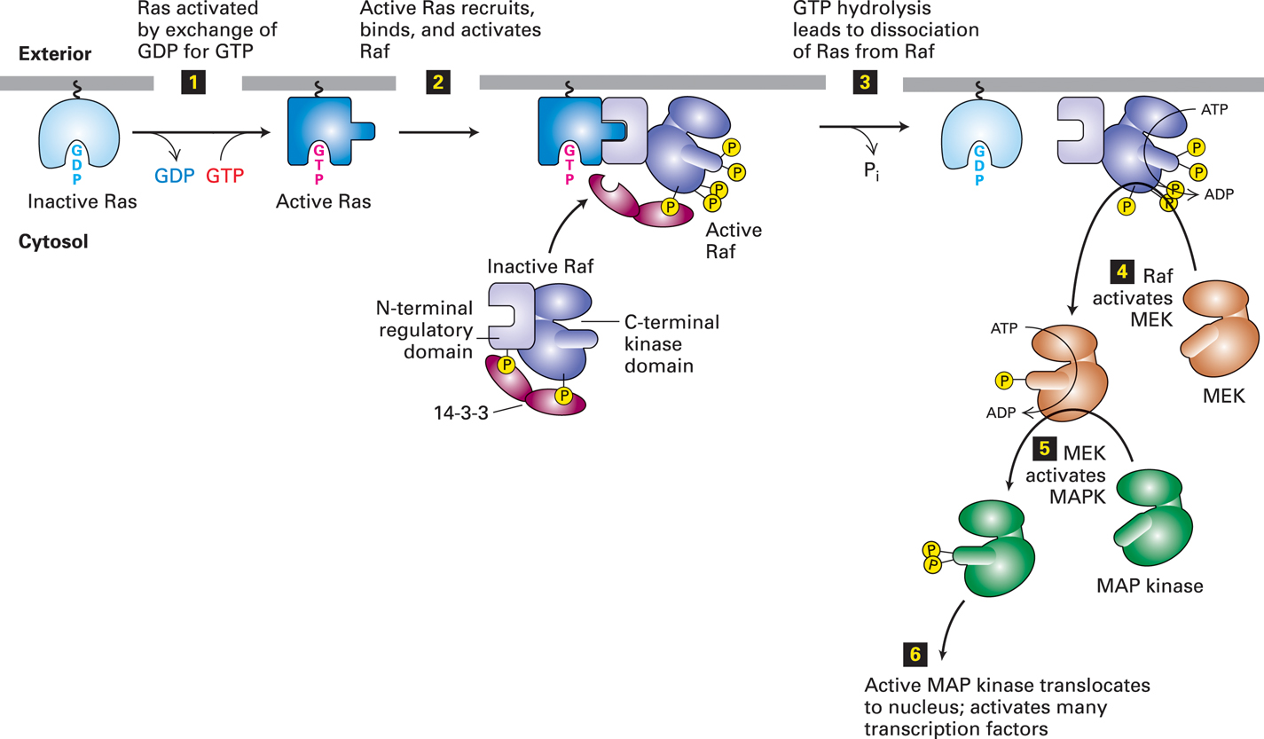
The Ras/MAP kinase pathway
Activating mutations in the B-Raf gene
occur in >40% of skin cancer melanomas.
Select inhibitors of the B-Raf kinase
have recently entered the clinic.

Slide 17
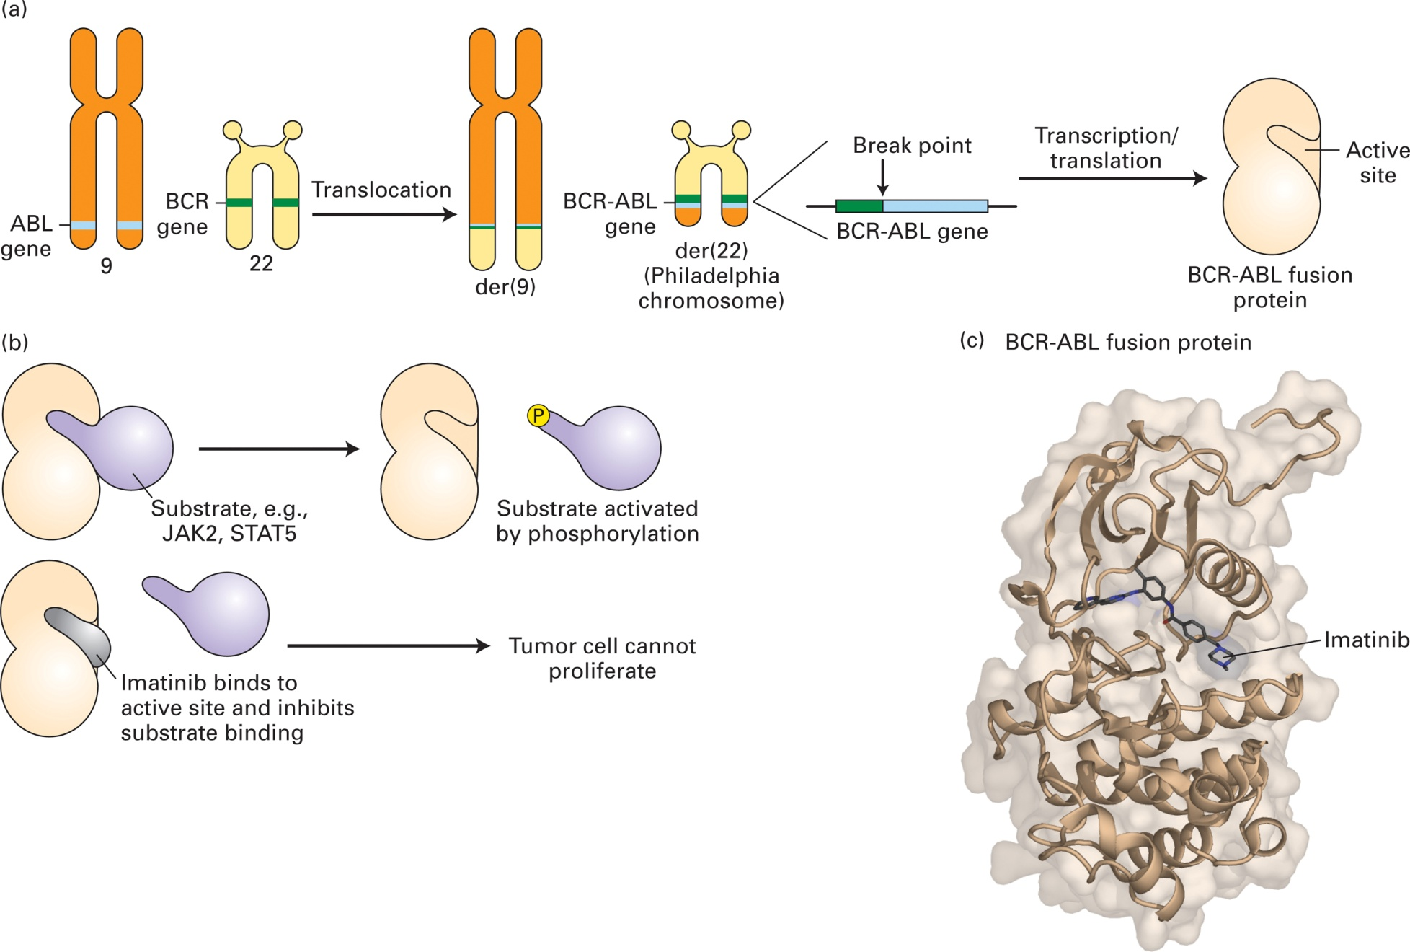
Bcr-Abl protein kinase found in chronic myelogenous leukemia (CML)
Imatinib (Gleevec) is a Tyr kinase inhibitor
approved by the FDA in 2001 to treat CML
and other cancers

Slide 18
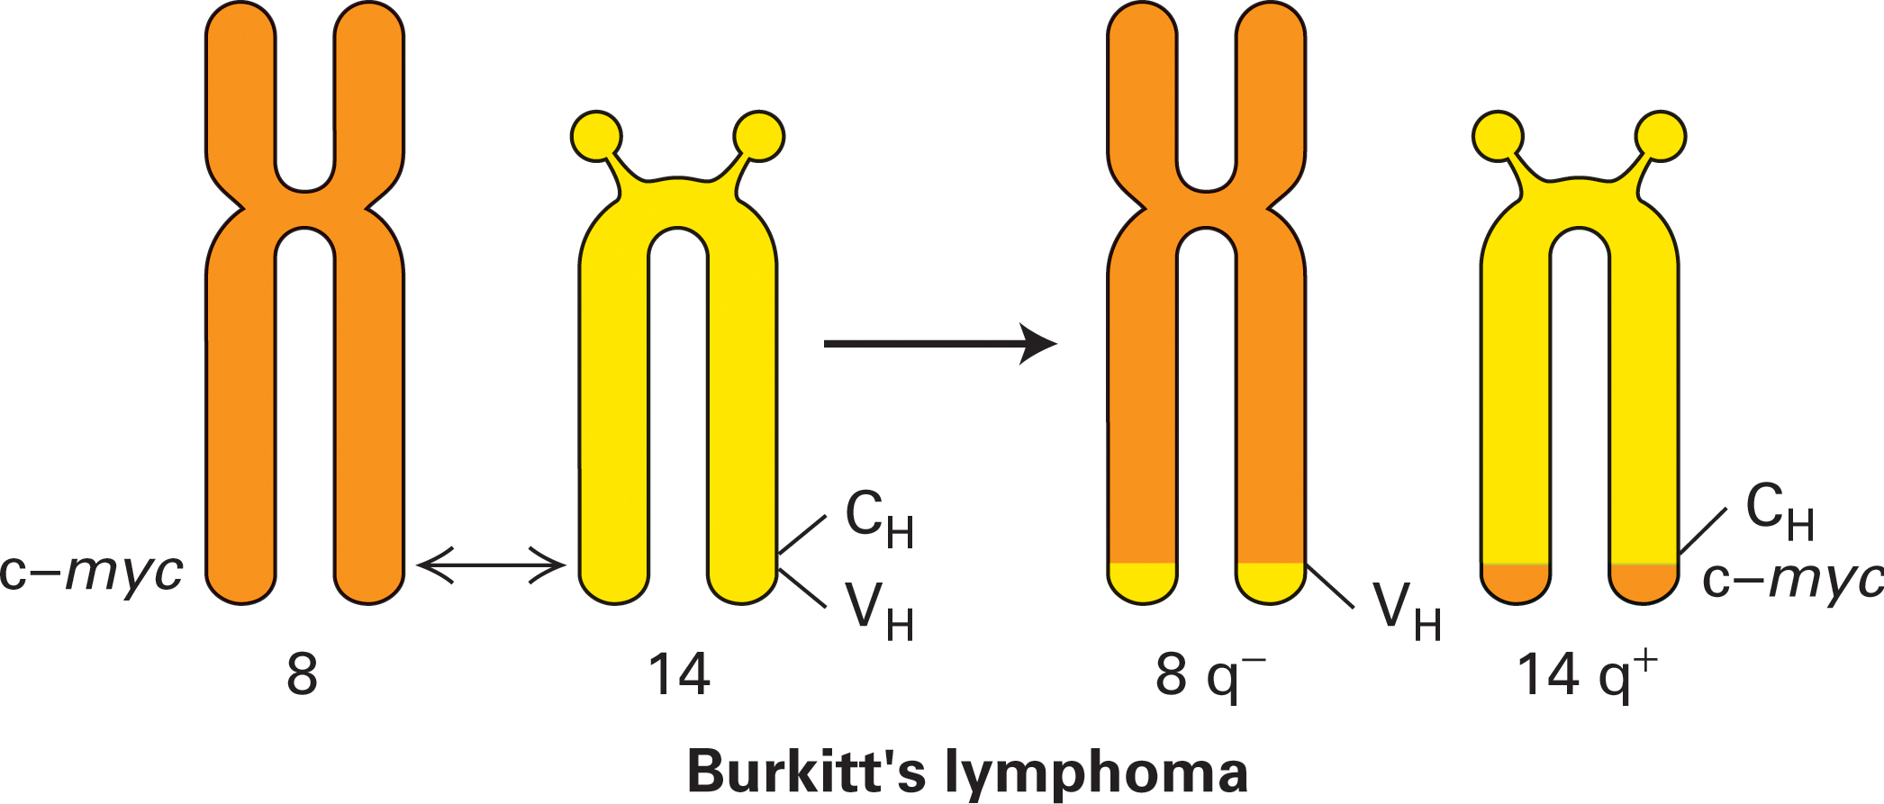
Chromosomal translocation in Burkitt’s lymphoma leading
to overexpression of c-Myc
The c-Myc transcription factor becomes overexpressed by a
chromosomal translocation putting c-Myc expression under the
control of an immunoglobulin enhancer in B cells

Slide 19
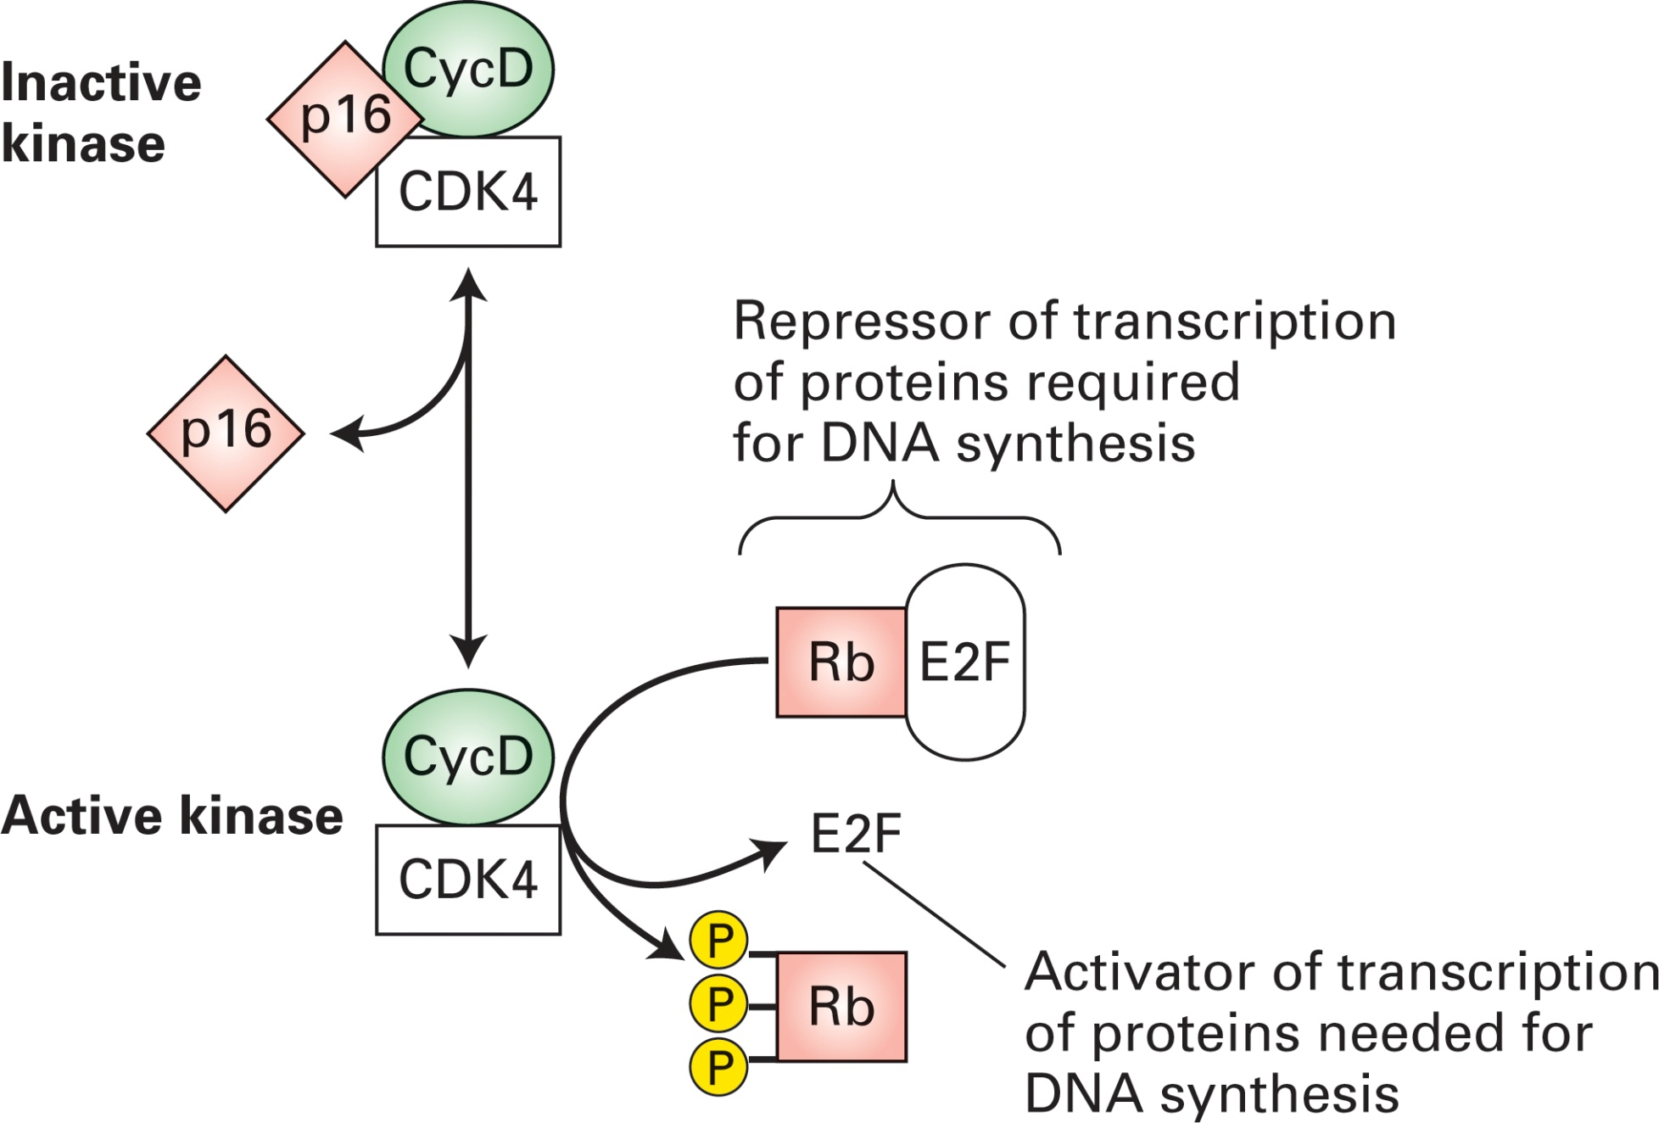
Cell cycle START control and cancer
Loss of function mutations in
the p16 or Rb tumor suppressors
or overproduction of CycD lead
to many cancer types

Slide 20
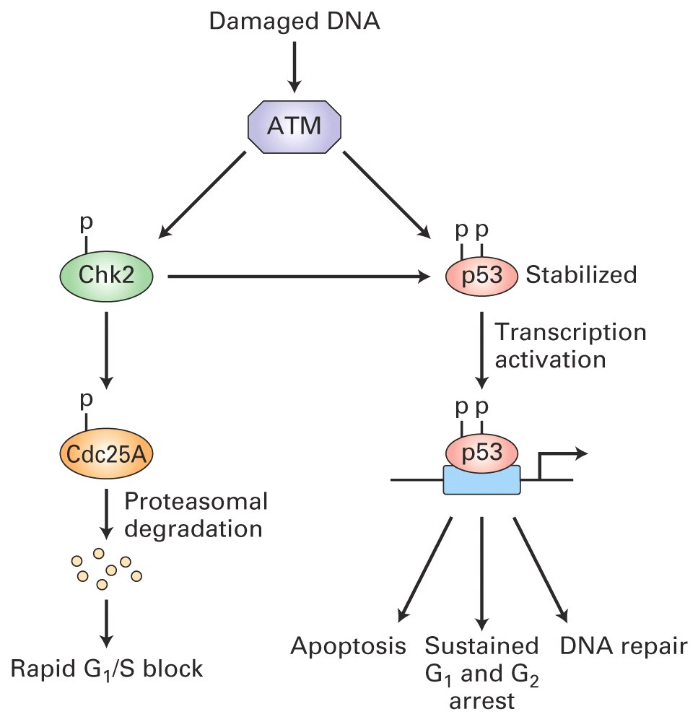
p53 and induction of apoptosis
p53 is a
tumor suppressor
and mutations of p53
are prevalent (>50%)
in many cancers

Slide 21
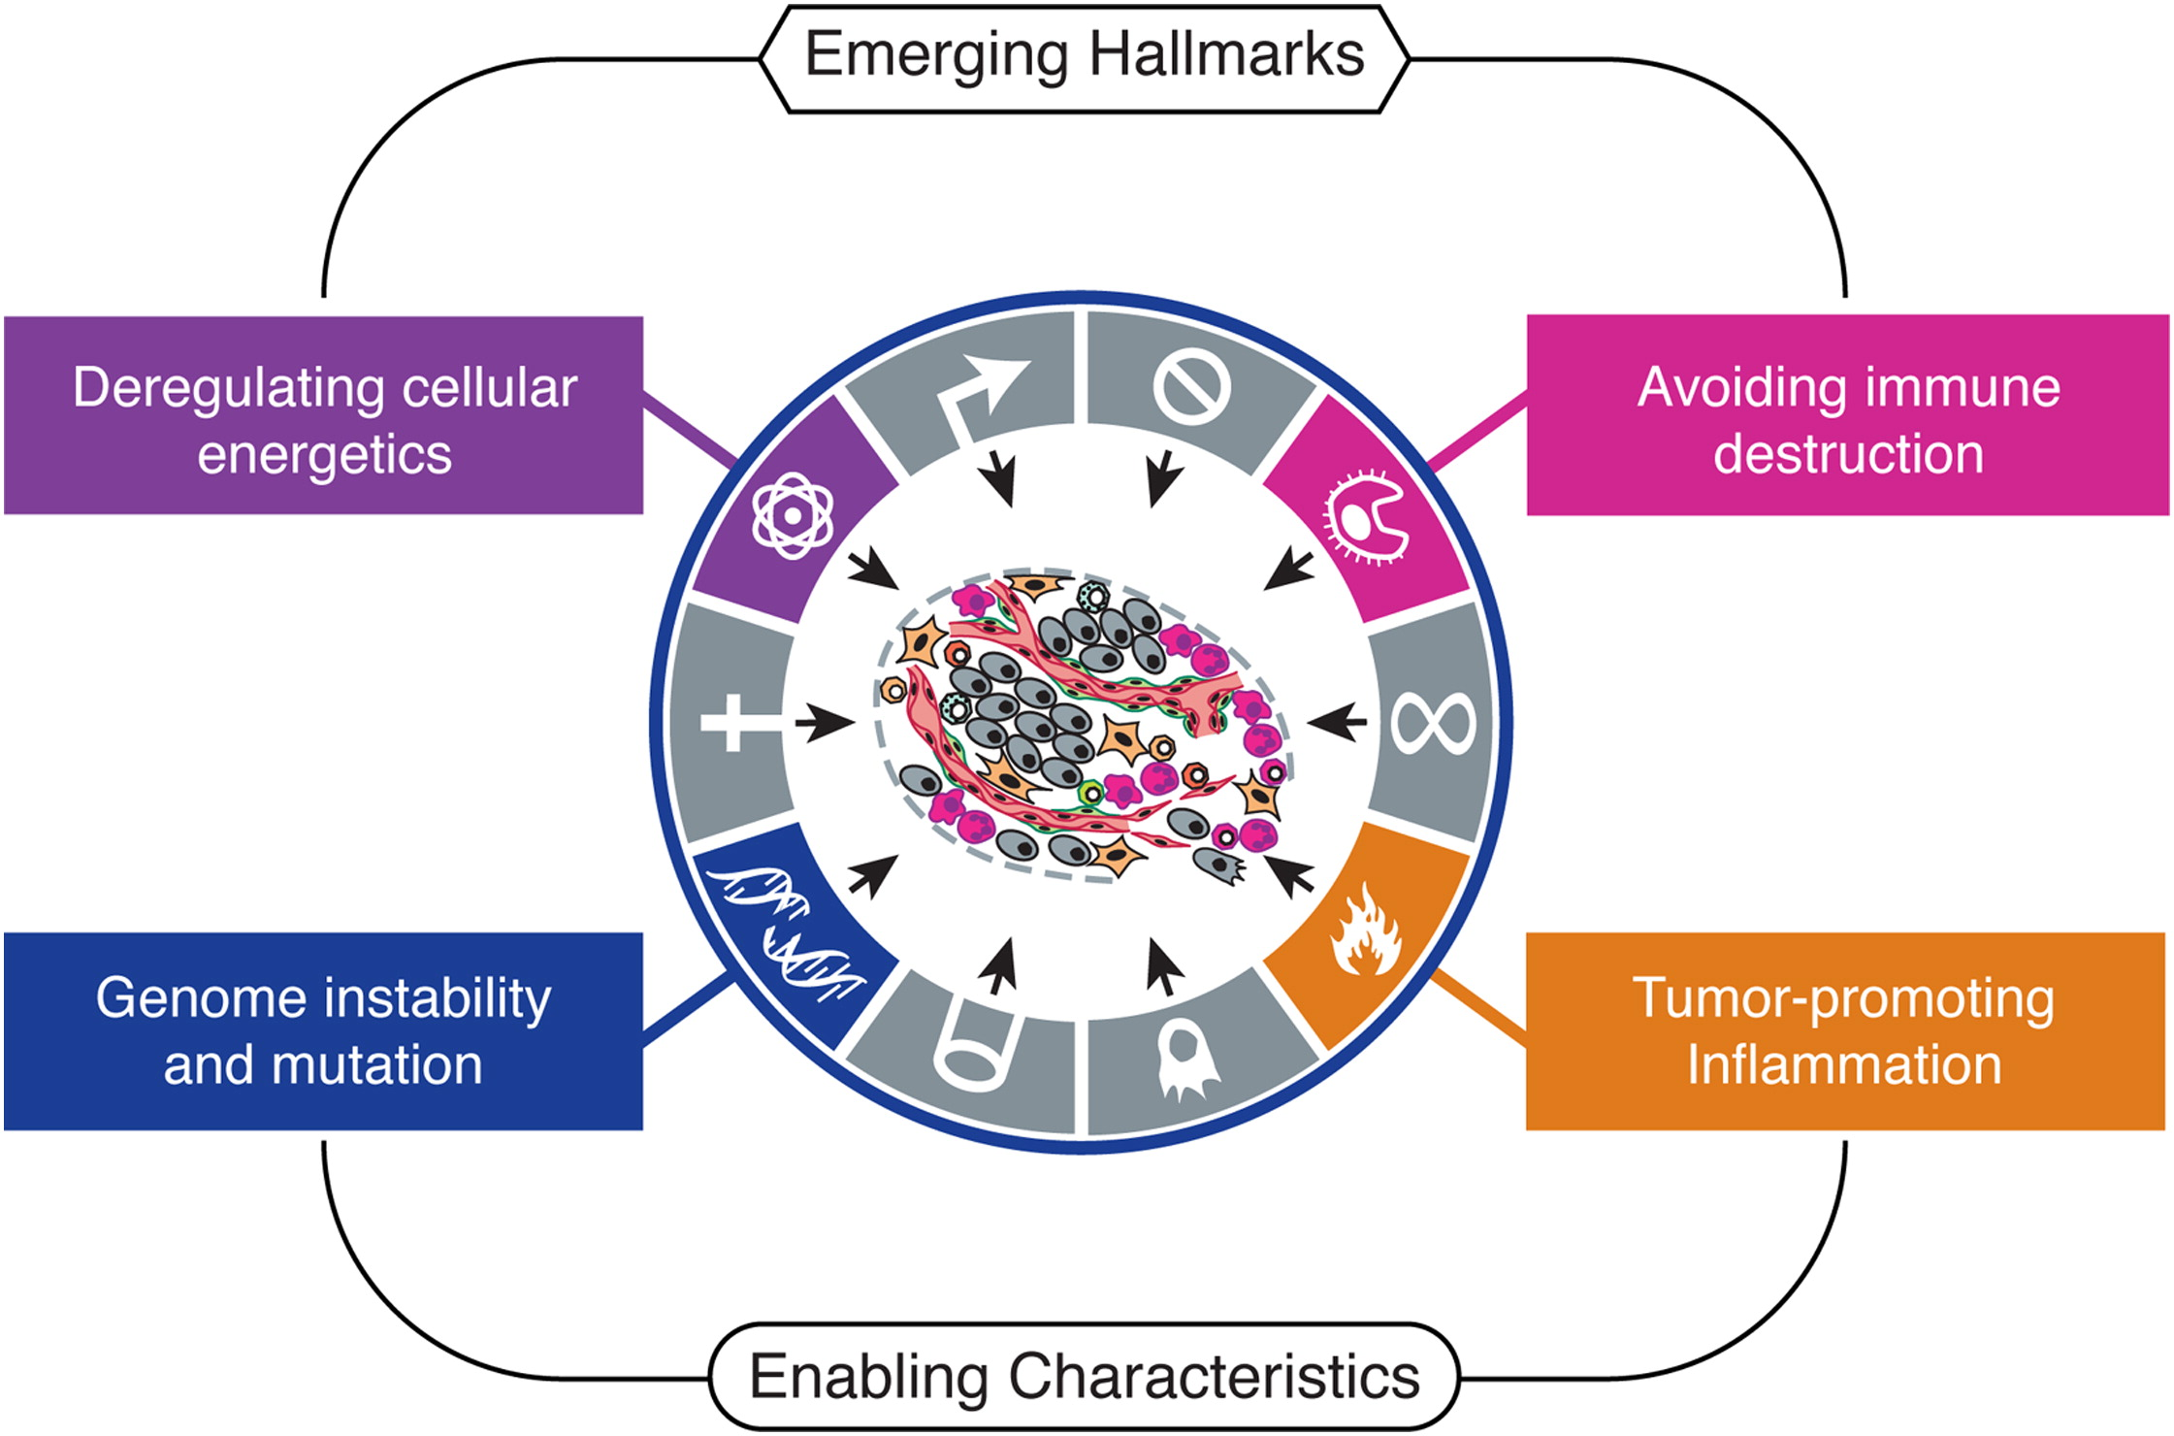
Emerging Hallmarks of Cancer
Notes:
An increasing body of research suggests that two additional hallmarks of cancer are involved in the pathogenesis of some and perhaps all cancers. One involves the capability to modify, or reprogram, cellular metabolism in order to most effectively support neoplastic proliferation. The second allows cancer cells to evade immunological destruction, in particular by T and B lymphocytes, macrophages, and natural killer cells. Because neither capability is yet generalized and fully validated, they are labeled as emerging hallmarks. Additionally, two consequential characteristics of neoplasia facilitate acquisition of both core and emerging hallmarks. Genomic instability and thus mutability endow cancer cells with genetic alterations that drive tumor progression. Inflammation by innate immune cells designed to fight infections and heal wounds can instead result in their inadvertent support of multiple hallmark capabilities, thereby manifesting the now widely appreciated tumor-promoting consequences of inflammatory responses.

Slide 22
Emerging Hallmarks of Cancer
Multistep tumor progression can be portrayed as
a succession of clonal expansions, each of which is triggered
by the chance acquisition of an enabling mutant genotype.
Because heritable phenotypes, e.g., inactivation of tumor
suppressor genes, can also be acquired through epigenetic
mechanisms such as DNA methylation and histone modifications, some clonal expansions may well be triggered by nonmutational changes affecting the regulation of gene expression.

Slide 23
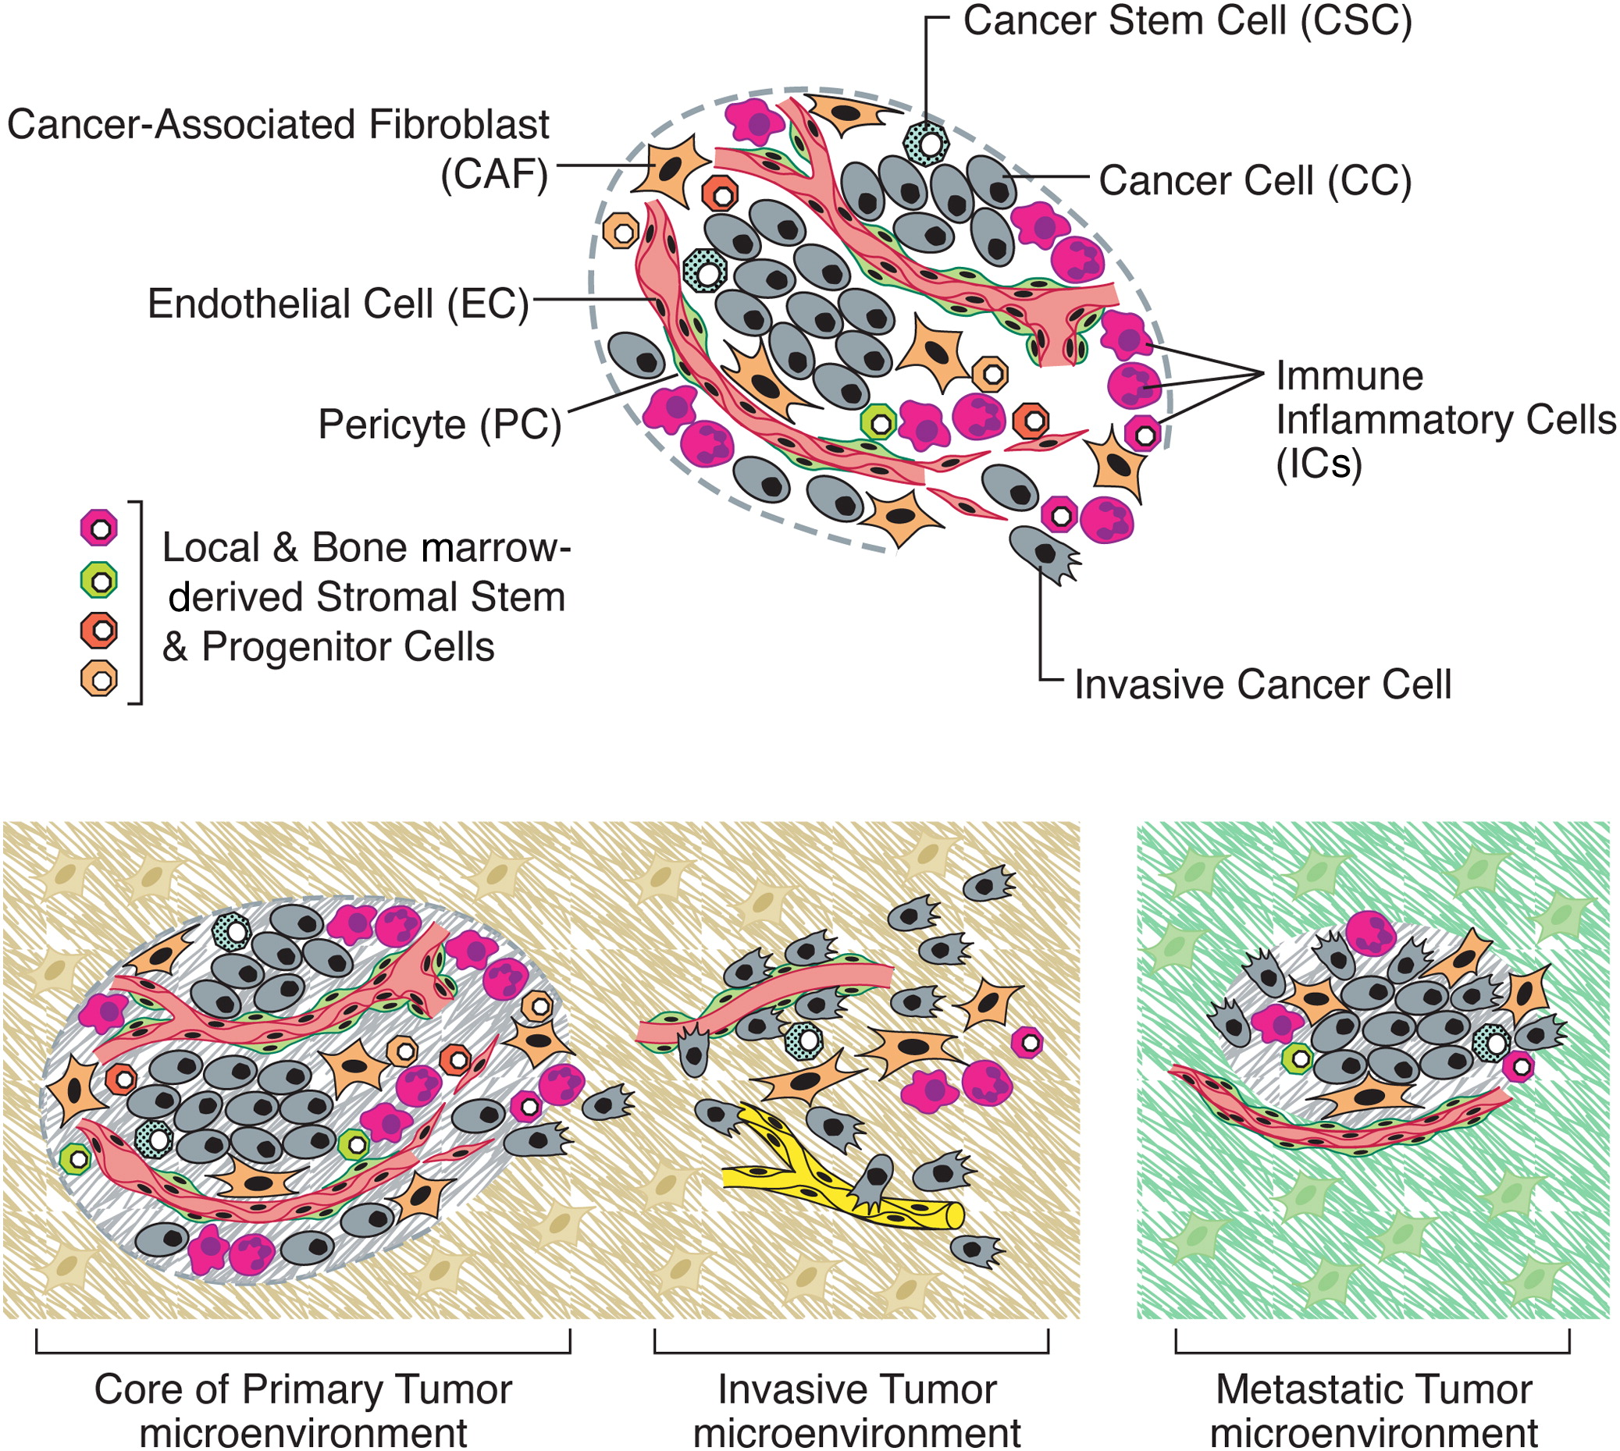
The Cells of the Tumor Microenvironment
Notes:
(Upper) An assemblage of distinct cell types constitutes most solid tumors. Both the parenchyma and stroma of tumors contain distinct cell types and subtypes that collectively enable tumor growth and progression. Notably, the immune inflammatory cells present in tumors can include both tumor-promoting as well as tumor-killing Subclasses. (Lower) The distinctive microenvironments of tumors. The multiple stromal cell types create a succession of tumor microenvironments that change as tumors invade normal tissue and thereafter seed and colonize distant tissues. The abundance, histologic organization, and phenotypic characteristics of the stromal cell types, as well as of the extracellular matrix (hatched background), evolve during progression, thereby enabling primary, invasive, and then metastatic growth. The surrounding normal cells of the primary and metastatic sites, shown only schematically, likely also affect the character of the various neoplastic microenvironments. (Not shown are the premalignant stages in tumorigenesis, which also have distinctive microenvironments that are created by the abundance and characteristics of the assembled cells.)

Slide 24
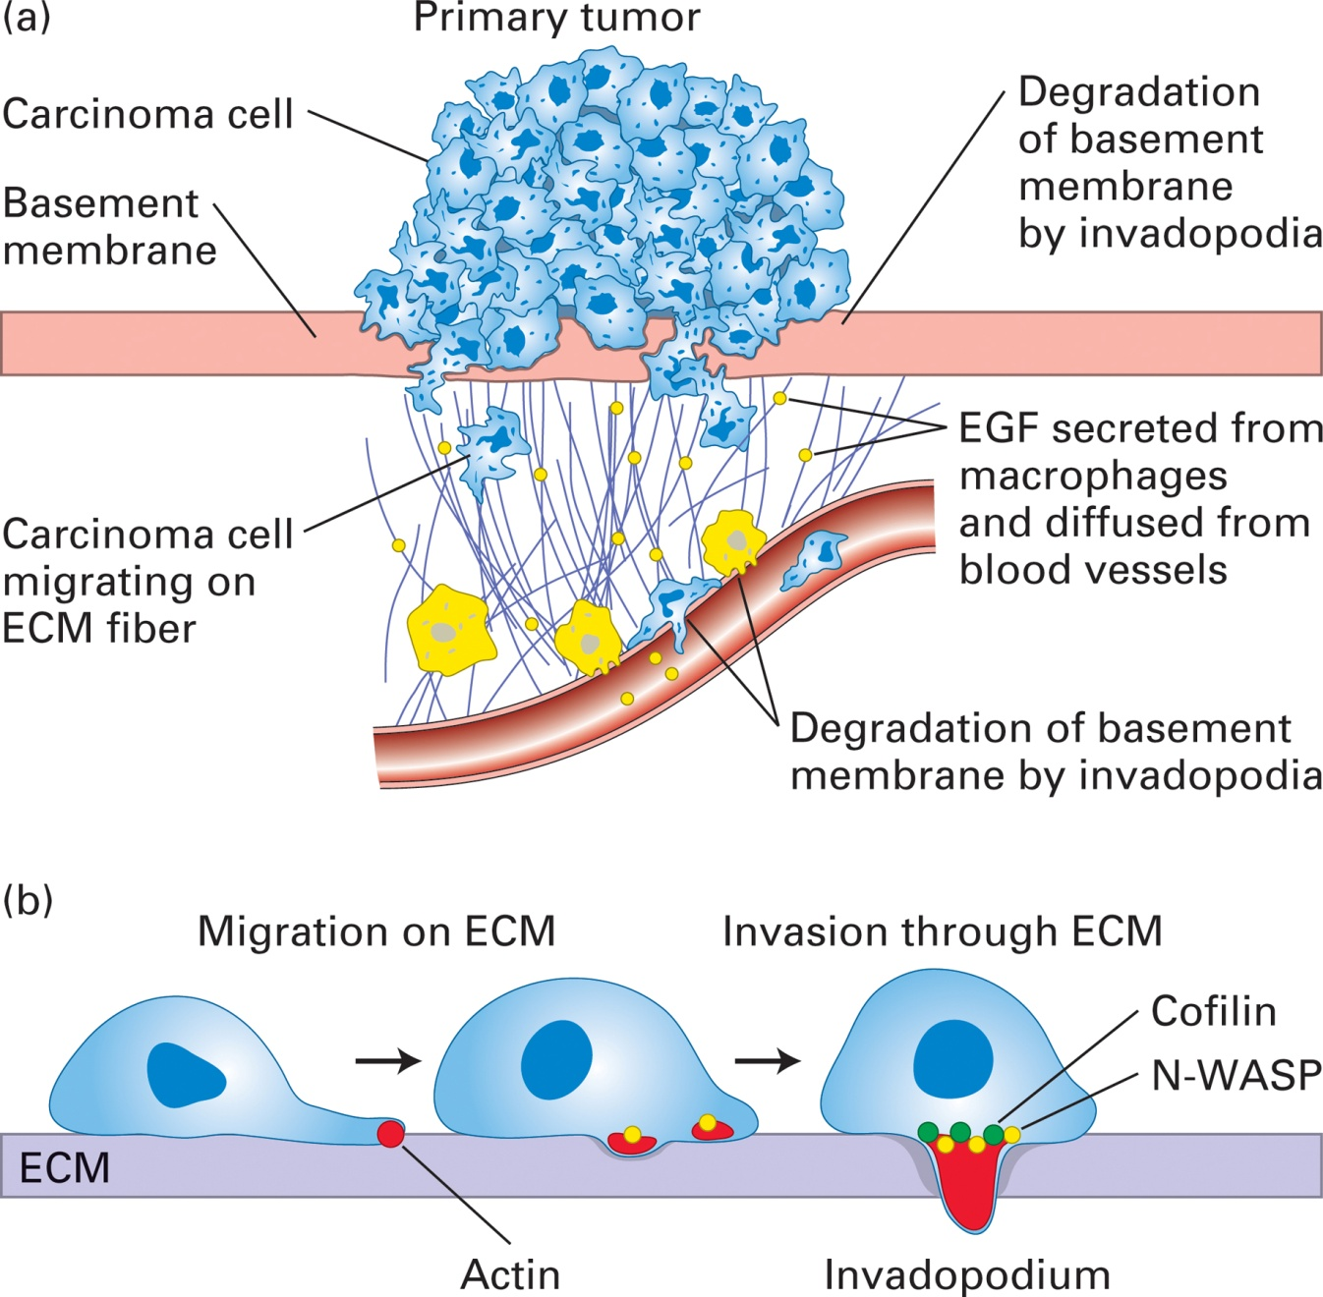
Metastasis

Slide 25
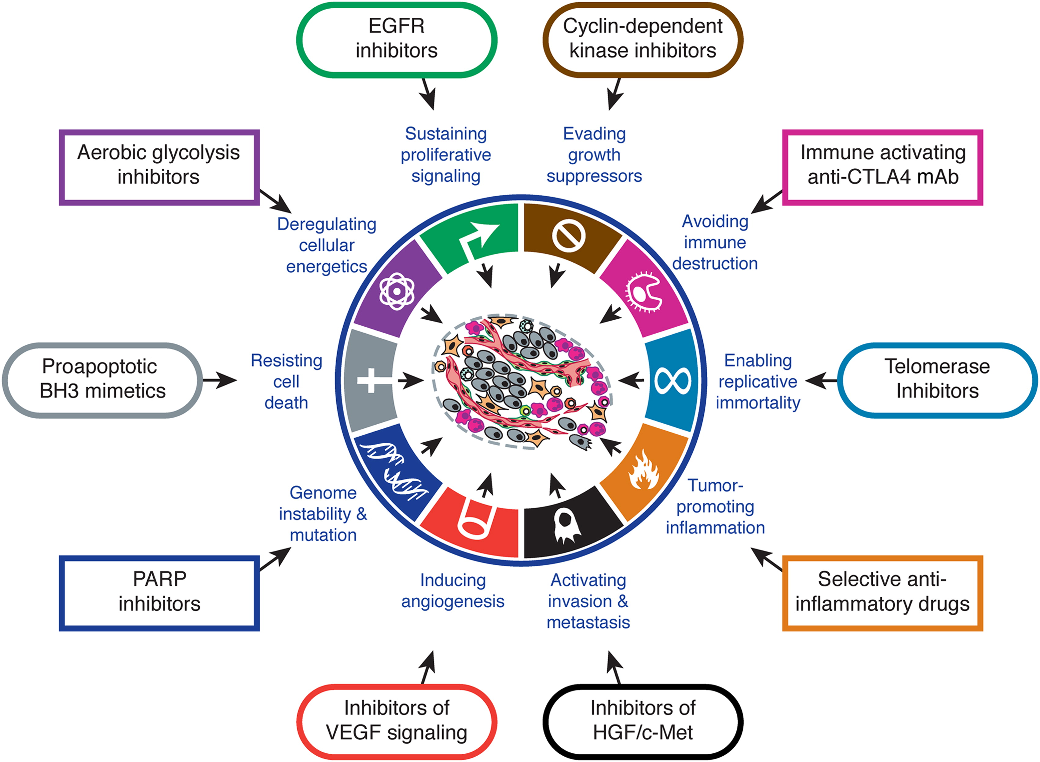
Therapeutic Targeting of the Hallmarks of Cancer
Notes:
Drugs that interfere with each of the acquired capabilities necessary for tumor growth and progression have been developed and are in clinical trials or in some
cases approved for clinical use in treating certain forms of human cancer. Additionally, the investigational drugs are being developed to target each of the
enabling characteristics and emerging hallmarks depicted in Figure 3, which also hold promise as cancer therapeutics. The drugs listed are but illustrative
examples; there is a deep pipeline of candidate drugs with different molecular targets and modes of action in development for most of these hallmarks.

