Slide 1
Lecture 49 Bone Physiology
Resorption and Formation
Pat O’Connor
oconnojp@njms.rutgers.edu

Slide 2
Components of Bone
Extracellular Matrix
Cellular
90% mineral
Hydroxyapatite
Ca₁₀(PO₄)₆(OH)₂
10% organic
Type I collagen
Osteocalcin
other collagens
other proteins
growth factors
Osteoblasts
Osteocytes
Periosteal
Endosteal
Osteoclasts
Hematopoietic Cells
Mesenchymal Stem Cells
Chondrocytes
growing or healing bones
Articular surfaces

Slide 3
Bone Development: Endochondral Ossification

Slide 4
Bone Development: Intramembraneous Ossification

Slide 5
Bone Structural Types
Bone tissue is compromised of the same components but:
Lamellar Bone:
collagen fibrils are alligned to provide maximum mechanical advantage
Found mostly in CORTICAL BONE (aka compact bone)
Woven Bone:
collagen fibers are haphazardly aligned
Found mostly in TRABECULAR BONE (aka cancellous or spongy bone)

Slide 6
Function ► Form
Mechanical Functions
cortical bone
lamellar tissue
Physiological Functions
trabecular bone
woven tissue
surface area
7 m² (lungs 70 m²)
Bone is Anisotropic

Slide 7
Osteoblasts Make Bone
Collagen and alkaline phosphatase secretion
Forms poorly mineralized OSTEOID
Calcium precipitates quickly in osteoid (days to weeks)
Calcium salt converted in hydroxapatite (weeks to months)
Bone remodeling
Induced by many stimuli

Slide 8
Bone Microstructure: collagen fibrils

Slide 11
Bone Functions: Resorption & Formation Follow Function
Protection: heart and brain
Breathing: rib cage
Hematopoiesis
Mechanical strength: sustain body weight and movements
Locomotion: sites for muscle attachment
Calcium Regulation

Slide 12
Response to Mechanical Loading: Wolff’s Law
“The Law of Transformation of Bone” By Julius Wolff (1892)
Bone structure and shape adapt to mechanical loading conditions
Microdamage Repair

Slide 13
Calcium Homeostasis
Calcium content of adult human: 1.1 kg
Total plasma calcium: 2.5 mM
Functions:
Blood coagulation
Cardiac and muscle contraction
Nerve function
Serum calcium concentration principally regulated by 3 hormones
1,25-dihydroxycholecalciferol (Vitamin D)
↑ osteoclast function;
↑ intestinal Ca²⁺ adsorption
Parathyroid hormone (PTH)
↑ osteoclast formation;
↑kidney Ca²⁺ re-absorption;
↑ Vit D
Calcitonin
↓ osteoclast activity

Slide 14
Bone Homeostasis
Normally, bone resorption and formation are
balanced allowing for continual renewal of skeletal
tissue and repair of micro-damage.

Slide 15
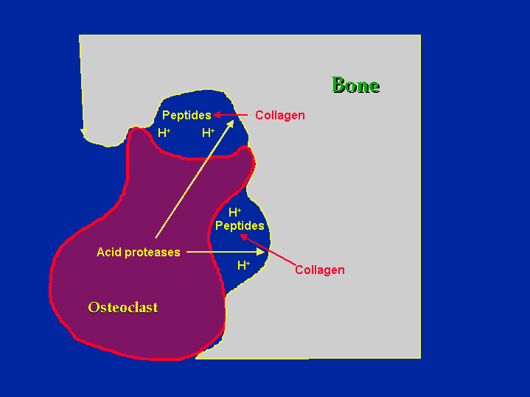
Osteoclasts Resorb Bone
Howship’s Lacunae
Carbonic Anhydrase II
Tartate Resistant Acid Phosphatase
Cathepsin K

Slide 16
Osteoclast Differentiation Requires M-CSF and RANKL
M-CSF RANKL OPG

Slide 17
Osteoblasts Regulate Osteoclasts: Coupling and RANKL & OPG
Enhances osteoclast
differentiation
RANKL
OR
“Coupling”
Reducing bone
resorbtion
OPG

Slide 18
When things go wrong:
Osteoporosis: reduced amount of bone tissue
Osteomalacia: poorly mineralized bone tissue
Osteopetrosis: excessive bone tissue with enhanced mineralization
Osteosclerosis: localized areas of increased bone density

Slide 19
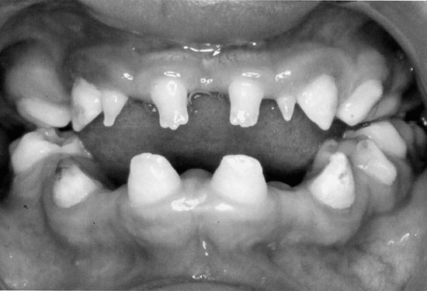
Osteopetrosis
Abnormally high bone mineralization
Increased bone tissue
Affects tooth eruption and formation
Generally caused by defects in osteoclast development

Slide 20
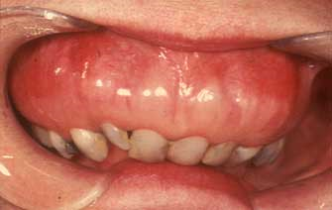
Osteosclerosis: Padget’s Disease
Localized areas of sclerotic bone
Sclerotic bone is abnormally dense.
Approx. 50% of Padget’s patients have complications involving mandible or maxilla
Cause unknown

Slide 21
Osteomalacia
Poorly mineralized bone tissue
Generally caused by Vitamin D defiency
Rickets in children
Bowed legs

Slide 22
Osteoporosis
Low bone mass
Microarchitectural deterioration of bone tissue
Enhanced bone fragility
~25% of women over 65 years old have osteoporosis-related vertebral fractures
Age, gender, genetic background, environment, endocrinology, and bone structure

Slide 23
Localized Bone Loss: Periodontal Disease
Usually caused by local acute or chronic inflammation
Bone loss exposes roots of teeth making them susceptible to:
Cavities
Loosening

Slide 24
Treating Osteoporosis
Estrogen therapy
Reduces RANKL expression
Bisphosphonates
Induce osteoclast apoptosis
Behavior (diet and exercise)
Estrogen receptor drugs
raloxifene
PTH like drugs
Calcitonin
Anti-RANKL

Slide 25
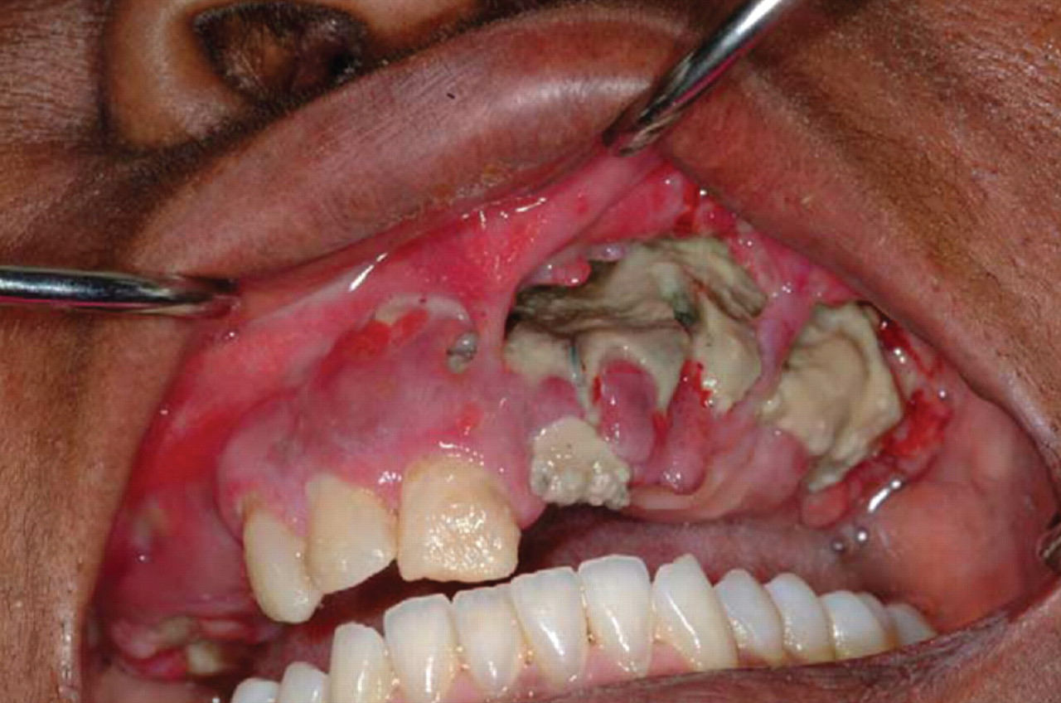
Osteonecrosis of the jaw.
BUENCAMINO M C A et al. Cleveland Clinic Journal of Medicine 2009;76:467-475
Notes:
Osteonecrosis of the jaw. REPRODUCED FROM RUGGIERO SL, MEHROTRA H, ROSENBERG TJ, ENGROFF SL. OSTEONECROSIS OF THE JAWS ASSOCIATED WITH THE USE OF BISPHOSPHONATES: A REVIEW OF 63 CASES. J ORAL MAXILLOFACIAL SURG 2004; 62:527–534, WITH PERMISSION FROM ELSEVIER. WWW.SCIENCEDIRECT.COM/SCIENCE/JOURNAL/02782391.

Slide 26
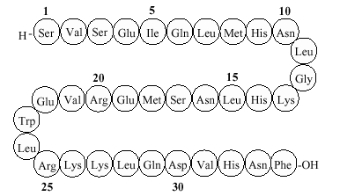
Alternative Osteoporosis Therapies Densumab: anti-RANKL antibody
Anti-CATABOLIC
Densumab: anti-RANKL antibody
Pro-ANABOLIC
Teriparatide: PTH1-34 (Forteo)

Slide 27
Treating Peridontal Bone Loss
Prevention
Stopping loss
Bone graft
Tissue graft
Guided Tissue Regeneration
Growth Factors
Dentures

Slide 28
Differential Protein Composition in Mammalian Calcified Tissue
Component | Cartilage | Bone | Dentin | Enamel
Type I Collagen | + | ++ | + | -
Type II Collagen | ++ | - | - | -
GLA Proteins | + | + | + | -
Osteocalcin | - | + | + | -
Glycoproteins | + | + | + | +
Proteoglycans | + | + | + | ND

Slide 29
Questions

