Slide 1
Learning Objectives
Know mechanism of intestinal absorption and clearance of triglycerides from blood
Know mechanism of action of drugs that prevent accumulation of plasma triglycerides
Know how carbon atoms of glucose are channeled into fatty acids
Know the rate limiting enzyme of fatty acid synthesis and how its activity is regulated by metabolites and hormones
Know why some fatty acids are designated as essential and what would happen metabolically if these FA were missing from the diet.

Slide 2
Consequences of obesity
Type 2 diabetes, which can lead to heart disease, kidney failure, blindness, amputation of the feet or legs, and nerve damage
Heart disease, such as hardening of the arteries, heart attack, and angina
High blood pressure, which can lead to heart disease, stroke, kidney failure, and vision loss
High cholesterol, which can lead to heart disease, stroke, and kidney failure
Obstructive sleep apnea has been associated with high blood pressure
Acid reflux/GERD, which can lead to esophagitis, Barrett’s esophagus, and esophageal cancer (adenocarcinoma)
Cancer
Depression
Osteoarthritis and joint pain, which can lead to loss of mobility
Stress urinary incontinence
Female reproductive health disorder, which can lead to infertility and sexual dysfunction

Slide 3
Results of Five Year Follow-up
Treatment | Weight Loss (percent of patients)
Diet and Exercise | 2-5 %
Prescription weight loss medications | 0 %
Bariatric Surgery (gastric bypass, gastric banding) | 50-70%

Slide 4
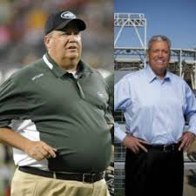
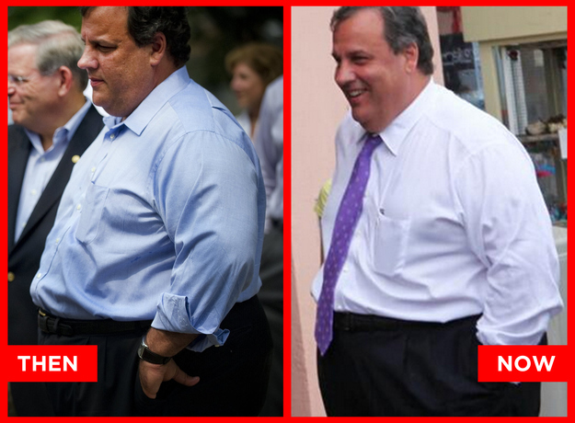
Before and after gastric banding
THEN
NOW

Slide 5
Fatty Acids Nomenclature
γ β α
CH3-CH2-CH2-CH2-CH2-CH2-CH2-CH2-CH2-CH2-CH2-CH2-CH2-CH2-CH2-COOH
16 15 14 13 12 11 10 9 8 7 6 5 4 3 2 1
Palmitic acid (C:16)
CH3-CH2-CH2-CH2-CH2- CH2-CH=CH-CH2-CH2-CH2-CH2-CH2-CH2-CH2-COOH
ω Palmitoleic acid (C16:1 Δ⁹) or C16:1 ω-7)
(Omega)

Slide 6
Fatty acid nomenclature
Name |  | # Carbon atoms | Double | Position of |  | Unsaturated
 |  |  | bonds | double bonds |  | FA class
Butyric |  | 4 | 0
Lauric |  | 12 | 0
Myristic |  | 14 | 0
Palmitic |  | 16 | 0
Palmitoleic |  | 16 | 1 | 9Δ⁹ |  | ω-7
Oleic |  | 18 | 1 | 9Δ⁹ |  | ω-9
Linoleic |  | 18 | 2 | 9,12 Δ^{9,12} |  | ω-6
Linolenic |  | 18 | 3 | 9,12,15 Δ^{9,12,15} |  | ω-3
Arachidonic |  | 20 | 4 | 5,8,11,14 |  | ω-6
EPA(eicosapentaenoic acid) |  | 20 | 5 | 5,8,11,14,17 |  | ω-3
DHA(docosahexaenoic acid) |  | 22 | 6 | 4,7,10,13,16,19 |  | ω-3

Slide 7
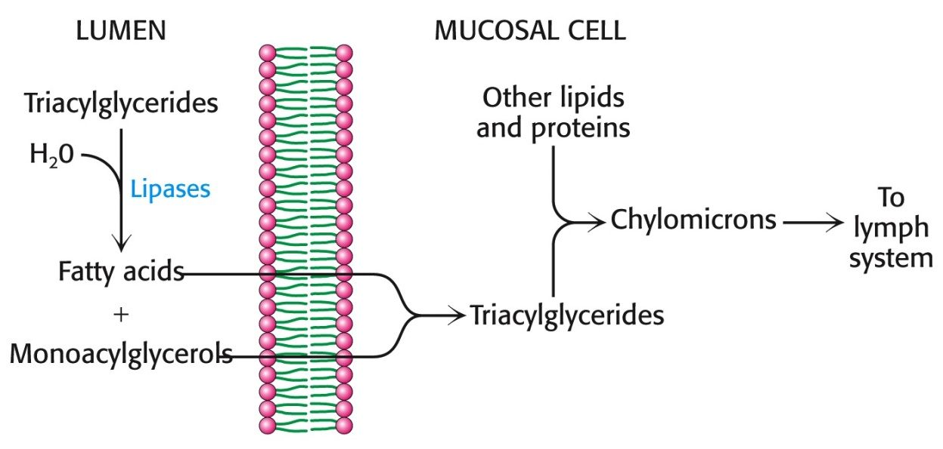
1. Obesity due to dietary Lipids
Dietary Lipids are Broken Down by Pancreatic Lipase and Transported through the Lymph System
Packed together with Apoprotein B-48 ->to give Chylomicrons (180-500 nm in diameter)

Slide 8
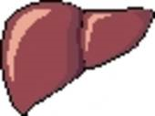
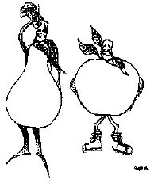
Metabolism of TG of Chylomicrons
Dietary Lipids
Intestinal Mucosa
Lipoprotein Lipase
Chylomicrons
TG, CE
Chylomicron
Remnants
CE
LPL
Liver
Fatty Acids
Muscle
Adipose

Slide 9
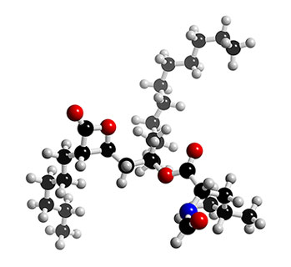
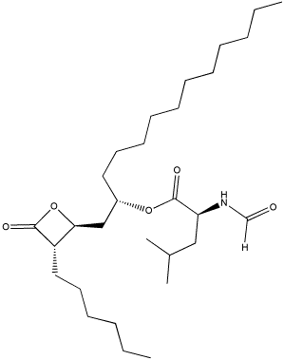
Orlistat (Xenical) (Obtained from bacterium Streptomyces toxytricini):
Inhibits pancreatic lipase. Prevents absorption of lipids

Slide 10
Lovaza (promotes lowering of plasma triglycerides) (ω-3 fatty acid ethyl esters)
Eicosapentaenoic acid ethyl ester (EPA)
Docosahexaenoic acid ethyl ester, (DHA)
1. Stimulates activity of Lipoprotein Lipase?
2. Inhibition of acyl CoA: 1,2 diacyl glycerol acyl transferase (incorporation of fatty acids into triacyl glycerols)?

Slide 11
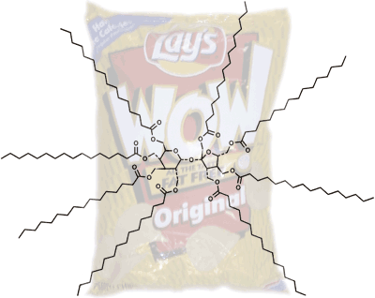
Olestra

Slide 12
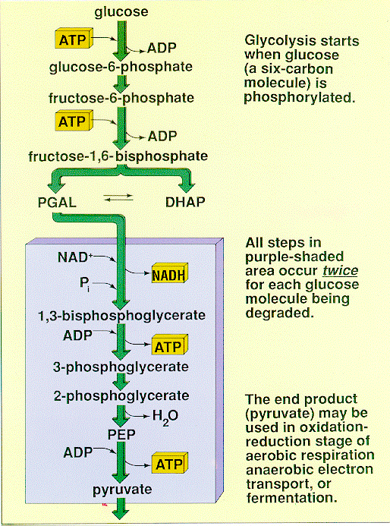
2. Obesity resulting from Glucose Intake

Slide 13
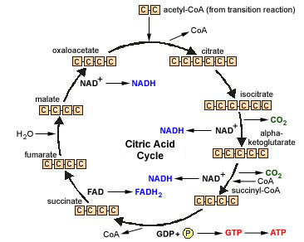
Pyruvate to Mitochondria

Slide 14
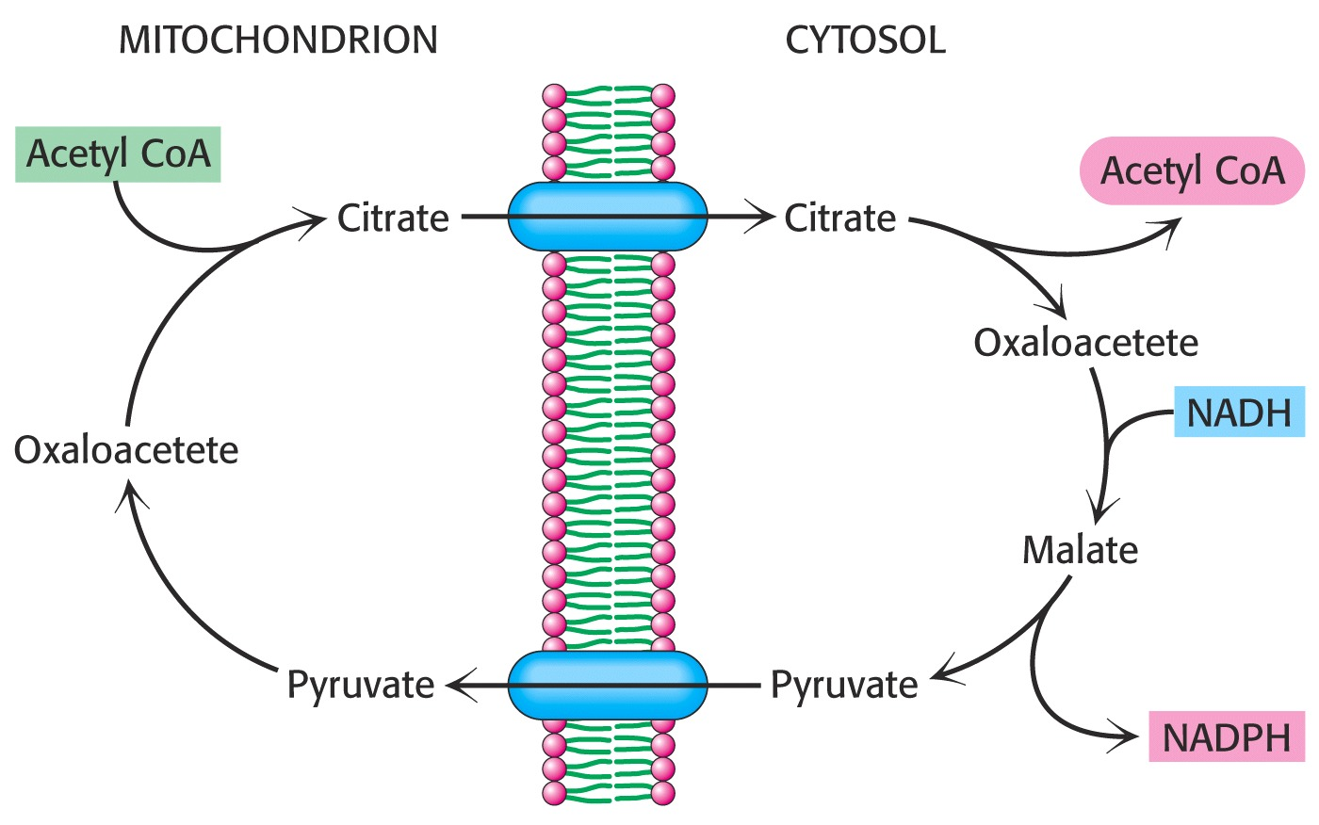
Translocation of carbon compounds from mitochondria to cytosol for fatty acid synthesis
Citrate translocase
FA synthesis
Pyruvate translocase
Glycolysis

Slide 15
How does one convert acetyl CoA to fatty acids?
Acetyl CoA + Malonyl CoA + NADPH
(from glucose) ( from Hexose shunt)
Fatty Acids

Slide 16
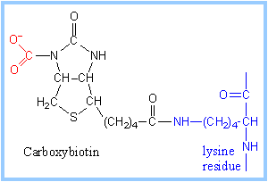
Acetyl CoA Carboxylase Reactions: Formation of Malonyl CoA
Catalyzed by Acetyl CoA Carboxylase (ACC), a multienzyme containing two enzyme activities and BCCP (biotin carboxyl carrier protein)
ACC is the rate-limiting enzyme of FA Synthesis
BCCP-biotin carboxyl carrier protein-
10,000 mol. wt; no enzymatic function.
2. Biotin Carboxylase (BC)
BCCP + HCO₃⁻ + ATP→ BCCP-CO₂ + ADP + P
3. Transcarboxylase (TC)
BCCP-CO₂ + Acetyl CoA→ Malonyl CoA + BCCP
CH₃-C-SCoA CO₂-CH₂-C-SCoA

Slide 17
Overall Reaction of Fatty Acid Synthesis
Acetyl CoA + HCO⁻¹₃+ ATP→ Malonyl CoA + ADP +P
Acetyl CoA Carboxylase
CH₃- CO-SCoA + 7 CO₂-CH₂- CO-SCoA + 14 NADPH + 14 H⁺
Fatty Acid Synthase complex: 6 enzyme activities and ACP (acyl carrier protein) (size ~10,000 daltons)
Palmitic Acid + 14 NADP⁺ + 8 CoA + 7 CO₂ + 7 H₂O
(C:16 Fatty acid)

Slide 18
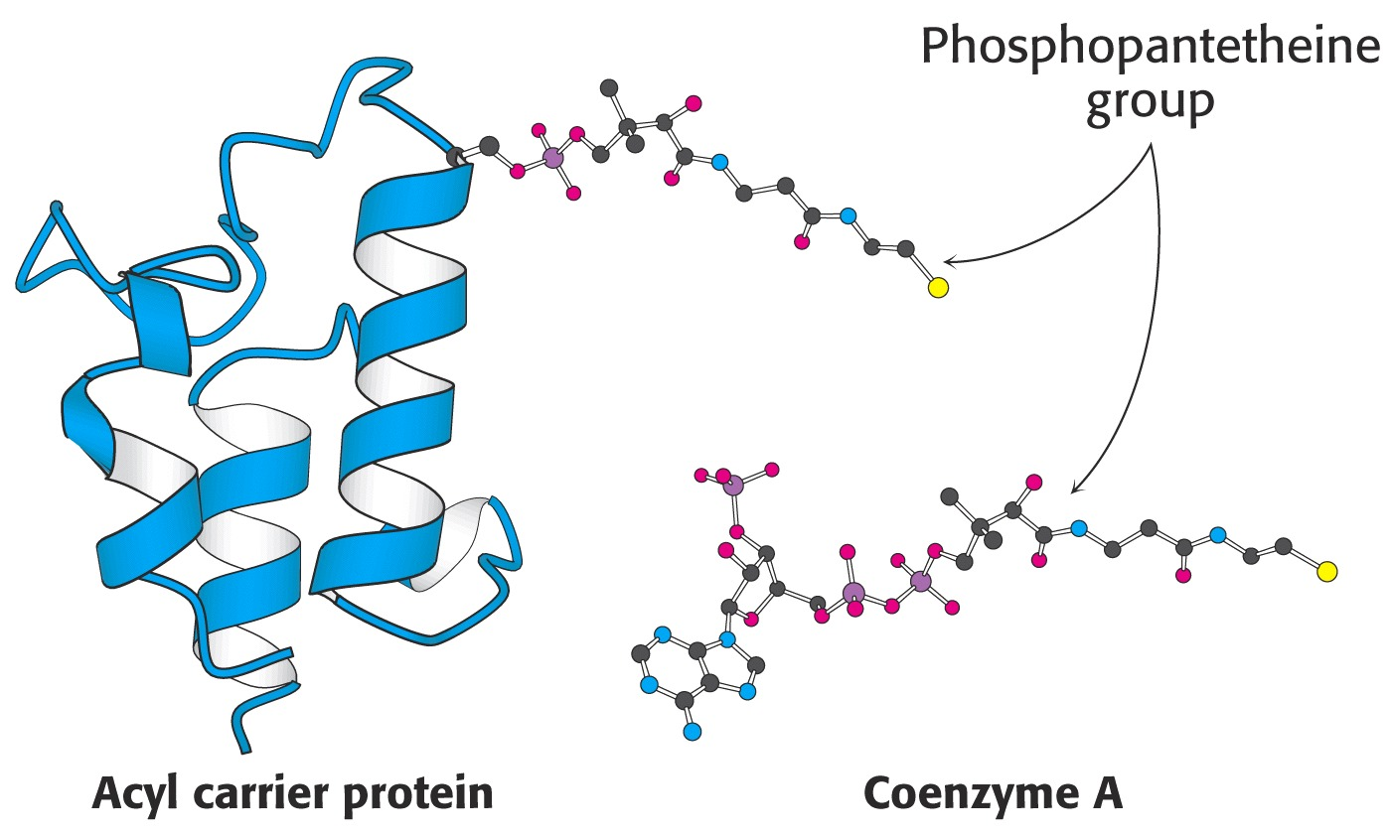
Type I FAS-a multi-enzyme complex in eukaryotes
Type II-FAS-Separate individual enzymes in prokaryotes
Activation of Acetyl and Malonyl CoA in Fatty acid Synthesis
reactive unit
Activation for Synthesis
Activation for Degradation

Slide 19
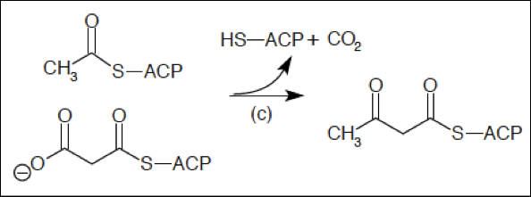
Acetyl -SACP
Malonyl-S ACP
Acetoacetyl- SACP
Beta-hydroxybutyryl-SACP
Crotonyl-SACP or
Enoyl-SACP

Slide 20
Butyryl -SACP
Butyryl-SACP + Malonyl-SACP >>>>>> Hexanoyl –SACP (C6)
Hexanoyl-SACP + Malonyl-SACP>>>>>> Octanoyl-SACP (C8)
Octanoyl-SACP + Malonyl-SACP>>>>>> Decanoyl-SACP (C10)
Decanoyl-SACP + Malonyl-SACP>>>>>>Dodecanoyl-SACP (C12)
Dodecanoyl-SACP + Malonyl –SACP>>>>Tetradecanoyl-SACP (C14)
Tetradecanoyl-SACP + Malonyl-SACP>>>>Hexadecanoyl-SACP (C16)
Hexadecanoyl-SACP Hexadecanoic acid (C16 FA)
CH3-CH2-CH2-CH2-CH2-CH2-CH2-CH2-CH2-CH2-CH2-CH2-CH2-CH2- acetyl CoA Malonyl CoA CH2-COOH

Slide 21
Regulation of FA Synthesis Citrate and End products
Citrate
Palmitoyl CoA and
Malonyl CoA
ACC (dimer) ACC (polymer)
(~400,000) (4-8 x10⁶)
(low activity) (high activity)
+Citrate
(-)Palmitoyl CoA
(-)Malonyl CoA

Slide 22
AMP Activated Protein Kinase
Glucagon
P
ATP ADP
ACC partially active dimer
ACC Inactive
Protein Phosphatase 2
Insulin
+ Citrate
- Citrate
Citrate
P
Protein Phosphatase 2
Insulin
Citrate
Citrate
ACC Partially Active polymer
Highly Active polymer

Slide 23
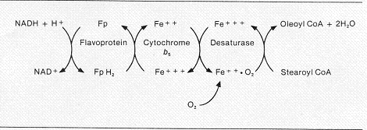
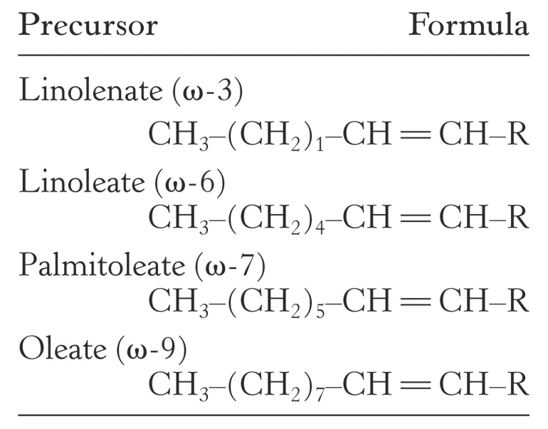
Introduction of Double Bonds to Fatty Acids (microsomal system)
C:18:1, ∆⁹ or ω-9
C:18
Precursors used to generate longer unsaturated FA (essential fatty acids)
Mammals cannot introduce double bonds beyond C-9

Slide 24
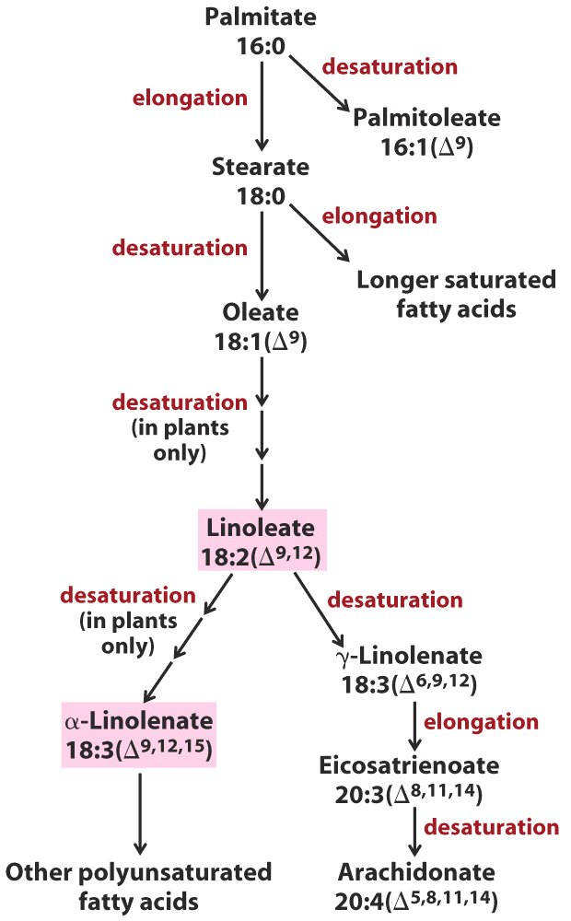
Desaturation and Elongation of FA
Essential FA
Mammals cannot introduce double bonds beyond C-9
Eicosanoides -> Hormones

Slide 25
When the liver converts excess glucose into fatty acids, all of the following are true EXCEPT
Glucose is converted by glycolysis into pyruvate in the cytosol
Pyruvate is converted to acetyl CoA by pyruvate dehydrogenase in the cytosol
Acetyl CoA and oxaloacetate form citrate that leaves the mitochondria
Citrate lyase converts citrate, CoA and ATP into oxaloacetate, acetyl CoA, ADP and Pi
The acetyl CoA is converted to palmitate and the oxaloacetate is converted to pyruvate

Slide 26
When the liver converts excess glucose into fatty acids, all of the following are true EXCEPT
The control enzyme is acetyl CoA carboxylase
The enzyme is activated by protein phosphatase
Protein phosphatase is activated as a result of glucagon binding to liver cells
The control enzyme converts ATP, CO2, and acetyl CoA into malonyl CoA, ADP, and Pi
The concentrations of glucagon, epinephrine, or AMP are low because high concentrations would inhibit the control enzyme

Slide 27
All of the following statements about essential fatty acids are true EXCEPT
They can not be synthesized by humans cells
They are essential for the synthesis of some prostaglandins and other eicosanoids
They contain omega-3 or omega-6 double bonds
They contain at least 4 double bonds
They are linoleic and linolenic acid

